Slide 1
CAREER Workshop April 6, 2015
FLORIDA STATE UNIVERSITY
Resources Available to You
at FSU
Beth Hodges
Director, Office of Proposal Development

Slide 2
http://www.research.fsu.edu/opd/

Slide 3
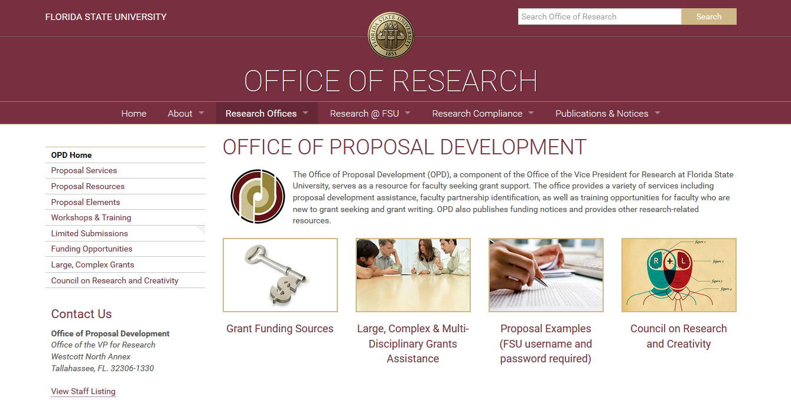
Office of Proposal Development Site

Slide 4
CAREER Related
NSF CAREER Workshop Site
http://www.research.fsu.edu/OPD/
workshops.html
Link to the CAREER Program Solicitation
List of NSF CAREER Awardees from FSU
Examples of Successful CAREER Proposals
CAREER PowerPoint Presentation from an NSF Program Director
All PowerPoint Presentations given today
Notes:
On the OPD site, under “Workshops & Training”

Slide 5
As you write…
Narrative assistance
Connection with
pre-reviewers

Slide 6
External Funding Assistance
Searchable Funding Databases
Funding Alerts
Workshops
Proposal Resources
Examples of Successful Proposals
Grant Writing Articles and Guides
The Grant Application Writer’s Workbooks for NSF & NIH

Slide 7
Internal Funding
Programs
Arts & Humanities Program Enhancement Grants (AHPEGs)
Committee on Faculty Research Support (COFRS) Regular Summer Awards
First Year Assistant Professor Awards (FYAP) Summer awards
Funding Agency Travel Program (FAT)
Multidisciplinary Support Program (MDS)
Planning Grants (PG) (fall and spring)
Small Grant Program (SGP) (fall and spring)
GAP Grants (Commercialization)
EIEG Grants (Equipment Grants)
Honorary Programs:
Distinguished Research Professor Award (DRP)
Developing Scholar Awards (DSA)
Distinguished University Scholar (DUS)

Slide 8
We are here to help
www.research.fsu.edu/opd

