Slide 1

Time and Effort Reporting – Federal Requirements
CReATE
FSU Office of Research
CReATE ver. 03/11 © 2011 Florida State University. All rights reserved

Slide 2
Why Do Effort Reporting?
§1012.95, Florida Statutes, Required number of classroom teaching hours for university faculty members (commonly referred to as the “12-hour law”)
§J.10, OMB Circular A-21, Cost Principles for Educational Institutions

Slide 3
§J.10, OMB Circular A-21
Support salaries charged and effort expended on sponsored projects
Demonstrate compliance with effort commitments made to agencies

Slide 4
What is Effort?
Effort is the amount of time spent on a particular activity, whether directly charged to a project or cost-shared
Effort is expressed as a percentage of the total amount (100%) of time spent on compensated work-related activities (instruction, research, service, administration, etc.)
Effort reporting (through FACET) is the official method of documenting to sponsors that the effort committed, charged, or cost shared was contributed

Slide 5
Assignment of Responsibility and Effort Certification
The AOR is prediction of how a faculty member will spend his/her time
The Effort Report is how a faculty member actually spent his/her time.

Slide 6
Effort Reporting vs. Payroll
Payroll distributions describe the funding source(s) of an individual’s salary (based on expectations)
FSU’s effort reporting process displays payroll information to provide a general reminder of the source (E&G, sponsored projects, etc.) of an individual’s salary during the certification period
  At the end of the term, it may become apparent through the effort certification process that the estimate for sponsored research effort was not correct and a funding adjustment may be required

Slide 7
What is certified effort?
A certified statement documenting one’s effort during a specified period
Certification is to confirm that the distribution of activity reported represents a reasonable estimate of the work performed
Certifications must be signed by the employee, principal investigator, or responsible official “using suitable means of verification that the work was performed”
FSU’s FACET application is an After-the-Fact Certification
Certification Frequency
    Exempt – certifies on a semester basis
    Non-Exempt – certifies on a monthly basis

Slide 8
Certifying Effort
Federal guidelines recognize activities that constitute effort are often difficult to separate
Effort certification must rely on a reasonable estimate of effort, therefore, a degree of tolerance is appropriate
If actual effort differs from payroll by < 5% of an employee’s total effort, it is acceptable to enter effort = to funded %
Effort % entered that is less than funded % will require payroll corrections
Notes:
5% example:
PI project funded = 45%
PI actual effort approx = 43%
PI can certify effort = 45%
If certify 43% then will have to transfer 2% off.

Slide 9
Why Worry?
Salary and Wage expenses represent the largest direct cost component on sponsored projects at FSU
Certified effort reports provide auditable documentation to demonstrate that our sponsors did in fact receive the level of effort committed in proposals and/or awards (or a reduced level as approved by the sponsor)

Slide 10
Consequences of Adverse Findings
Cost Disallowances
Designation as High Risk Organization
Special Terms and Conditions in Awards
Special Monitoring by Federal Agencies
Temporary Withholding of Payments
Withholding of Future Awards

Slide 11
Cost of Non-Compliance
Recently a number of universities have paid large settlements for noncompliance
  University of South Florida returned $4.1 million to settle charges, including effort reporting problems
  Florida International University agreed to pay $11.5 million to settle a number of charges including failure to properly document faculty had spent the percentage of time on federal projects that had been promised (2005)
  Johns Hopkins agreed to pay back $2.6 million to settle charges of over billing related to effort (2004)

Slide 12
FACET Application
F – Faculty
A – Assignments
C – Commitments &
E – Effort Certification
T – Tracking

Slide 13
Effort Entry Considerations
Activities performed for academic term = Effort Certification
Department process
  FACET rep entry
  Employee/Knowledgeable Person entry
Departmental Research Effort
  SRAD/PI Support (Fund 550)
    Projects will not display on Enter Effort page
  FSU Foundation (Fund 547)
    Projects will not display on Enter Effort page

Slide 14
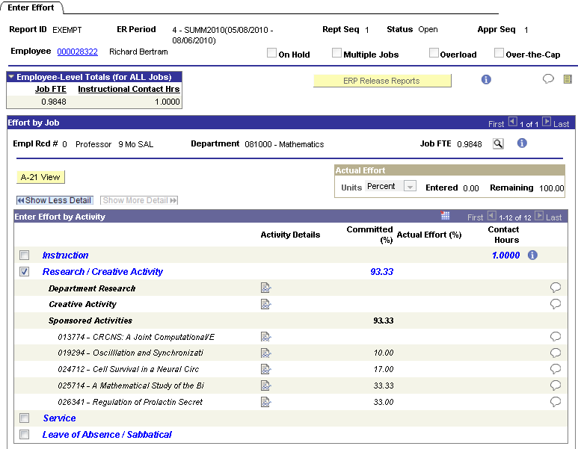
Entering Effort in FACET

Slide 15
Compliance Issues
Compliance with Effort Commitments
NSF 2 Months Rule
Agency Salary Caps
Grant Funding of Courses

Slide 16
What is the minimum amount of effort required for sponsored projects?
Clarification by OMB re: minimum effort
  “…most Federally-funded research programs should have some level of committed faculty (or senior researcher) effort, paid or unpaid by the Federal Government.”
  Exceptions
    Equipment/instrumentation grants
    Doctoral dissertation support
    Student augmentation program
  > 0% over the life of the award

Slide 17
What is a commitment of effort?
Quantifiable effort included in the proposal and/or award
Committed effort must be honored, reported, and captured in effort reporting system
Committed effort may be paid for by the sponsor or with non-sponsor funds (e.g. E&G, SRAD, etc.)

Slide 18
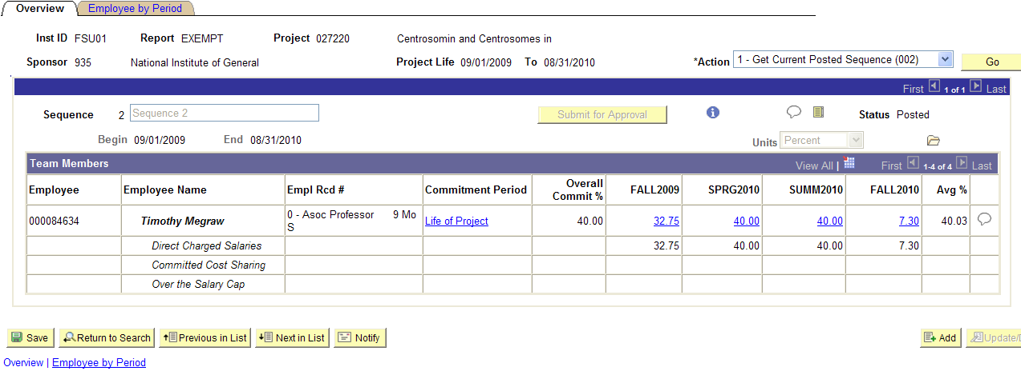
Commitments in FACET

Slide 19
What if actual effort is different from committed effort for a sponsored project?
Actual effort which is less than committed effort
  General rule = greater than 25% requires notification to and approval of the sponsor
Some sponsored projects may require approval for any reduction
Commitments can be adjusted for future periods, if allowable
  Once a report is certified, prior commitments will not be adjusted

Slide 20
What is contributed or cost shared effort?
Represents the portion of effort that is not paid for by the sponsor
Three types cost shared effort
  Committed Cost Sharing – any effort quantified in the proposal/award and is not funded by the sponsor
  Uncommitted Cost Sharing – any effort expended on the project that is not required by the sponsor nor quantified in the proposal/award
  Salary Cap Cost Sharing – salary of project personnel which exceeds sponsor imposed limit on individual salaries
    NIH salary cap -- limits the ‘rate of pay’ of individuals not the amount of salary dollars requested for the individual
      NIH Cap Effective 12/23/2012 is $179,700
    Salary in excess of sponsor limits cannot be used to satisfy program mandated cost sharing requirements

Slide 21
How is cost shared effort reported?
The total effort expended on a project will be reported on one line
FACET allocates overall effort entered:
  Direct Charged Salaries
  Committed Cost Sharing Effort
  Over the Salary Cap
  Uncommitted Cost Sharing

Slide 22
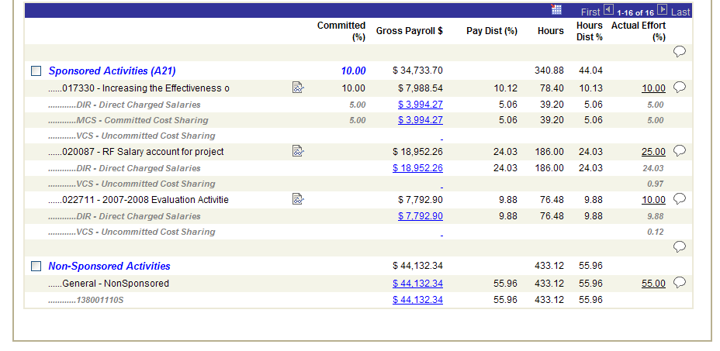
The A-21 View

Slide 23
NSF 2 Months Rule
NSF will ONLY pay 2 months of a key faculty salary during an calendar year
  Exception: more than 2 months included in proposal
FSU’s year = Summer, Fall, Spring
Based on hours
  For a full FTE: (40*2)*26.1÷12*2=348 Hours
Monitoring started with Summer 2010 term
  Error in FACET firing for Fall 2010 reports
  SRAS Coordinators work with departments to resolve

Slide 24
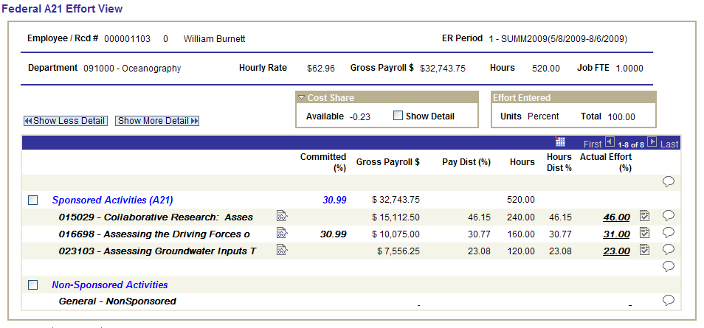
NSF 2 Months Rule in FACET
Sum of hours exceeds maximum (240+160=400)
Both of these Projects are NSF Project

Slide 25
Salary Cap (e.g. NIH)
Cap can be entered by sponsor to be applied to all projects with that sponsor
Cap can be entered by project
OTC funding process discussed in cost sharing presentation

Slide 26
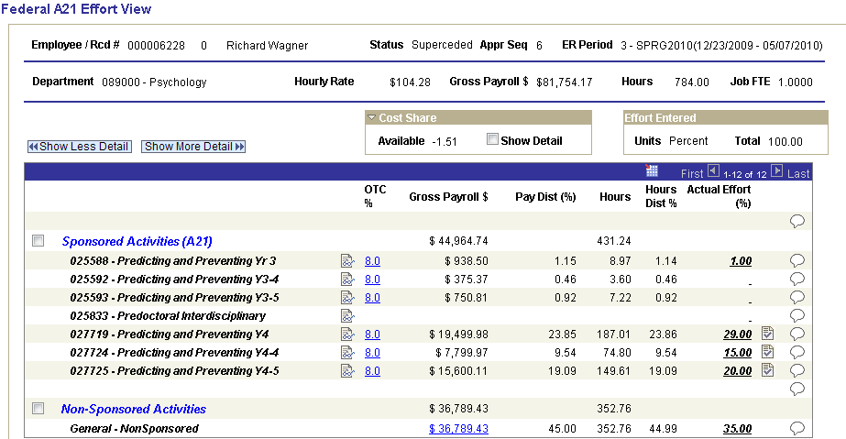
Salary Cap in FACET
This reflects the amount of salary that is over the cap

Slide 27
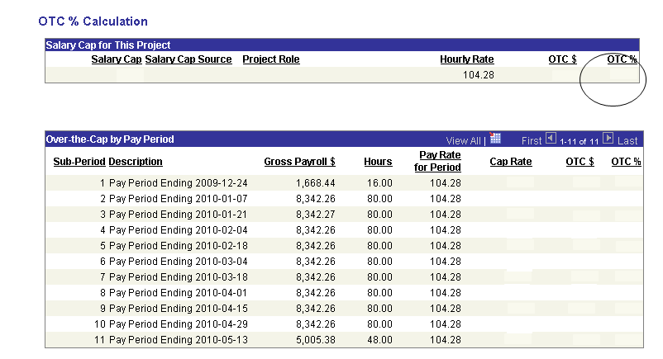
Salary Cap in FACET
86.06
18.22
8
86.06
18.22
8
86.06
18.22
8
86.06
18.22
8
86.06
18.22
8
86.06
18.22
8
86.06
18.22
8
86.06
18.22
8
86.06
18.22
8
86.06
18.22
8
86.06
18.22
8
86.06
18.22
8

Slide 28
Courses Funded by Grants
Courses can be funded by a grant if:
  Award purpose is INS
  Award purpose is RES or OSA and
    Course Section Type
      Graduate Dissertation, Graduate Thesis or DIS and the work is directly related to the project OR
    The Instruction attribute has been added to the project
      Instruction Allowed
      Cost Share Instruction Allowed
Requires cost share budget setup and appointment so that
  Funding source for courses can be selected
  Effort on grant funded course and effort on project combined for total effort on project

Slide 29
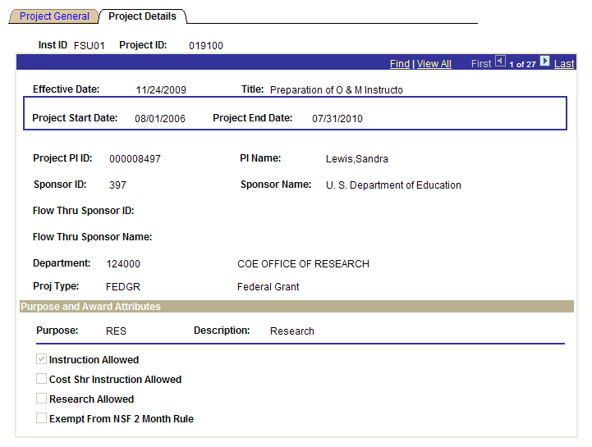
Projects and Instruction
Purpose (RES, OSA, or INS)
Attributes on Project

Slide 30

Payroll Cost Transfers
Guidelines on RDFs
  Moving salary off of sponsored project onto non sponsored funding source – APPROVE
  Moving salary between or onto projects reallocating original ePAF distribution – APPROVE (in most cases)
  All other situations – CASE BY CASE

Slide 31
Can a certified effort report be changed?
Certified effort reports assert that the information represented is to the best of the certifier’s knowledge, is accurate, and complete
Changes to previously certified effort erode the credibility of the certifier as well as the entire effort certification process
In the FACET systems, retroactive funding adjustments will trigger the need to re-certify the affected effort report

Slide 32
QUESTIONS

