Slide 1
NIH Simplified Review Framework: Insights from Study Section
Stacey Patterson, PhD
Vice President for Research
September 25, 2025

Slide 2
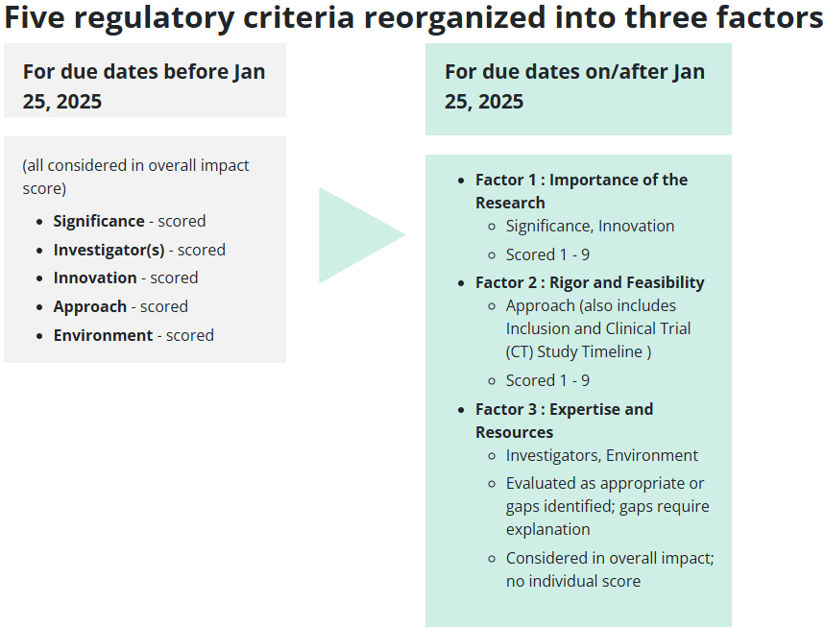
Notes:
https://grants.nih.gov/policy-and-compliance/policy-topics/peer-review/simplifying-review/framework

Slide 3
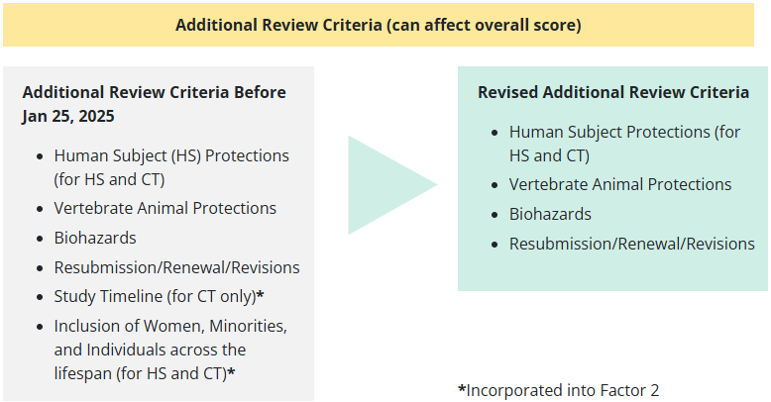
Notes:
https://grants.nih.gov/policy-and-compliance/policy-topics/peer-review/simplifying-review/framework

Slide 4
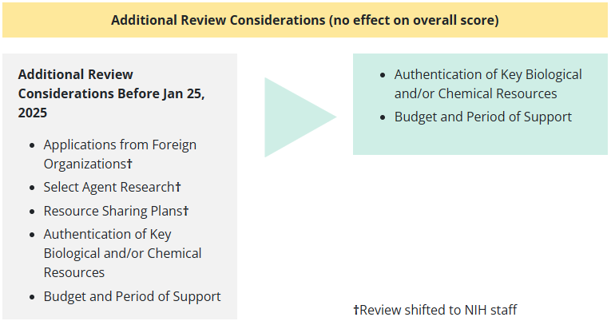
Notes:
https://grants.nih.gov/policy-and-compliance/policy-topics/peer-review/simplifying-review/framework

Slide 5
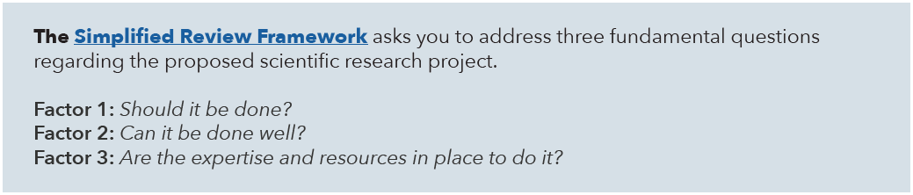
From a Reviewer’s Perspective

Slide 6
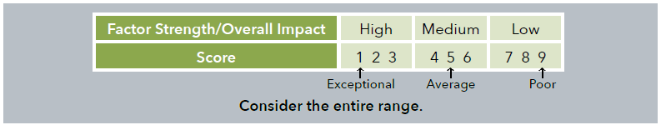
From a Reviewer’s Perspective

Slide 7
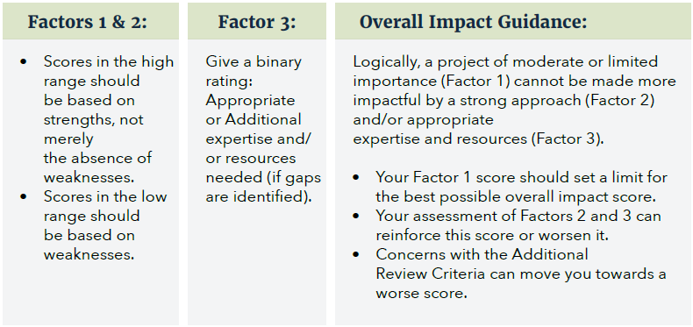
Review Guidance

Slide 8
What this means in practice…
Importance of the Research (Factor 1) is the score-driving criterion!
The Overall Impact Score cannot be better than your Factor 1 score
Focus on the Significance of your research, first and foremost

Slide 9
What this means in practice…
For Innovation, focus on how the research will address a specific gap and move the field forward
Technical innovation (e.g., state-of-the-art technologies) has been de-emphasized
In other words, lacking technical innovation should not be viewed by reviewers as a negative

Slide 10
What this means in practice…
Rigor and Feasibility (Factor 2) can either reinforce or drive down your Overall Impact Score
A strong study design in your Approach is still absolutely necessary but cannot rescue an unimportant research question
Details from your Human Subjects and Clinical Trials forms are now scored – give them the appropriate attention!

Slide 11
What this means in practice…
Expertise and Resources (Factor 3) is evaluated as either appropriate for the study or not
Since these components are no longer scored, it reduces the bias previously seen in Investigator and Environment evaluations
Reviewers must explain specific gaps if they identify any
If gaps are identified, they can drive down your Overall Impact Score

Slide 12
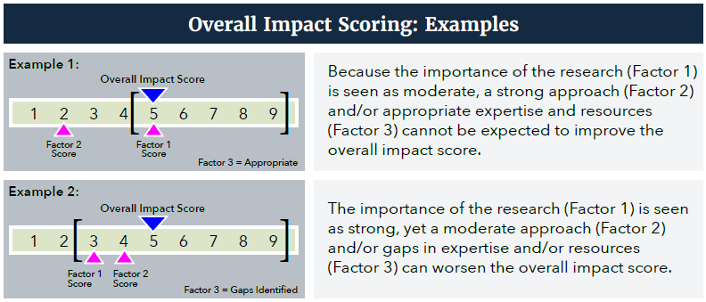
Review Guidance

Slide 13
Other Notes
Most likely that study sections are virtual to increase efficiency
Overall, study section meetings are shorter and each proposal is getting less discussion time
Getting discussed at all is so important
Your proposal’s fate is very much in the hands of your assigned reviewers
After assigned reviewers give feedback, the rest of the group is most likely to identify additional weaknesses, if there is any commentary

Slide 14
Other Notes
If your proposal is not discussed due to a lack of Significance, you will need to reframe to improve Factor 1 scores
Highly suggest getting new eyes on the revised proposal before resubmission
This is a good opportunity for a mock review
In study section review, gaps in Factor 3 are rare among proposals that are discussed
Factor 3 generally isn’t mentioned at all, unless there are gaps
Reviewers are reminded not to mention the investigators’ track record unless for a renewal application

Slide 15
My take aways
Proposal writing 101
Write for a general audience
Significance is the single most important review criterion
Get feedback on your proposal!
Be thoughtfully responsive when resubmitting
Early career investigators: you all are doing some really cool, impactful work!
Keep submitting proposals

