Slide 1
Building the NIH Grant Proposal
Robert Porter, PhD
GrantWinners Seminars
reporter@utk.edu
(865) 577-4816

Slide 2
NIH Mission
To acquire new knowledge to help prevent, detect, diagnose, and treat disease and disability, from the rarest genetic disorder to the common cold.

Slide 3
A Collection of Institutes:
(DHHS > PHS > NIH)
National Cancer Institute (NCI)
National Institute of Aging (NIA)
National Institute on Drug Abuse (NIDA)
National Heart, Lung and Blood Institute (NHLBI)
National Human Genome Research Institute (NHGRI)
National Institute of Environmental Health Sciences (NIEHS)
National Institute of Allergies and Infectious Diseases (NIAID)
National Institute of Neurological Disorders and Stroke (NINDS)
National Institute of Biomedial Imaging and Bioengineering (NIBIB)
National Institute of Arthritis and Musculoskeletal and Skin Diseases (NIAMS)
National Institute on Deafness and Other Communication Disorders (NIDCD)
National Center for Complementary and Alternative Medicine (NCCAM)
National Institute of Child Health & Human Development (NICHD)
National Institute of Dental and Craniofacial Research (NIDCR)
National Institute of Alcohol Abuse and Alcoholism (NIAAA)
National Institute of General Medical Diseases (NIGMS)
National Institute of Mental Health (NIMH)
National Library of Medicine (NLM)
National Eye Institute (NEI)
(and several more!)

Slide 4
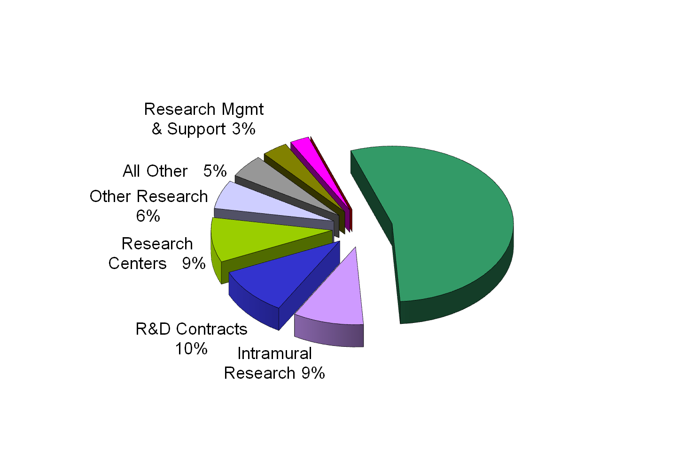
NIH 2012 Budget
$30.7 Billion
Training 3%
Research Project
Grants 55%
$17 billion

Slide 5
Dividing Up the Money:
80,000+ grant proposals submitted each year
Proposals reviewed by 258 separate study sections
and special emphasis panels--26,000 reviewers!
Proposal success rates average from
15 to 25 per cent
(Can be as low as 8 – 10 per cent in
more competitive programs)
Overall success rate of 18% for past
two years

Slide 6
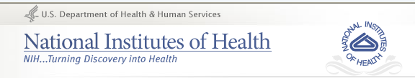
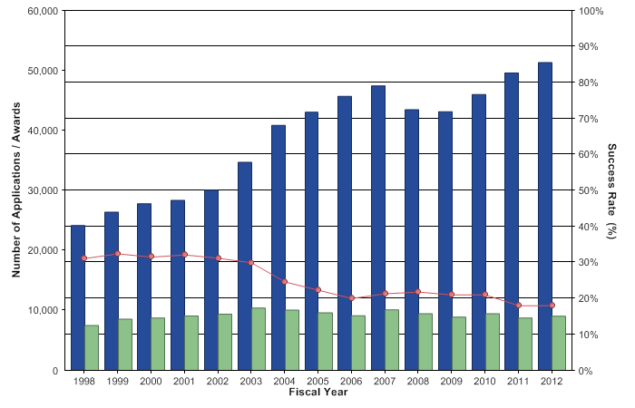
Proposal Success Rates 1998 - 2012

Slide 7
NIH Funding Priorities
Number of people who have a disease
Number of deaths caused by a disease
Degree of disability produced by a disease
Degree to which a disease cuts short a life
Economic and social costs of a disease
Need to act rapidly to control spread of a disease
Lesson:
Cite data to quantify impact of disease
on health, society and the economy

Slide 8
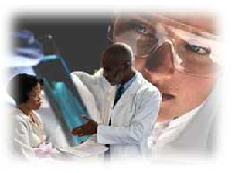
“Translational Research”
Stresses “bench to bedside” themes
Seeks more efficient application of basic discoveries to patient care
Promotes closer collaborations between basic scientists and clinicians
Supports investigators seeking rapid translation of novel discoveries
See :NIH “Roadmap”
www. nihroadmap.nih.gov/

Slide 9
Common Funding Tracks
R01 – Research Projects. A single, circumscribed project proposed by PIs (most common)
R03 – Small Research Grants. Limited support for preliminary short-term projects
R15 - Academic Research Enhancement Awards (AREA). Health professional schools with <$6M NIH funding annually are eligible
R21 – Exploratory/Developmental Grants. Support new lines of research in specific program areas
R13 – Conference. Support conferences, meetings and workshops
R25 – Education Projects. Support development and/or implementation of projects with emphasis on education, training, or technical assistance
“K” Awards. Career Awards--numerous tracks depending on degree
and career stage (Go to “K Kiosk” and “K Wizard” pages)
NEW! PI Awards. Pathway to Independence (K99R00)
Speeds Postdoc transition from mentored research
to PI status on R01 (5 yr funding)

Slide 10
More emphasis on “New”
and “Early Stage” investigators”
Designed to give advantage to investigators who have not been a PI on R01 awards
“Pathways to Independence” accelerates postdocs to tenure-track positions
“New Innovator” award favors outstanding ideas w/o voluminous preliminary data
“Early Stage” proposals reviewed more on approach
and less on track record and preliminary data
Many institutes have reserved pools of funds for NI’s
Portal:
http://grants.nih.gov/grants/new_investigators/

Slide 11
Pretest: NIH “Jeopardy Quiz”
Answer: 28
What is the question?
___ How many WMD’s have been found in Iraq?
___ How many states have reduced funding to universities as a result of budget pressures?
___ How many times NIH application instructions say “applicant must,” “length may not exceed,” “application will be deemed incomplete,” or “proposal will be returned without review”?

Slide 12

Best Web Portal:
www.grants.nih.gov/grants/oer.htm

Slide 13
Warning:
Electronic Submission Here!
Major change from PHS 398 paper forms to
SF 424 electronic forms (www.Grants.gov)
R01, R03 & R21’s now required
Early problems with Grants.gov appear
to be resolved
Remember:
Body of grant remains much the same, but
START EARLY
working with sponsored research office!

Slide 14
Keys to Successful Applications
Original, compelling ideas
Focused research & administrative plans
Appropriate resources/facilities
Knowledge of relevant published work
Success with earlier work (preliminary data)
Future directions and contingency plans
Adequate staff with experience/training in essential methodology
Prepared according to NIH requirements

Slide 15
Top Ten Reasons for Failure*
Lack of original ideas
Diffuse, unfocused or superficial Research Plan
Lack of knowledge of relevant published work
Lack of experience in essential methodology
Uncertainty concerning future directions
Questionable reasoning in experimental approach
Absence of acceptable scientific rationale
Unrealistically large amount of work
Lack of sufficient experimental detail
Uncritical approach
*presented at an NIH grants conference

Slide 16
Planning the Application:
Plan for 3 – 6 months to write the application
List some ideas that excite you; test them with colleagues (form your own review panel!)
Study program goals, Program Anouncements (PA) or Request for Applications (RFA) carefully
Search RePORTER database to see what related projects have been funded; carve out your niche
Sharpen the focus of your application (simple, testable hypothesis, 3-4 specific aims); test with colleagues!
Contact key NIH Program Officers; test idea(s) for “fit”
Key Question: GO/NO GO?

Slide 17
If “GO”...
Read the SF424 Application Guide carefully
Contact the Research Office; establish working relationship
Be prepared to address 5 traditional NIH review criteria
- Significance: ability of project to improve health
- Approach: feasibility of methods & budget
- Innovation: originality of your approach*
- Investigator: qualifications and experience of investigator(s)
- Environment: suitability of facilities, equipment & institutional support
Plus the NEW criterion: IMPACT!
*NB: too much innovation can be risky

Slide 18
Planning the Application, cont’d:
Map out deadlines and benchmarks for proposal development, working back from the submission date
Note where an institutional approval, e. g., IRB review, has to be scheduled
If submitting a revised application, provide detailed explanation of all changes (1 page allowed)
Postdocs: Start early to get letters of reference and institutional commitment (very important to reviewers)
Remember:
Establishing your credibility can be as important
as the topic you’re proposing

Slide 19

Key Sections of the Application:
Description (Abstract)*
Research Plan
Budget
Assurances
Biographical Sketch
Resources and Environment
Appendix
*NB: Do this last!

Slide 20
The Abstract
PURPOSE: Describe succinctly every major aspect of proposed project except budget
Used to assign institute and study section
Length: 1/2 page (space provided)
Should touch briefly on:
- Background and significance of proposed research
- Specific aims or hypothesis
- Unique features of project
- Methodology (action steps) to be used
- Expected results
- Evaluation methods

Slide 21
Tips for the Abstract:
Strive to be COMPLETE though BRIEF
View it as a one page advertisement
Write it last after you’ve completed the entire proposal
DO NOT merely cut and paste from the first page of the project description
Keep in mind purposes other than the review:
- Brief description of your project for annual reports
- Requests from top management at NIH
Remember:
This may the only section that some reviewers will read!
Make it a brief “stand alone” statement of the scope,
methods and significance of your project

Slide 22
Research Plan: Overview
CORE OF THE PROPOSAL. Describes:
- What: Specific Aims
- Why: Significance & Innovation
- How: Approach - Research Design & Methods - Preliminary Results
CONTENTS. Must answer:
- What do you intend to do?
- Why is it important? How is it innovative?
- What has already been done in the field? How will you add to it?
- What have you done to establish the feasibility of your methods?
- How will the research be accomplished? (Who, What, When, Where, Why)

Slide 23
Research Plan: New Format & Page Limits!
1. Introduction: (Resubmitted proposals only: +1 page)
2. Specific Aims: 1 page (All “R” proposals)
3. Research Strategy
a. Significance
b. Innovation
c. Approach (Research Design & Methods)
- Preliminary Studies (new applications)
- Progress Report for renewals
New page limits for Research Strategy (a+b+c):
R01 = 12 pages (down from 25!)
R03, R21 = 6 pages (down from 11!)
“Enhancing Peer Review” initiative:
http://enhancing-peer-review.nih.gov/index.html

Slide 24
Tips for the Research Plan:
Make sure that all sections (Specific Aims/Research Strategy) are internally consistent and dovetail with each other.
Show knowledge of recent literature and how you will build upon it.
Emphasize how some combination of a) a novel hypothesis; b) important preliminary data; and c) a new experimental approach will enable important progress to be made.
Establish credibility of the PI and co-investigators.
Remember:
Make it easy to read & follow the logic of your argument:
Use white spaces, pictures, bold headings, numbering

Slide 25
Research Plan
Part 2: Specific Aims
PURPOSE: To describe concisely and realistically what the proposed research is intended to accomplish
CONTENTS. Should cover:
- The project’s overall purpose and broad goals
- Hypothesis or hypotheses to be tested (if an experimental design)
- Specific, time-phased research objectives (“specific aims”)

Slide 26
Tips for Part 2: Specific Aims
Start with a brief narrative describing the long term goals of the project, followed by a specific, testable hypothesis, followed by
2 – 4 Specific Aims, numbered.
Make sure the hypothesis is adequately supported by citations in Part B (Background & Significance), and by data in Part C, (Preliminary Results). Show that the objectives are attainable within the stated time frame in Part D (Research Design & Methods).
State each Specific Aim in a single concise sentence.
Be sure all aims are related; test for clarity and cohesiveness.
Remember:
A small, focused project has a better chance than a diffuse, multifaceted one;
You are unlikely to get money merely to study something or collect data.

Slide 27
Develop a solid hypothesis!
A tentative assumption made in order to draw out
and test its logical or empirical consequences.
--Webster’s
The foundation of most successful NIH grants
(Exceptions: Studies of bioterrorism, design of biomedical
devices, software for computational biology, etc.)
Structure a statement that will be proved or disproved
by the experimental design
Good: Analogues to chemokine receptors can inhibit HIV infection.
Bad: Analogues to chemokine receptors can be biologically useful.
Worse: A wide range of molecules can inhibit HIV infection.

Slide 28
Specific Aims
Aims (research objectives) must be focused,
logically coherent, and capable of testing
the hypothesis
Hypothesis: Components of automobile exhaust accelerate
the degradation of statuary in Washington DC
Aim 1: To determine the content of sulfur, lead and copper
in statuary as a function of age
Aim 2: To correlate the rate of degradation with the
introduction of unleaded gasoline in the DC area

Slide 29
Part 3: Research Strategy
a. Significance
PURPOSE: Present a convincing scholarly argument for your proposed project
CONTENTS:
- Highlight the problem to be investigated and its importance
- Summarize the current state of existing knowledge, with citations and relevant data
- Justify your research approach
- Identify gaps or limitations that your project will address
- Show how your research will impact public health

Slide 30
Tips for Research Strategy
3a. Significance
Be persuasive; cite authoritative sources to prove the importance of the research problem
Cite enough relevant research to show familiarity with state of the art scholarship
Acknowledge differences that may exist in the field
Embrace creativity; stress innovations in experimental methods or proposed interventions (BUT justify their feasibility!)
Show how this work will advance the field
Remember:
The foundation of your argument should always come back
to how your research supports the goals and objectives
of the program you’re applying to

Slide 31
Part 3: Research Strategy
b. Innovation
PURPOSE: Describe how the research will utilize novel concepts, approaches or methodologies to advance knowledge
CONTENTS:
- Describe the project’s unique qualities
- Emphasize original applications of theoretical concepts
- Justify the use of new methodologies, or the development of new instrumentation

Slide 32
Tips for Research Strategy
3b. Innovation
Justify originality by citing data that show improvements or better results
Show how the new approach will accomplish research goals and objectives better or more efficiently than existing methods
Demonstrate the feasibility of your innovations: Present your case in a way that promises project success
Remember:
Too much innovation magnifies the element of risk!

Slide 33
Part 3: Research Strategy
c. Approach
PURPOSE: Provide detailed description of how the research will be carried out
CONTENTS: Should include
- An overview of the design
- Details of methods to be used for each specific aim
- Methods for collecting, analyzing and interpreting results
- Sequential work plan: Activities, timelines, responsibilities
- Discussion of challenges and limitations and how they will be overcome or mitigated
- Expected results (or alternative approaches, if needed)
- Precautions to be taken if hazards are involved

Slide 34
Tips for Research Strategy
3c. Approach
Number the sections to correspond to numbers of Specific Aims
Where possible cite your own publications to show familiarity with experimental techniques
Justify your approach by stating why you chose your method(s) over alternatives (the “why” as well as the “how”)
If you must use a complex technology for the first time, add a co-investigator or experienced consultant
Document proposed collaborations and offers of restricted materials or equipment with letters of authorization
Remember:
Pictures do more than words: Use charts, illustrations and graphs
to help reviewers “see” exactly how the project will unfold

Slide 35
Part 3: Research Strategy
c. Preliminary Results
PURPOSE: Provide experimental support for hypothesis and research design; establish capabilities of investigators
CONTENTS: Should include
- Brief description of recent studies done by investigators that establish feasibility of the proposed design
- Reference to older studies that provide important background
- Results of previous studies not directly relevant can help if they verify competence with the proposed experimental techniques

Slide 36
Tips for 3c:
Preliminary Results
Show how previous work has prepared you to conduct this research successfully
All figures, tables and illustrations of preliminary data must be in this section
Color images okay with Grants.gov, but check w/B&W printer
If originals are reduced, make sure legends are readable
Cite but do not dwell exhaustively on results already published. Summarize key findings and include reprints in the appendix (up to 10)
Remember:
“It is virtually impossible to obtain a favorable review
without strong preliminary data.”
- NCI Grantwriting Guide

Slide 37
Budget and Justification
Modular: Less than $250,000 per year
- Only need to list personnel and % effort (LOE)
- No other itemization necessary
- Direct costs requested in modules of $25,000
Non-modular: > $250,000 per year
- Requires detailed itemization (forms 4 & 5)
- NB: Budgets > $500,000/yr require NIH approval prior to submission
(at least 6 weeks in advance)
PURPOSE: Justify all expenses required to achieve project aims and objectives
Recommended Length: Special forms provided. Read instructions carefully!

Slide 38
Budget Tips
Be realistic. Padding and deliberate underbudgeting are quickly spotted.
Describe specific duties and name the individuals for each position listed, with percentage of effort requested each year
If non-modular:
Justify all equipment purchases
Break out supply costs into major categories (reagents, disposables, etc.)
Detail and justify all travel costs
All budget items and year-to-year fluctuations should match the research plan 1:1.
Be complete but concise (no page limits)
Remember:
Failure to adequately justify expenditures will cause
reviewers to question the validity of your research plan!

Slide 39
Assurances and Certifications
PURPOSE: Document institutional compliance with all relevant federal laws and guidelines
CONTENTS. Required Assurances:
Human Subjects Human Fetal Tissue Vertebrate Animals Embryonic Stem Cells Inclusion of Children Women & Minority Inclusion Debarment & Suspension Drug-Free Workplace Lobbying Delinquent Federal Debt Research Misconduct Handicapped Individuals Civil Rights Sex Discrimination Age Discrimination

Slide 40
Tips re: Assurances
Become familiar with all compliance requirements that pertain to your proposal, especially if your research involves:
- Human Subjects - Vertebrate Animals - Recombinant DNA/RNA - Human Gene Transfers - Biohazards - Hazardous Materials - Radioactivity - Conflict of Interest
2. Allow plenty of time, as some compliance documentation may have to come from other institutions.
3. Make contact early with the Office of Sponsored Programs!
4. IRB approval not necessary with proposal, but no money will flow until it’s obtained!
Remember:
Lack of proper certifications and assurances
will cause your proposal to be returned without review!

Slide 41
Biographical sketches
PURPOSE: Provide credentials of all key personnel in concise, standard format
Format pages provided (limited to 4 pages)
Education/Training
A. Positions and Honors
B. Selected Peer-reviewed publications
C. Research Support (Ongoing & Completed)

Slide 42
Resources and Environment
PURPOSE: Describe the resources, facilities and support available to the researcher
Recommended Length: Form provided
Make sure you:
1. Include all requirements mentioned in proposed Research Plan
2. Justify any reliance on external resources
3. Show that all subcontractors and collaborators have the capability to perform assigned tasks
4. Match resources with budget requests

Slide 43
Appendix
PURPOSE: Provide relevant supplemental material
May include:
- Up to 10 publications or manuscripts accepted for publication
- Abstracts, patents or other relevant material
- Surveys, questionnaires, data collection instruments, clinical protocols
Not advisable for any commonly known protocol or procedure
NB: Do not use to circumvent the 12 page limit!

Slide 44
NIH Peer Review:
New Scoring System
7
6
5
4
9-point scale introduced in 2010
(1 = “Exceptional” and 9 = “Poor”)
Most important new score will be the final IMPACT rating:
(1 to 9)
Ratings will be in whole #’s only; no decimals
Reviewers will also provide ratings for each of five traditional NIH criteria
- Significance
- Investigator(s)
- Innovation
- Approach
- Environment

Slide 45
7
New Scoring System, cont’d
6
5
4
Preliminary score: Reviewers send in their scores for the 5 present review criteria, plus the final IMPACT score
Note: Impact score is an independent rating, not an average of the 5!
Applications in the lower half are “less competitive,” and will Not be Discussed
PI’s of “ND” proposals WILL receive all scores from individual reviewers, but no overall IMPACT score
After discussing competitive proposals, reviewers may change their scores
Reviewer scores are averaged, x 10, for a range of 10 – 90
Average IMPACT scores are then percentiled for final ranking to determine funding order

Slide 46

7
Scoring System, cont’d
6
5
4
Definition of 9 – point scale:

Slide 47

NIH Study Section Video
www.csr.nih.gov/

Slide 48
NIH Grant Cycles

Slide 49

Standard Due Dates: Competing Applications
(Warning: partial page, changes frequently!)
http://grants.nih.gov/grants/funding/submissionschedule.htm

Slide 50
Guides for NIH proposals
Yang, Otto. Guide to Effective Grant Writing. Springer, New York, 2005
Ogden, Thomas E. and Israel A. Goldberg. Research Proposals: A Guide to Success,
3rd edition. Academic Press, San Diego, 2002
Reif-Lehrer, Liane. Grant Application Writer’s Handbook, 4th edition.
Jones and Bartlett, Boston, 2005
Gerin, William. Writing the NIH Grant Proposal: A Step-by-Step Guide.
Sage Publications, Thousand Oaks CA, 2006

Slide 51
Some Final Tips for Success...
Read successful proposals
Look up study section charters, rosters & prior awards www.csr.nih.gov/Committees/rosterindex.asp / RePORTER database
Develop an “elevator speech” for your project
Contact program officer(s) early and often
Learn the basics of Grants.gov
Follow application instructions exactly
Use direct English (basic, concise, active voice);
avoid jargon (especially in early sections)

Slide 52
More Tips for Success...
Observe type size and page limits strictly; NO TNR!
(Arial, Helvetica, Palatino, Linotype, Georgia, 11 or larger)
Use plenty of visual illustrations; trust white spaces
Ask informed readers to check for clarity and consistency
Engage a final proofreader (not an investigator!)
Use checklist to assure required items are completed
Give yourself plenty of time for rewrites and final polishing
Prepare to resubmit!

