Slide 1
Florida State University – Florida A&M University
NEH Information Session &
Application-Writing Workshop
February 21, 2014

Slide 2
Statistics for Selected
Institutions
Endowment-wide, since 1976
 | Submitted | Funded | Percentage
Albany State University | 58 | 9 | 16%
Florida A&M University | 86 | 8 | 9%
Florida State University | 397 | 71 | 18%
University of Alabama | 152 | 31 | 20%
University of Florida | 642 | 137 | 21%
University of Georgia | 507 | 83 | 16%
University of Mississippi | 288 | 65 | 23%
University of Montevallo | 26 | 4 | 15%
University of Southern Mississippi | 243 | 50 | 21%
Valdosta State University | 54 | 6 | 11%

Slide 3

Grant-making budgets, fy 2013
Division of Education
$12.5 million
Special Initiatives & Programs
$6.1 million
Division of Public Programs
$12.7 million
NEH Total for Grants
$102.2 million (FY2013)
Division of Research
$13.7 million
Office of
Digital
Humanities
$3.9 million
Office of
Federal / State
Partnership
$38.3 million
Division of Preservation & Access
$14.4 million
Office of
Challenge Grants
$10.1 million
(matching)

Slide 4
Funding opportunities at NEH
NEH is supported by your tax dollars and is responsible to you

Slide 5
Funding opportunities at NEH
NEH is supported by your tax dollars and is responsible to you
NEH makes awards in all areas of the humanities

Slide 6
The Humanities
The term 'humanities' includes, but is not limited to, the study of the following: language, both modern and classical; linguistics; literature; history; jurisprudence; philosophy; archaeology; comparative religion; ethics; the history, criticism and theory of the arts; those aspects of social sciences which have humanistic content and employ humanistic methods; and the study and application of the humanities to the human environment with particular attention to reflecting our diverse heritage, traditions, and history and to the relevance of the humanities to the current conditions of national life.
National Foundation on the Arts and the Humanities Act of 1965

Slide 7
Funding opportunities at NEH
NEH is supported by your tax dollars and is responsible to you
NEH makes awards in all areas of the humanities
Help is always available

Slide 8
Funding opportunities at NEH
NEH is supported by your tax dollars and is responsible to you
NEH makes awards in all areas of the humanities
Help is always available
Awards made offered through seven grant-making divisions/offices

Slide 9
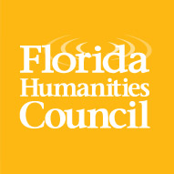
Federal/state partnership
The Florida Humanities Council
599 Second Street South
St. Petersburg, FL 33701
fhc@flahum.org
http://flahum.org
Notes:
Third, the Division of Research Programs. This division supports the work of scholars, working individually or in teams, doing research for scholarly and general audiences. You have a sheet describing all of the division’s grant programs. These include the Fellowship, probably the best-known of the Endowment’s grants. That’s what people are talking about when they say “Oh, that person got an NEH!”

Slide 10
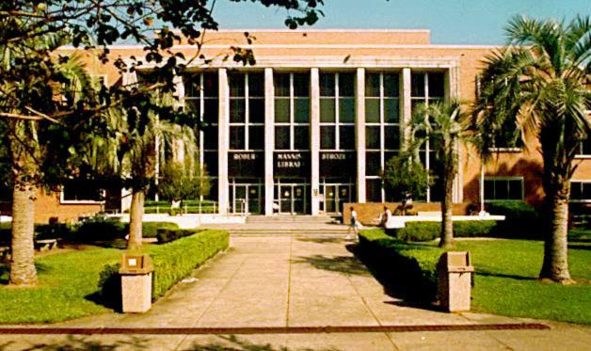
Challenge grants
Institution-building grants to improve humanities programs and carry out long-term plans for strengthening basic resources, and enhance financial stability.
Notes:
Third, the Division of Research Programs. This division supports the work of scholars, working individually or in teams, doing research for scholarly and general audiences. You have a sheet describing all of the division’s grant programs. These include the Fellowship, probably the best-known of the Endowment’s grants. That’s what people are talking about when they say “Oh, that person got an NEH!”

Slide 11
Deadline–May 1, 2014
University of Florida: endow faculty and staff salaries and public programs at the Randall Research Center ($350K, 3:1 match)
Eckerd College: endow a professorship in film studies ($300K, 3:1 match)
Notes:
Randall Research Center is a center for history and archaeology

Slide 12

Digital Humanities
Encourages innovations in the digital humanities through research that brings new approaches or documents best practices; creation of digital tools for preserving, analyzing, and making accessible digital resources; and examination of the philosophical implications and impact of emerging technologies.
Notes:
Our Office of Digital Humanities is supporting a lot of cutting-edge work in incorporating technology into research and public engagement in the humanities. This includes creating new tools and collaborating on new research approaches.

Slide 13
  Digital Humanities Start-Up Grants—September 11, 2014
  Digital Humanities Implementation Grants—February 19, 2014
  Institutes for Advanced Topics in the Digital Humanities—March 11, 2014
  Florida State University: “Populating Prosop. A Social Networking Tool for the Past: Two Workshops” (Will Hanley, $50K, 2 years)
Notes:
Their projects include Digital Humanities Start-Up and Implementation Grants and Institutes for Advanced Topics in the Digital Humanities. This institute would train the participants to design and implement international "team-taught" courses in the humanities that bring together both teachers and students from multiple nations. This proposed institute builds upon the project director's 2008 Digital Humanities Start-Up Grant project that allowed faculty members from the State University of New York system to pilot team-taught classes in medieval literature, European history, and sociology with partner faculty members from institutions in Turkey, Ireland, and French Canada. The team of faculty members now proposes to share the results of their experiences with a national audience by leading an institute on how humanities faculty at higher education institutions in the United States could develop "co-equal learning environments where faculty members from two cultures work together to generate a shared syllabus and a multi-cultural learning environment based on solid academic coursework." The institute faculty would be drawn from those humanities faculty from the State University of New York (SUNY) campuses that participated in the initial project; whenever possible, their partner in the team-taught course from the institution outside of the United States would also take part in the institute. The first phase of the institute would be a three-day workshop to be hosted by the SUNY Center for Collaborative Online International Learning. Participants would choose from five different focus groupings so that they would have an opportunity to intensively share course content and development issues. The four foci are Human Societies (for faculty in sociology and anthropology); Languages and Literature; Media, Arts, and Cultures; International Affairs; and Freshman Humanities Foundations. During the workshops, participants would learn about the history of networked learning in a global environment and explore how cross-cultural team collaboration works within the context of particular humanities subject or related disciplines. Participants would also be introduced to a variety of online learning management systems and open-source online communication tools that they would be exploring further in subsequent phases of the project. The institute would continue with a 10-week online training component where the faculty participants would begin to build their international collaborative courses with support from the technical staff at their home campuses. The faculty participants would then maintain their discussions with the institute faculty as they teach their courses during 2012 academic year. And finally, the participants would reconvene in March 2013 for a capstone conference. Panels devoted to each of the broad humanities disciplinary categories of the initial workshops would allow participants to present the results of the courses experiences and share their "lessons learned" with each other.

Slide 14

Education
Grants strengthen teaching and learning through new or revised curricula and materials, collaborative study, seminars, and institutes.
Notes:
The education division has programs that support teaching, for both college and pre-college classrooms. You have a sheet describing the division’s programs.

Slide 15
  Landmarks of American History and Culture—March 4, 2014
  Seminars and Institutes—March 4, 2014
  Enduring Questions—September 11, 2014
Summer Seminar for College Teachers: “Vietnam 1945-1975” (University of Miami)
Summer Institute for School Teachers: “The Americas of Jose Marti”(University of South Florida)
Landmarks of American History: Two workshops on the early life and work of Zora Neale Hurston (conducted in Eatonville by the Florida State Humanities Council)
NEH Enduring Questions Course: “What does it mean to be free?” (State University of West Georgia)
Notes:
Their projects include Digital Humanities Start-Up and Implementation Grants and Institutes for Advanced Topics in the Digital Humanities. This institute would train the participants to design and implement international "team-taught" courses in the humanities that bring together both teachers and students from multiple nations. This proposed institute builds upon the project director's 2008 Digital Humanities Start-Up Grant project that allowed faculty members from the State University of New York system to pilot team-taught classes in medieval literature, European history, and sociology with partner faculty members from institutions in Turkey, Ireland, and French Canada. The team of faculty members now proposes to share the results of their experiences with a national audience by leading an institute on how humanities faculty at higher education institutions in the United States could develop "co-equal learning environments where faculty members from two cultures work together to generate a shared syllabus and a multi-cultural learning environment based on solid academic coursework." The institute faculty would be drawn from those humanities faculty from the State University of New York (SUNY) campuses that participated in the initial project; whenever possible, their partner in the team-taught course from the institution outside of the United States would also take part in the institute. The first phase of the institute would be a three-day workshop to be hosted by the SUNY Center for Collaborative Online International Learning. Participants would choose from five different focus groupings so that they would have an opportunity to intensively share course content and development issues. The four foci are Human Societies (for faculty in sociology and anthropology); Languages and Literature; Media, Arts, and Cultures; International Affairs; and Freshman Humanities Foundations. During the workshops, participants would learn about the history of networked learning in a global environment and explore how cross-cultural team collaboration works within the context of particular humanities subject or related disciplines. Participants would also be introduced to a variety of online learning management systems and open-source online communication tools that they would be exploring further in subsequent phases of the project. The institute would continue with a 10-week online training component where the faculty participants would begin to build their international collaborative courses with support from the technical staff at their home campuses. The faculty participants would then maintain their discussions with the institute faculty as they teach their courses during 2012 academic year. And finally, the participants would reconvene in March 2013 for a capstone conference. Panels devoted to each of the broad humanities disciplinary categories of the initial workshops would allow participants to present the results of the courses experiences and share their "lessons learned" with each other.

Slide 16

Preservation & access
Grants to preserve archival holdings (including digitization); enhance access to materials; train preservationists; and produce reference works for scholarly research, education, and public programming
Notes:
The education division has programs that support teaching, for both college and pre-college classrooms. You have a sheet describing the division’s programs.

Slide 17
  Education, Training, Research and Development—May 1, 2014
  Preservation Assistance Grants—May 1, 2014
  Collections and Reference Resources—July 17, 2014
  Sustaining Cultural Heritage Collections—December 3, 2014
  University of Florida ($381K, 3 years): “Preservation Microfilming and Cataloguing of American and British Children’s Literature, 1850-1869”
  Florida State University ($5,000, 1 year): “World War II Artifact Assessment Project”
  Spelman College ($122K, 2 years): “Spelman College Archive Stabilization Project – Compact Shelving”
Notes:
Their projects include Digital Humanities Start-Up and Implementation Grants and Institutes for Advanced Topics in the Digital Humanities. This institute would train the participants to design and implement international "team-taught" courses in the humanities that bring together both teachers and students from multiple nations. This proposed institute builds upon the project director's 2008 Digital Humanities Start-Up Grant project that allowed faculty members from the State University of New York system to pilot team-taught classes in medieval literature, European history, and sociology with partner faculty members from institutions in Turkey, Ireland, and French Canada. The team of faculty members now proposes to share the results of their experiences with a national audience by leading an institute on how humanities faculty at higher education institutions in the United States could develop "co-equal learning environments where faculty members from two cultures work together to generate a shared syllabus and a multi-cultural learning environment based on solid academic coursework." The institute faculty would be drawn from those humanities faculty from the State University of New York (SUNY) campuses that participated in the initial project; whenever possible, their partner in the team-taught course from the institution outside of the United States would also take part in the institute. The first phase of the institute would be a three-day workshop to be hosted by the SUNY Center for Collaborative Online International Learning. Participants would choose from five different focus groupings so that they would have an opportunity to intensively share course content and development issues. The four foci are Human Societies (for faculty in sociology and anthropology); Languages and Literature; Media, Arts, and Cultures; International Affairs; and Freshman Humanities Foundations. During the workshops, participants would learn about the history of networked learning in a global environment and explore how cross-cultural team collaboration works within the context of particular humanities subject or related disciplines. Participants would also be introduced to a variety of online learning management systems and open-source online communication tools that they would be exploring further in subsequent phases of the project. The institute would continue with a 10-week online training component where the faculty participants would begin to build their international collaborative courses with support from the technical staff at their home campuses. The faculty participants would then maintain their discussions with the institute faculty as they teach their courses during 2012 academic year. And finally, the participants would reconvene in March 2013 for a capstone conference. Panels devoted to each of the broad humanities disciplinary categories of the initial workshops would allow participants to present the results of the courses experiences and share their "lessons learned" with each other.

Slide 18
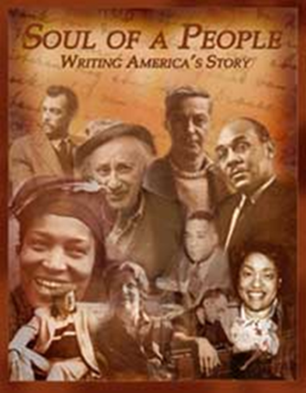


Public Programs
Grants for the presentation of the humanities for large and diverse public audiences. Grants typically support radio and television documentaries, exhibitions and interpretation of historic sites, reading and discussion series, lectures, symposia, and after school programs.
Notes:
The Division of Public Programs supports a wide range of public humanities programs that reach large and diverse public audiences. Fundable activities include, but are not limited to, radio and television programs for national broadcast, exhibitions and interpretation of historic sites, reading or film discussion series, lectures, and symposia. You will see on the Public Programs sheet a description of the grant programs.

Slide 19
  Media: Development and Production—August 13, 2014
  Museums, Libraries, and Cultural Institutions: Planning and Implementation Grants—August 13, 2014
  NEH on the Road—December 31, 2014
  Public libraries in Ft. Lauderdale, Gainesville, Cape Coral, and Key West: “Lincoln, the Constitution, and the Civil War: A traveling exhibition”
  Jacksonville Public Library: “Jazz Legacy, An American Art Form: A film viewing and discussion series”
  Bass Museum of Art: “Staging Mid-Century Miami: Implementation of a traveling exhibition”
Notes:
Their projects include Digital Humanities Start-Up and Implementation Grants and Institutes for Advanced Topics in the Digital Humanities. This institute would train the participants to design and implement international "team-taught" courses in the humanities that bring together both teachers and students from multiple nations. This proposed institute builds upon the project director's 2008 Digital Humanities Start-Up Grant project that allowed faculty members from the State University of New York system to pilot team-taught classes in medieval literature, European history, and sociology with partner faculty members from institutions in Turkey, Ireland, and French Canada. The team of faculty members now proposes to share the results of their experiences with a national audience by leading an institute on how humanities faculty at higher education institutions in the United States could develop "co-equal learning environments where faculty members from two cultures work together to generate a shared syllabus and a multi-cultural learning environment based on solid academic coursework." The institute faculty would be drawn from those humanities faculty from the State University of New York (SUNY) campuses that participated in the initial project; whenever possible, their partner in the team-taught course from the institution outside of the United States would also take part in the institute. The first phase of the institute would be a three-day workshop to be hosted by the SUNY Center for Collaborative Online International Learning. Participants would choose from five different focus groupings so that they would have an opportunity to intensively share course content and development issues. The four foci are Human Societies (for faculty in sociology and anthropology); Languages and Literature; Media, Arts, and Cultures; International Affairs; and Freshman Humanities Foundations. During the workshops, participants would learn about the history of networked learning in a global environment and explore how cross-cultural team collaboration works within the context of particular humanities subject or related disciplines. Participants would also be introduced to a variety of online learning management systems and open-source online communication tools that they would be exploring further in subsequent phases of the project. The institute would continue with a 10-week online training component where the faculty participants would begin to build their international collaborative courses with support from the technical staff at their home campuses. The faculty participants would then maintain their discussions with the institute faculty as they teach their courses during 2012 academic year. And finally, the participants would reconvene in March 2013 for a capstone conference. Panels devoted to each of the broad humanities disciplinary categories of the initial workshops would allow participants to present the results of the courses experiences and share their "lessons learned" with each other.

Slide 20
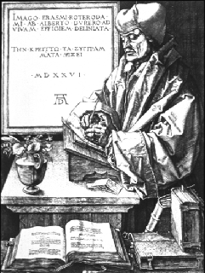
Research
Grants support individuals and teams of scholars pursuing advanced research in the humanities that will contribute to scholarly knowledge or to the general public's understanding of the humanities.
Notes:
Third, the Division of Research Programs. This division supports the work of scholars, working individually or in teams, doing research for scholarly and general audiences. You have a sheet describing all of the division’s grant programs. These include the Fellowship, probably the best-known of the Endowment’s grants. That’s what people are talking about when they say “Oh, that person got an NEH!”

Slide 21
  For Individual Scholars
  Awards for Faculty at HBCUs, HSIs, and TCs – April 15, 2014
  NEH Fellowships (6-12 months) – May 1, 2014
  Summer Stipends (8 weeks) –September 30, 2014
Randolph Clarke, Florida State U: “Omissions: Metaphysics, Agency, and Responsibility”(12-month fellowship, $50,400)
Elizabeth Spiller, Florida State U: “Science, Matter Theory, and Literary Creation in the Renaissance” (6-month fellowship, $25,200)
Frank Gunderson, Florida State U: “Interpretting Sukuma (Tanzania) Song Texts as Historical Sources” (2-month summer stipend, $6,000)
Stanley Harrold, SC State U: “The Abolitionist Movement’s Involvement in American Politics, 1750-1865: (12-month award for faculty, $50,400)
Notes:
Their projects include Digital Humanities Start-Up and Implementation Grants and Institutes for Advanced Topics in the Digital Humanities. This institute would train the participants to design and implement international "team-taught" courses in the humanities that bring together both teachers and students from multiple nations. This proposed institute builds upon the project director's 2008 Digital Humanities Start-Up Grant project that allowed faculty members from the State University of New York system to pilot team-taught classes in medieval literature, European history, and sociology with partner faculty members from institutions in Turkey, Ireland, and French Canada. The team of faculty members now proposes to share the results of their experiences with a national audience by leading an institute on how humanities faculty at higher education institutions in the United States could develop "co-equal learning environments where faculty members from two cultures work together to generate a shared syllabus and a multi-cultural learning environment based on solid academic coursework." The institute faculty would be drawn from those humanities faculty from the State University of New York (SUNY) campuses that participated in the initial project; whenever possible, their partner in the team-taught course from the institution outside of the United States would also take part in the institute. The first phase of the institute would be a three-day workshop to be hosted by the SUNY Center for Collaborative Online International Learning. Participants would choose from five different focus groupings so that they would have an opportunity to intensively share course content and development issues. The four foci are Human Societies (for faculty in sociology and anthropology); Languages and Literature; Media, Arts, and Cultures; International Affairs; and Freshman Humanities Foundations. During the workshops, participants would learn about the history of networked learning in a global environment and explore how cross-cultural team collaboration works within the context of particular humanities subject or related disciplines. Participants would also be introduced to a variety of online learning management systems and open-source online communication tools that they would be exploring further in subsequent phases of the project. The institute would continue with a 10-week online training component where the faculty participants would begin to build their international collaborative courses with support from the technical staff at their home campuses. The faculty participants would then maintain their discussions with the institute faculty as they teach their courses during 2012 academic year. And finally, the participants would reconvene in March 2013 for a capstone conference. Panels devoted to each of the broad humanities disciplinary categories of the initial workshops would allow participants to present the results of the courses experiences and share their "lessons learned" with each other.

Slide 22
  Also for Individual Scholars
Fellowship Programs at Independent Research Institutions
Library of Congress - Kluge Fellowships
NEH-Japan US Friendship Commission – Advanced Social Science Research on Japan fellowships
NEH-National Science Foundation – Documenting Endangered Languages fellowships
Notes:
Their projects include Digital Humanities Start-Up and Implementation Grants and Institutes for Advanced Topics in the Digital Humanities. This institute would train the participants to design and implement international "team-taught" courses in the humanities that bring together both teachers and students from multiple nations. This proposed institute builds upon the project director's 2008 Digital Humanities Start-Up Grant project that allowed faculty members from the State University of New York system to pilot team-taught classes in medieval literature, European history, and sociology with partner faculty members from institutions in Turkey, Ireland, and French Canada. The team of faculty members now proposes to share the results of their experiences with a national audience by leading an institute on how humanities faculty at higher education institutions in the United States could develop "co-equal learning environments where faculty members from two cultures work together to generate a shared syllabus and a multi-cultural learning environment based on solid academic coursework." The institute faculty would be drawn from those humanities faculty from the State University of New York (SUNY) campuses that participated in the initial project; whenever possible, their partner in the team-taught course from the institution outside of the United States would also take part in the institute. The first phase of the institute would be a three-day workshop to be hosted by the SUNY Center for Collaborative Online International Learning. Participants would choose from five different focus groupings so that they would have an opportunity to intensively share course content and development issues. The four foci are Human Societies (for faculty in sociology and anthropology); Languages and Literature; Media, Arts, and Cultures; International Affairs; and Freshman Humanities Foundations. During the workshops, participants would learn about the history of networked learning in a global environment and explore how cross-cultural team collaboration works within the context of particular humanities subject or related disciplines. Participants would also be introduced to a variety of online learning management systems and open-source online communication tools that they would be exploring further in subsequent phases of the project. The institute would continue with a 10-week online training component where the faculty participants would begin to build their international collaborative courses with support from the technical staff at their home campuses. The faculty participants would then maintain their discussions with the institute faculty as they teach their courses during 2012 academic year. And finally, the participants would reconvene in March 2013 for a capstone conference. Panels devoted to each of the broad humanities disciplinary categories of the initial workshops would allow participants to present the results of the courses experiences and share their "lessons learned" with each other.

Slide 23
  For Teams of Scholars
  Scholarly Editions and Translations – December 9, 2014
  Collaborative Research – December 9, 2014
University of Florida (Benjamin Hebblethwaite): “Archive of Haitian Religion and Culture” ($241K, 36 months, Collaborative Research)
Florida State University (Mary Pohl): “Origins of the MesoAmerican City: Ritual and Polity at La Venta, Tabasco, Mexico ($280K, 36 months, Collaborative Research)
University of Georgia (Elizabeth Wright): “Annotated Edition and Translation of Latin Poetry on the Battle of Lepanto” ($90K, 24 months, Scholarly Editions and Translations)
Notes:
Their projects include Digital Humanities Start-Up and Implementation Grants and Institutes for Advanced Topics in the Digital Humanities. This institute would train the participants to design and implement international "team-taught" courses in the humanities that bring together both teachers and students from multiple nations. This proposed institute builds upon the project director's 2008 Digital Humanities Start-Up Grant project that allowed faculty members from the State University of New York system to pilot team-taught classes in medieval literature, European history, and sociology with partner faculty members from institutions in Turkey, Ireland, and French Canada. The team of faculty members now proposes to share the results of their experiences with a national audience by leading an institute on how humanities faculty at higher education institutions in the United States could develop "co-equal learning environments where faculty members from two cultures work together to generate a shared syllabus and a multi-cultural learning environment based on solid academic coursework." The institute faculty would be drawn from those humanities faculty from the State University of New York (SUNY) campuses that participated in the initial project; whenever possible, their partner in the team-taught course from the institution outside of the United States would also take part in the institute. The first phase of the institute would be a three-day workshop to be hosted by the SUNY Center for Collaborative Online International Learning. Participants would choose from five different focus groupings so that they would have an opportunity to intensively share course content and development issues. The four foci are Human Societies (for faculty in sociology and anthropology); Languages and Literature; Media, Arts, and Cultures; International Affairs; and Freshman Humanities Foundations. During the workshops, participants would learn about the history of networked learning in a global environment and explore how cross-cultural team collaboration works within the context of particular humanities subject or related disciplines. Participants would also be introduced to a variety of online learning management systems and open-source online communication tools that they would be exploring further in subsequent phases of the project. The institute would continue with a 10-week online training component where the faculty participants would begin to build their international collaborative courses with support from the technical staff at their home campuses. The faculty participants would then maintain their discussions with the institute faculty as they teach their courses during 2012 academic year. And finally, the participants would reconvene in March 2013 for a capstone conference. Panels devoted to each of the broad humanities disciplinary categories of the initial workshops would allow participants to present the results of the courses experiences and share their "lessons learned" with each other.

Slide 24
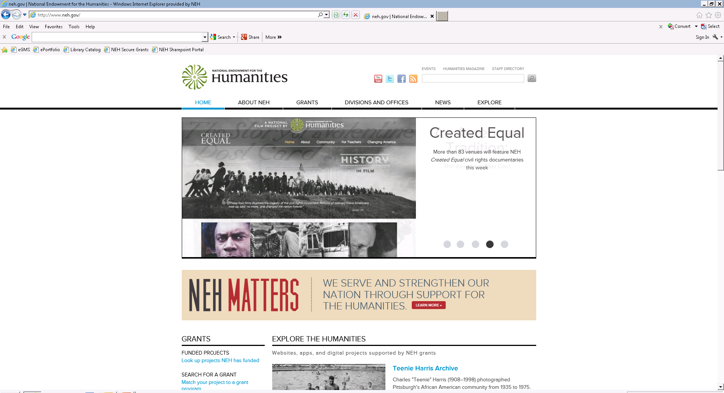

Slide 25
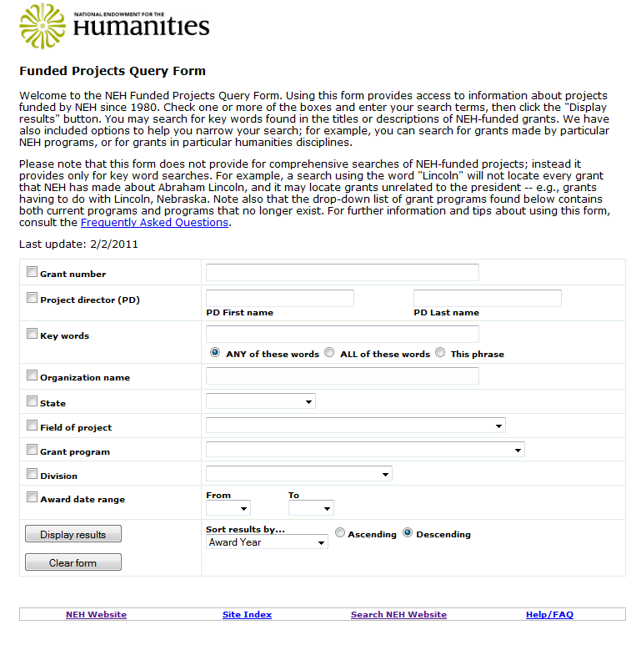

Slide 26
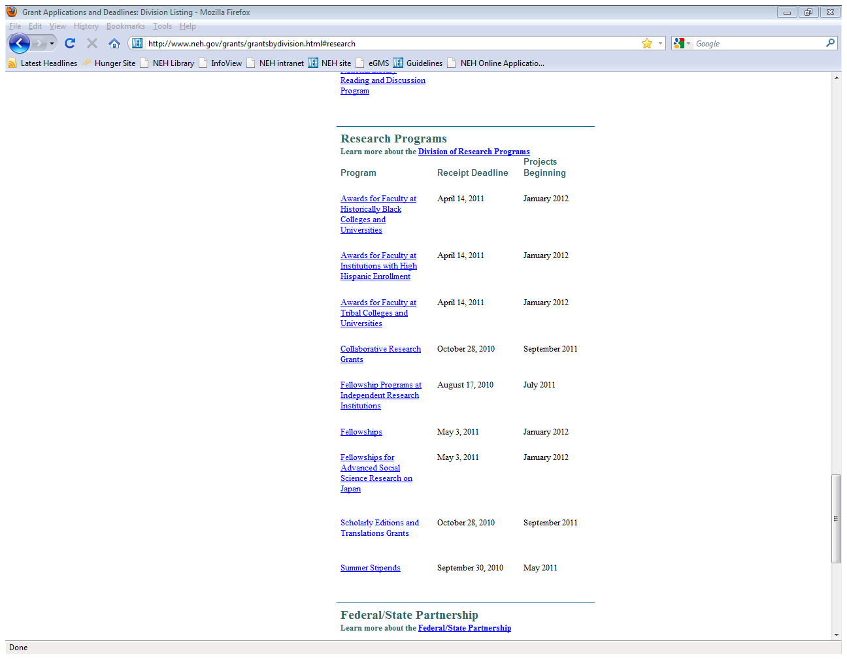

Slide 27
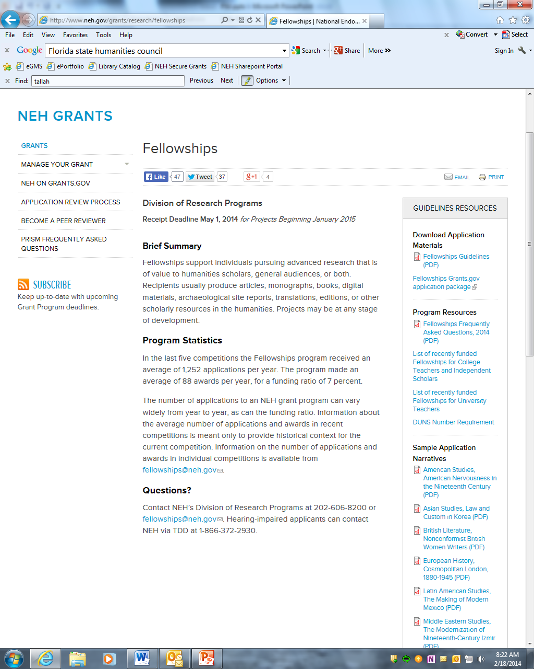
Notes:
Their projects include Digital Humanities Start-Up and Implementation Grants and Institutes for Advanced Topics in the Digital Humanities. This institute would train the participants to design and implement international "team-taught" courses in the humanities that bring together both teachers and students from multiple nations. This proposed institute builds upon the project director's 2008 Digital Humanities Start-Up Grant project that allowed faculty members from the State University of New York system to pilot team-taught classes in medieval literature, European history, and sociology with partner faculty members from institutions in Turkey, Ireland, and French Canada. The team of faculty members now proposes to share the results of their experiences with a national audience by leading an institute on how humanities faculty at higher education institutions in the United States could develop "co-equal learning environments where faculty members from two cultures work together to generate a shared syllabus and a multi-cultural learning environment based on solid academic coursework." The institute faculty would be drawn from those humanities faculty from the State University of New York (SUNY) campuses that participated in the initial project; whenever possible, their partner in the team-taught course from the institution outside of the United States would also take part in the institute. The first phase of the institute would be a three-day workshop to be hosted by the SUNY Center for Collaborative Online International Learning. Participants would choose from five different focus groupings so that they would have an opportunity to intensively share course content and development issues. The four foci are Human Societies (for faculty in sociology and anthropology); Languages and Literature; Media, Arts, and Cultures; International Affairs; and Freshman Humanities Foundations. During the workshops, participants would learn about the history of networked learning in a global environment and explore how cross-cultural team collaboration works within the context of particular humanities subject or related disciplines. Participants would also be introduced to a variety of online learning management systems and open-source online communication tools that they would be exploring further in subsequent phases of the project. The institute would continue with a 10-week online training component where the faculty participants would begin to build their international collaborative courses with support from the technical staff at their home campuses. The faculty participants would then maintain their discussions with the institute faculty as they teach their courses during 2012 academic year. And finally, the participants would reconvene in March 2013 for a capstone conference. Panels devoted to each of the broad humanities disciplinary categories of the initial workshops would allow participants to present the results of the courses experiences and share their "lessons learned" with each other.

Slide 28
Questions?
Russell Wyland, Deputy Director
NEH Division of Research
1100 Pennsylvania Avenue NW, Room 318
Washington, DC 20506
RWyland@neh.gov
202-606-8391
Also: research@neh.gov / 202-606-8200

Slide 30
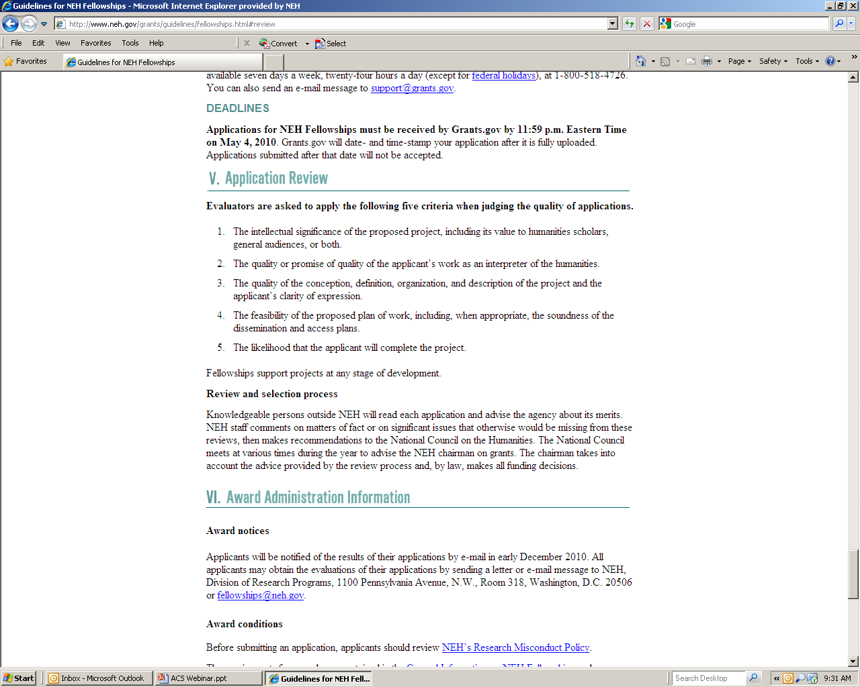

Slide 31
Stages of Review
Peer Review Panelists
NEH staff
National Council
Chairman

Slide 33


Slide 34
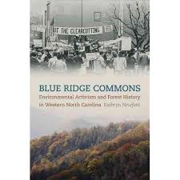

Slide 35
