Slide 1
Engaging with DARPA
Dr. Tyler McQuade
February 13, 2015
Distribution Statement “A” (Approved for Public Release, Distribution Unlimited)

Slide 2
DARPA
Formed in 1958 to PREVENT and CREATE strategic surprise.
Capabilities, mission focused
Finite duration projects
Diverse performers
Multi-disciplinary approach…from
basic research to system engineering
Making pivotal early investments that change what’s possible…
Distribution Statement “A” (Approved for Public Release, Distribution Unlimited)

Slide 3
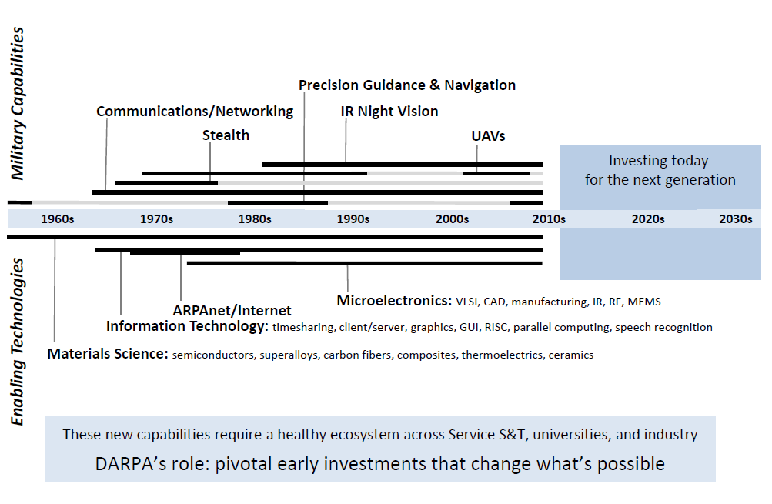
Mission: Breakthrough Technologies for National Security
Distribution Statement “A” (Approved for Public Release, Distribution Unlimited)

Slide 4
Major Factors Shaping DARPA Investments Today
Wide range of national security challenges: evolving nation states, shifting networks
Powerful, globally available technologies set a fast pace
Military systems’ cost, pace, and inflexibility limit our operational capabilities
Distribution Statement “A” (Approved for Public Release, Distribution Unlimited)

Slide 5
DARPA Technical Offices
BTO
DSO
I2O
MTO
STO
TTO
Biology, Technology & Complexity
Discover, Model, Design & Build
Information, Innovation & Cyber
Electronics, Photonics & MEMS
Networks, Cost Leverage & Adaptability
Weapons, Platforms & Space
Restore and Maintain Warfighter Abilities
Harness Biological Systems
Apply Biological Complexity at Scale
Physical Sciences
Mathematics
Transformative Materials
Supervised Autonomy
Novel Sensing and Detection
Harnessing Complexity
Cyber
Data Analysis at Massive Scales
ISR Exploitation
Biological Platforms
Computing
Electronic Warfare
Manufacturing
Novel Concepts
Photonics
Positioning, Navigation and Timing
Thermal Management
Battle Mgmt, Command & Control
Comms & Networks
ISR
Electronic Warfare
Positioning, Navigation and Timing
Air Systems
Ground Systems
Marine Systems
Space Systems
Distribution Statement “A” (Approved for Public Release, Distribution Unlimited)

Slide 6
Defense Sciences Office
Who we are:
A collaborative team of diverse, opportunistic technology entrepreneurs
“DARPA’s DARPA” – office that creates DoD opportunity from fundamental scientific discovery
Informed, but not constrained, by current trends and conflicts
What we do:
Invest in multiple, often disparate, scientific disciplines
Reshape existing fields or create entirely new disciplines (sometimes when the payoff to DoD may not be fully understood)
Harvest and accelerate the development of promising breakthroughs to create enabling technologies for broad impact against national security challenges
The Nation’s first line of defense against scientific surprise
Distribution Statement “A” (Approved for Public Release, Distribution Unlimited)

Slide 7
National Security Challenges
Diverse threats: Can we counter the diversity of national security threats by rapidly accelerating scientific discovery and innovation?
Speed of change: Can we speed the creation of new capabilities, to respond or adapt to unpredictable threats? Can we remove technology barriers to rapid or low volume acquisition?
Complex systems: Can we harness complexity in the systems we build? Can we quantify and manage uncertainty and risk for robust, less costly systems?
Erosion of boundaries: Can reliable and timely detection and management of CBRNE materials and devices address WMD threats arising from the erosion of boundaries?
Distribution Statement “A” (Approved for Public Release, Distribution Unlimited)

Slide 8
DSO New Programs
Materials Development for Platform (MDP) | Methodology, framework and tools to decrease applied development cycle time for fielding a new material by 4x | BAA release: 8/7/2014
Atoms to Product (A2P) | Advanced assembly processes to bring nanotechnology into the manufacturing mainstream. | BAA release: 9/2/2014
Simplifying Complexity in Scientific Discovery (SIMPLEX) | Computer-based math models that exploit complex, heterogeneous data sets to help speed scientific discovery | BAA release: 9/11/2014
Intense and COmpact Neutron Sources (ICONS) | Advanced sources to move neutron imaging from facility to field | BAA release: 9/24/2014
Spectral Combs from Ultraviolet to Terahertz (SCOUT) | Advanced stand-off detection of trace chem/bio species in clutter | BAA release: 10/7/2014
Agnostic Compact Demilitarization of Chemical Agents (ACDC) | On-site agnostic chemical destruction capability using local resources to convert harmful agents with no hazardous output | BAA release: 12/10/2014
Enabling Quantification of Understanding in Physical Systems (EQUiPS) | Foundational mathematics to enable quantification of uncertainty in physical systems | BAA release: 12/18/2014
Fast Lightweight Autonomy (FLA) | Minimalistic algorithms for high-speed autonomous navigation in cluttered, unfamiliar environments | BAA release: 12/22/2014
Materials for Transduction (MATRIX) | Integrate transduction modeling, design and validation into unified R&D approach with applications focus | BAA release: x/xx/2015
Distribution Statement “A” (Approved for Public Release, Distribution Unlimited)

Slide 9
Bubbling Technology Opportunities
???
(Tell us what you think they are)
Distribution Statement “A” (Approved for Public Release, Distribution Unlimited)

Slide 10
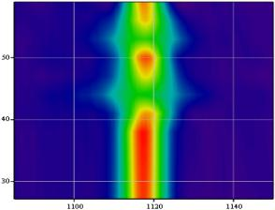
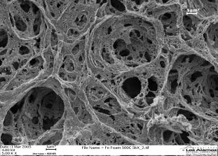
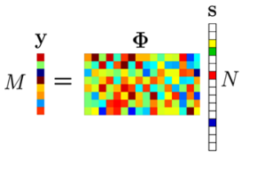
Topic Areas
© 2007 Ned Batchelder
Supervised Autonomy
Development of theory, tools, and components to enable extended autonomous activity in unstructured, infrastructure-poor environments
Novel Sensing and Detection
New approaches to sensing and detecting CBRNE materials and devices
Harnessing Complexity
Exploration of the science of complexity, and its application to new engineering paradigms
© Robert Llewellyn/Corbis
Transformative Materials
Decoupling and control of countervailing material properties; design and fabrication of new materials across multiple length scales
Physical Sciences
Exploration of scientific breakthroughs and boundaries that enable unique capabilities for national security
Mathematics
Development of advanced mathematics and modeling tools
Distribution Statement “A” (Approved for Public Release, Distribution Unlimited)
Notes:
Sources: http://www.aerogel.org/?p=932

Slide 11
DSO Office-wide BAA is a formal access point to communicate new ideas to DSO PMs
1-year-long office wide BAA; designated BAA coordinator and email address
Does not supersede program BAAs
Executive summaries, abstracts, and proposals
Can you come in and discuss your idea? YES, but please submit the executive summary first so we know who is best aligned to hear from you, and so we can maintain a record of your submittal.
Submit 5-page Abstract
Submit 1-page Executive Summary
Feedback indicates interest
Submit Proposal
Feedback encourages proposal
Distribution Statement “A” (Approved for Public Release, Distribution Unlimited)

Slide 12
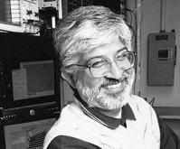
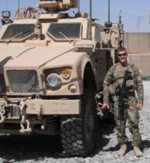
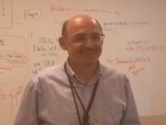
Program Managers
Fariba Fahroo
Mathematics
Mark Micire
Robotics
James Gimlett
Physics
Prem Kumar
Quantum and Nonlinear Optics
Judah Goldwasser
Structural Materials
Doran Michels
Ground Combat Systems
Michael Maher
Materials and Manufacturing
Gill Pratt
Robotics and Neuromorphic Systems
John Main
Material System Innovation
Tyler McQuade
Chemistry
Predrag Milojkovic
Imaging and Optics
Reza Ghanadan
Complexity Science
Vincent Tang
Applied Physics
Distribution Statement “A” (Approved for Public Release, Distribution Unlimited)
12
Notes:
3 columns
Look up Bios….

Slide 13
Responses to Executive Summaries and Abstracts
No-Interest/Discourage indicates:
The submission does not present an approach to developing technology that is aligned with the DARPA/DSO focus areas and interests.
The submission is not important to DSO’s areas of responsibility as outlined in the BAA.
The submission does not substantiate a revolutionary national security capability within the DSO portfolio.
The proposed approach does not clearly identify current limitations that would be overcome.
The submission does not identify barriers to implementing new operational concepts and postulate solutions.
The submission does not convey technology significantly beyond the state of the art.
It does NOT mean that you cannot resubmit or that you cannot submit a full proposal... BUT you should strongly consider the Government assessment before expending more resources.
Distribution Statement “A” (Approved for Public Release, Distribution Unlimited)

Slide 14
Responses to Executive Summaries and Abstracts
Interest/Encourage means:
We find your idea interesting and we would like to know more.
It does NOT mean that you are funded or that a full proposal will be accepted.
Funding potential:
Intent is to fund seedlings
Efforts larger than seedlings are rare, but may occur for efforts that support or lead to multiple programs.
Distribution Statement “A” (Approved for Public Release, Distribution Unlimited)

Slide 15
General Advice
DO read the BAA-14-46 document in its entirety.
DO use the executive summary and abstract process.
If you are submitting a full proposal, read BAA-14-46 through again, and especially the Evaluation Criteria.
DO forward any questions related to the DARPA/DSO Office Wide BAA to DARPA-BAA-14-46@darpa.mil.
If you have no response after 7 weeks, DO email the Office-Wide BAA to check status.
Distribution Statement “A” (Approved for Public Release, Distribution Unlimited)

Slide 16
Backups

Slide 17
Looking to the Future
National Security Landscape
Wide range of national security challenges:
from nation states
to diffuse, shifting terror networks
Globally available technologies
Cost as a major factor in choices about operational capabilities
DARPA Approaches
Game-changing new systems
Layered, multi-technology systems
Catalyzing new national technology capabilities
Exploiting commercially available technologies
Adaptable solutions
Inverting the cost equation
DISTRIBUTION F: Further dissemination only as directed by DARPA Public Release Center or higher DoD authority

Slide 18
DSO Office History
1960 Nuclear Monitoring
1980 Defense Sciences
1960 Materials Sciences
1976 Cybernetic Technology
2014 Biological Technology
1958 Solid Propellants
1963
1992 Microelectronics Technology
1995
1999 Microsystems Technology
1985 Engineering Applications
1989 Defense Manufacturing
1992
1987
1990 Electronic Systems Technology
1963 Information Sciences & Technology (now Information Innovation)
Distribution Statement “A” (Approved for Public Release, Distribution Unlimited)

Slide 19
National Security Challenges
Wide range of national security challenges: evolving nation states, shifting networks
Can we counter the diversity of national security threats by rapidly accelerating scientific discovery and innovation?
Can we better detect and manage CBRNE materials to counter threats arising from the erosion of boundaries?
Powerful, globally available technologies set at a fast pace
Can we speed the creation of new capabilities and remove technology barriers to rapid or low volume production?
Military systems’ cost, pace, and inflexibility limit our operational capabilities
Can we harness complexity and manage uncertainty/risk in the systems we build?
Distribution Statement “A” (Approved for Public Release, Distribution Unlimited)

