Slide 1

CAREER Program Development
2013 NSF CAREER Proposal Writing Workshop
University of South Florida
CAREER Proposal Writing Workshop
Notes:
1

Slide 2
Workshop Goals
Provide potential CAREER awardees with recommendations on developing a competitive CAREER proposal
  What is a CAREER proposal? The Larger Context
    DOs and DON’Ts
  Getting a Research Topic
  Finding a Home
  Writing the Summary
  Intellectual Merit and Broader Impacts
  The NSF merit review process
  Ethics
  Supplements
  Progress/Final Reports
  Getting Involved

Slide 3
CAREER Program
“A Foundation-wide activity that offers the National Science Foundation’s most prestigious awards in support of junior faculty who exemplify the role of teacher-scholars through outstanding research, excellent education and the integration of education and research within the context of the mission of their organizations.”

Slide 4
CAREER Award
Funds the academic career development of new faculty (it is not a research award)
Is based on a development plan, ”a well-argued and specific proposal for activities that will, over a 5-year period, build a firm foundation for a lifetime of contributions to research and education”
Duration: 5 years
Min (in most programs, it’s also a max.) amount: $400,000
Deadline for Engineering: July 23, 2013 (for other directorates, see solicitation)

Slide 5
What’s New for 2013?
Cover sheet requiring certification of eligibility has been removed
Restriction placed on the content allowed in letters of collaboration, 1 page max
Length of departmental letter, 2 pages, must include specific elements
Minimum grant size in OPP, $500K
Details on international/global dimensions and cross-disciplinary activities
Removal of requirement for yearly departmental letter with annual report

Slide 6
What’s New for 2013?
The same as 2011 and 2012, but beware, the Grant Proposal Guide has changed
Award size and duration stays the same
Eligibility stays the same
  Untenured Assistant Professor <Oct. 1
  Must hold doctorate degree <deadline
  Not Associate Professor
  No citizenship requirements (except PECASE)
  Limit 3 applications
Program solicitation number NSF 11-690
Don’t believe me – read the solicitation

Slide 7
You
Who are you?
  Your expertise/interests
  Your career/life goals
  Your position/resources
Your proposal should fit into your life plan
What is your life plan? Do you need to develop a strategic plan?

Slide 8
Your Strategic Plan
A strategic plan has three parts:
  Where are you today?
  Where do you want to be in the future (5, 10, 20 years from now)?
  How do you get from here to there?
A strategic plan is a roadmap for your life

Slide 9
Your Proposal
Should advance you toward your life goals
  Should be a stepping stone to the next thing
Should be compatible with your institution’s goals
Should represent a contribution to society at large
Test: If you accomplish your objectives, are you better off for the effort?

Slide 10
DOs
Have a strategic plan
Build on your strengths
Differentiate this proposal from your Ph.D. thesis work and other sponsored work
Perform thorough literature search and exploratory research before writing the proposal
  Journal articles (update with personal contact)
  Read the NSF Grant Proposal Guide (GPG)
Establish and keep your contacts

Slide 11
DON’Ts
Rush
Wait until last minute (1 month) to contact program directors
Make the proposed work (research and education) too broad
Make the proposed work too narrow
Ask for too much (or too little) money
Ignore rules (Grant Proposal Guide) and misc. items – violation of the GPG requirements will result in return without review

Slide 12
Proposal Basics
Write to the reviewers (not to me and not to yourself)
Your proposal will be judged by the reviewers
Reviewers want to know four things:
  What is it about (the research objective)?
  How will you do it (the technical approach)?
  Can you do it (you and your facilities)?
  Is it worth doing (intellectual merit and broader impact)?
This is, basically, all the proposal needs to convey – but it needs to convey this

Slide 13
Getting a Research Topic
CAREER Proposal Writing Workshop
Notes:
1

Slide 14
Beware!
The CAREER award is NOT a research award
The CAREER award is a career development award
Your proposal must reflect this focus
Notes:
2

Slide 15
NSF
We look for proposals that
  Are innovative and push the frontiers of knowledge
  Contribute to national needs and priorities
  Go beyond marginalia
  Integrate research and educational goals well
  Actually involve research
We do not support (except as incidental to the goals of the award)
  Developmental efforts
  Computer programming
  Design of…
  Commercialization
Notes:
2

Slide 16
The CAREER Research Topic
The CAREER proposal is not a research proposal
The CAREER proposal is a proposal detailing how you will spend $400,000 to enhance your career development
Your career involves a research path, not a research project
Determine your research path - your lifelong research goals - and then identify milestones toward your goals
Detail the first one or two as the research projects for your CAREER proposal

Slide 17
Your CAREER Research Path
Lifelong research goals
  Don’t end with a single project
  May never end
  Have broad application
Examples:
  To improve our ability to make engineering decisions under uncertainty and risk
  To perform large-scale modeling of engineering systems thereby enabling better system optimization
  To improve our understanding of metal cutting operations enabling improvements in machining

Slide 18
The Selected Research Topic
It must be research
It must not have been done before
It must be significant
There must be higher than probability zero that you can do it (no perpetual motion machines, no fuzzy logic)
It must lend itself to a viable research plan – there is a research methodology
You must have access to the facilities to accomplish the research
It should fit into your strategic plan

Slide 19
What is Research?
Research is the process of finding out something that we (everyone) don’t already know
Scientific research builds upon the extant knowledge base and it is methodical, repeatable and verifiable
  Methodical - you can specify in advance of the research a method to accomplish your objective
  Repeatable - not a “strange” (random) event
  Verifiable - tangible evidence

Slide 20
What is Research?
Research is the process of finding out something that we (everyone) don’t already know
Scientific research builds upon the extant knowledge base and it is methodical, repeatable and verifiable
Question: Exactly what will your research contribute to the knowledge base?

Slide 21
What is Research?
If your proposal focuses an artifact, it’s probably development, if it focuses knowledge, it’s likely to be research
Ref: Research 101 for Engineers

Slide 22
Groundwork
Know your field:
  What is the current state-of-the-art
  Who are the top ten researchers
  What they are doing right now
  Where they get their funding
  What they consider to be the key research issues
  Who would likely review your proposal
  What are the grant opportunities

Slide 23
The Research Objective
This is probably the hardest part of the proposal
Examples of what not to write:
  The research objective of this project is to create novel new transformational knowledge.
  The objective of my research is to provide a quantum leap in the design of anti-gravity boots.
  The goal of this project is to develop an integrated modeling tool for the hardening process.
  The goal of this project is to develop innovative advances to enhance wire sawing processes.
  Rapid prototyping machines are an important part of the vast array of tools. It is very important that we improve these machines. Rapid prototyping will form the backbone of manufacturing in the future.

Slide 24
The Research Objective
How to do it right:
  The research objective of this project is to measure the cross-section of the muon-nutrino interaction at 5 GeV accurate to 5%.
  The research objective of this proposal is to test the hypothesis that physical phenomena x,y,z dominate the chip formation process in the machining of brittle materials.
  The research goal of this project is to account for uncertainty in engineering design decision making through the application of utility theory.

Slide 25
The Research Objective
A well-stated objective leads one directly to the approach that must be taken to accomplish the objective

Slide 26
The Research Objective
Four acceptable ways to do it right:
  The research objective of this proposal is to test the hypothesis H.
  The research objective of this proposal is to measure parameter P with accuracy A.
  The research objective of this proposal is to prove conjecture C.
  The research objective of this proposal is to apply method M from field Q to solve problem X in field R.

Slide 27
Hypothesis Testing
If you are going to do an hypothesis test, you need to learn to do it right
  You must state a testable hypothesis—one for which you can write a plan
  Recognize that you can falsify the hypothesis or fail to prove it—generally a well stated hypothesis cannot be proven true
  The test of the hypothesis needs to be well planned
  Ref: Karl Popper

Slide 28
Hypothesis Example
Force is proportional to rate of change of momentum (F=ma)
The model fills the space
F
Each data point is a point, n points fill nothing
One valid outlier disproves the hypothesis
Ergo, we only disprove hypotheses
We accept an hypotheses only after repeated attempts to disprove it fail
ma

Slide 29
The Research Objective
Do not use words that mean “not research”
  Develop
  Design
  Optimize
  Control
  Manage
Use of words such as these gives the reviewers the impression that you are not doing research, there is no innovation, nothing is new, etc. – your ratings will be lower

Slide 30
The Research Objective
Doing it right:
  Frame your research: “My research goal is…”
  Then: “As a step toward this goal, the research objective(s) of this CAREER proposal is(are)...”
  Limit: 25 words or less
  Be specific about your research objective
  Note - if you are specific, the research methodology will follow directly
  Be sure your statement is comprehensible
  Put it up front - sentence one, paragraph one, page one
  Do not give a weather report or state-of-the-union address

Slide 31
Beyond the Research Objective
Your proposal must address four critical questions that reviewers will face:
  What is the proposal about?
    Be sure to include clear statements of both research and educational objectives
  Will the proposed approach accomplish the stated objectives?
    Be sure the reviewers are evaluating your approach based on your objectives
  Can the PI carry out the proposed approach?
    Preliminary results and previous work argue this
  Is it worth doing?
    Make the argument through the intellectual merit and broader impact statements

Slide 32
Finding a Home
CAREER Proposal Writing Workshop
Notes:
1

Slide 33
Questions
Is your “research” research?
  If it isn’t, it doesn’t belong at NSF
If the answer is “no,” skip to the end, look for support from other sources
If the answer is “yes,” what is your research objective?
  The right NSF home for your research depends on the your research objective, not on the application of your research
  Be prepared to answer the question: “What is your research objective?” (25 words or less)
NSF does not support applications studies

Slide 34
Your Funding Base
NSF should not be the sole source of funding for your area of research
  Internal support
  State support
  Industry support
  Other Federal agency support
List the potential funding sources for your research area

Slide 35
NSF is Organized Around Research Topics
Staff Offices
National Science Board
Office of the
Inspector General
Director
Directorate for
Computer and
Information
Science and
Engineering
Directorate for
Administration
Directorate for
Biological
Sciences
Directorate for
Education and
Human
Resources
Directorate for
Social,
Behavioral,
and Economic
Sciences
Directorate for
Engineering
Directorate for
Geosciences
Directorate for
Mathematical
and Physical
Sciences

Slide 36
ENG Organization
Office of the Assistant Director
Deputy Assistant Director
(OAD)
Emerging Frontiers
in Research and
Innovation (EFRI)
Senior Advisor
Nanotechnology
Engineering
Education and
Centers
(EEC)
Civil,
Mechanical, and
Manufacturing
Innovation
(CMMI)
Chemical,
Bioengineering,
Environmental,
And Transport
Systems
(CBET)
Electrical,
Communications
and Cyber
Systems
(ECCS)
Industrial
Innovation and
Partnerships
(IIP)
Notes:
“Enabling the nation’s future through discovery, learning, and innovation.”
By design, this vision captures the dynamism that has shaped NSF’s history. It’s no accident that terms like discovery, learning, and innovation are all resting side-by-side in the same set of words. You’ll see them again later when we focus on engineering.
An our strategic goals to fulfill the mission in three words: People, Ideas and Tools. And order is important!

Slide 37
The Next Step
Look up NSF’s web site: www.nsf.gov
  Check out research programs, read what research topics they support
Then call the appropriate program officers
  Be prepared to answer the question: “What is your research objective?” (25 words or less)
NSF does not support applications studies

Slide 38
Should I Meet My Program Officer?
Why? What do you intend to gain?
Or is your goal to schmooze? (It doesn’t help)
  Don’t even think about taking your program officer to lunch
If you decide to meet:
  Be prepared to listen (you don’t learn by talking)
  Be prepared with questions
  Remember, the program officer is not the panel
  You can get a free trip to NSF (more later)

Slide 39
Important Questions
Does my research objective fit well with your program?
What is your funding policy for CAREER awards? What is the maximum size of your CAREER awards? (Remember, the minimum is $400,000)
How are CAREER proposals submitted to your program reviewed?

Slide 40
Questions You Shouldn’t Ask a Program Director
Is NSF interested in my topic?
So, will you fund my research?
Is this a good research topic?
What research topic do you think I should work on?
What are my odds?
But this is my last chance, what can I do?
If I send a copy of my proposal to you, will you help me edit it?

Slide 41
Catch 22
My research doesn’t fit in any single NSF program, how about joint submission/review?
  Did you formulate a clear research objective?
  Is your research objective too broad?
  Do you want to consider focusing your scope?
Suppose my research really does span multiple programs?
  Contact all relevant program directors

Slide 42
How Could a Meeting Help?
Your program director can:
  Give advice on proposal submission
  Help you understand the review of a previous proposal
  Point you to resources you can use to help write a better proposal next time
  Give general guidance on good proposal writing
  Give you ideas for collaborations
Program officers look forward to constructive meetings with PIs

Slide 43
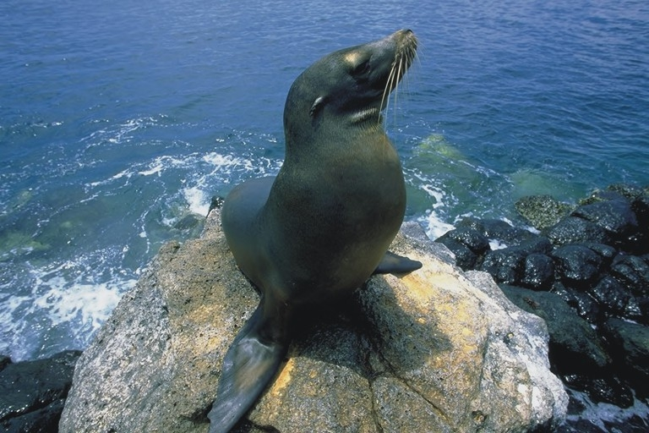
Could a Meeting Help?
Note - you learn by listening, not by talking. So shut up and listen.

Slide 44
Writing the Summary
CAREER Proposal Writing Workshop
Notes:
1

Slide 45
Writing the Summary
The most important statement is the statement of your proposed objectives
  It should be at the very beginning
  Do not begin with a weather report: “The sky is falling. Tools are breaking. Designs are failing…”
  Do not begin with a state-of-the-union address: “It is imperative that the nation develop a strong manufacturing base…”
Remember, this is not a tech paper, it is not a murder mystery (where we find out what the objective is on page 15)
Your Intellectual Merit and Broader Impact statements are important

Slide 46
The Summary Page
First paragraph
  My long-term research goal is…
  In pursuit of this goal, the research objective of this CAREER proposal is…
  The research approach is…
Second paragraph
  My long-term educational goal is…
  In pursuit of this goal, the educational objective of this CAREER proposal is…
  The educational approach is…
Third and fourth paragraphs – must use template
  Intellectual Merit
  Broader Impact
Anything else will lower your rating

Slide 47
What We Want to Know
What are your research and educational objectives?
  This is what directs your proposal to the appropriate program
What is your approach?
  Outline — just a few sentences
What is the specific research contribution you will make to the knowledge base (the intellectual merit)?
If successful, what will be the benefit to society (the broader impact)?

Slide 48
The Summary
The summary is now entered via a template that allows three blocks, total 4096 characters (a space is a character)
  A summary paragraph (you can make it two paragraphs)
  An Intellectual Merit paragraph
  A Broader Impacts paragraph
The summary page will be automatically formatted
Be sure it fits on the one page allowed

Slide 49
The Rest of Your Proposal
The next 15 pages of your proposal give backup and detail to your summary
Start with a restatement of your goals and objectives, clarify them, and provide a plan to accomplish them
  Task statements should actually detail the tasks needed to accomplish your objectives
  Tasks should conform to objectives 1-to-1
Restate and provide detail on your intellectual merit and broader impact
This is a good time to put forth your best effort

Slide 50
Tips on Proposal Writing
Use only 12 point type (approved fonts only)
Do not use figures or tables as filler - everything should contribute
Everything should be legible - do not use 2-point type on figures or tables
Be sure to explain exactly what is your contribution to the knowledge base
Use only the required format
Be sure to include intellectual merit and broader impact statements in the body of the proposal—a separate broader impact statement is now required

Slide 51
Tips on Proposal Writing
Don’t include letters of collaboration if
  They aren’t letters of collaboration
  Multiple letters are identical
  They are letters from previous proposals
  They are letters of recommendation
  They are more than one page in length
Don’t cut and paste together your new proposal from old declined proposals
Submit your proposal early, download it, proofread it and correct it if necessary before the deadline

Slide 52
Mentoring for Postdoctoral Researchers
All proposals submitted after April 6, 2009, that include funding to support postdoctoral researchers must include as a supplementary document a 1-page description of the mentoring activities that will be provided for such individuals.
Mentoring activities may include:
  Career counseling;
  Training in preparation of grant proposals;
  Publications and presentations;
  Guidance on ways to improve teaching and mentoring skills;
  Guidance on how to effectively collaborate with researchers from diverse backgrounds and disciplinary areas; and
  Training in responsible professional practices.

Slide 53
Mentoring for Postdoctoral Researchers (Cont’d)
Proposed mentoring activities will be evaluated as part of the merit review process under the Foundation's broader impacts merit review criterion.
Proposals that do not include a mentoring plan will be returned without review.

Slide 54
Follow the NSF Guidelines
Proposal & Award Policies & Procedures Guide (PAPPG)
  Grant Proposal Guide (GPG)
Program Solicitation
Budget guidelines

Slide 55
Grant Proposal Guide (GPG)
Provides guidance for preparation and submission of proposals to NSF;
  Allowable fonts, margins, page limits, bio format, etc.
  Process for deviations from the GPG (there will be none)
  Process and criteria by which proposals will be reviewed
  Reasons why a proposal may be returned without review
  Reconsideration process
  Process for withdrawals, returns & declinations
  Award process and procedures for requesting continued support
  Budget line item definitions
  Process for submission of collaborative proposals (subawards and multiple proposals)

Slide 56
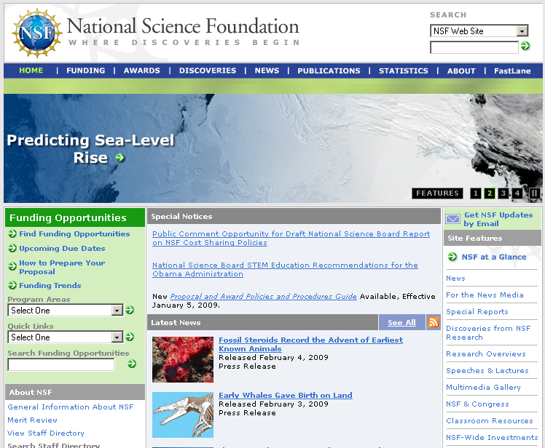
www.nsf.gov

Slide 57
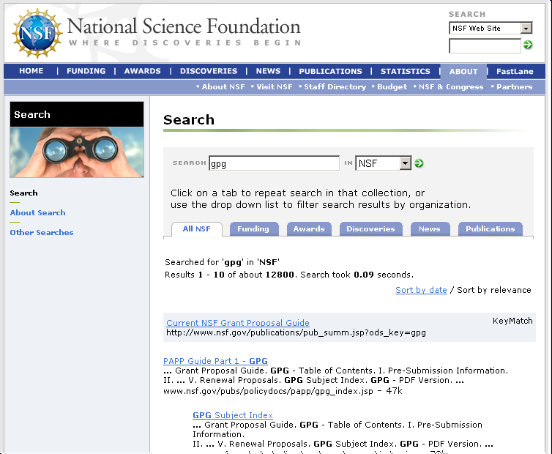
Search on GPG

Slide 58
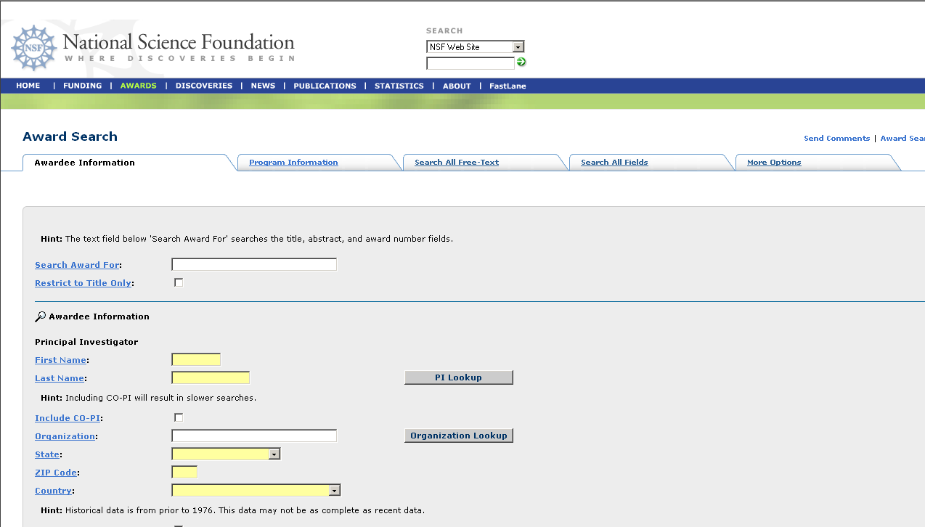
Award Search Capabilities

Slide 59
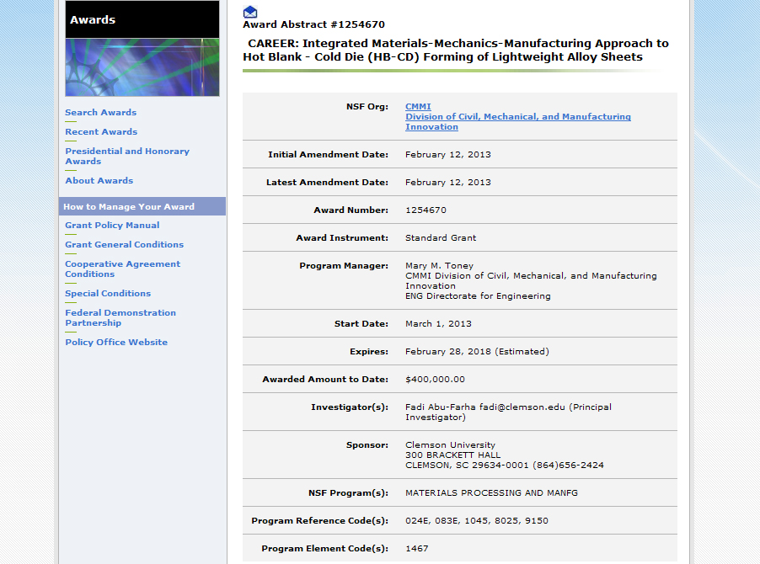
Award Data

Slide 60
Award Abstracts

Slide 61
Intellectual Merit and Broader Impact Statements
CAREER Proposal Writing Workshop
Notes:
1

Slide 62
IM and BI Statements
They are required
Your proposal will be rated based on them
But:
  What are they?
  What should you include?
  How should they shape your proposal?

Slide 63
Intellectual Merit
The Intellectual Merit is the contribution that your research makes to the knowledge base
Questions:
  What is already known?
  What is new?
  What will your research add?
  What will this do to enhance or enable research in your or other fields?
Why is your research important for the advancement of your field?

Slide 64
Broader Impact
The Broader Impact focuses on the benefit to society at large as a result of your research result
Means to benefit society include:
  Economic/environment/energy
  Education and training
  Providing opportunities for underrepresented groups
  Improving research and education infrastructure
The key issue is how your research results will be applied — why would the general public care?

Slide 65
Summary Template
My research goal is… In pursuit of this goal, the research objective of this CAREER proposal is to test the hypothesis that the propensity of a tree to break is directly proportional to how many monkeys are in the tree. The approach will be to take a sample of ten trees and load them with monkeys until they break…
My educational goal is… In pursuit of this goal, the education objectives of this CAREER proposal are… The approach to accomplishing these objectives will be…
Intellectual Merit – It is important that we know how many monkeys can climb a tree before it breaks because this affects our perceptions of monkey procreation and… The Snerd Theory holds that tree size limits monkey procreation. This study challenges that theory with the notion that… If the objective hypothesis is correct therefore, it will transform our approach to…
Broader Impact – Monkeys are used in medical research. By knowing how many monkeys can fit in a tree, we will be able to provide more monkeys for such research thereby advancing medical science more quickly and improving the quality of life. Also, by watching the monkeys get hurt when the tree breaks, graduate students will be less likely to climb trees, thereby increasing their probability of graduating.

Slide 66
Education
Undergraduate
  Curriculum
  Projects (REUs)
Graduate
  Curriculum
  Conferences
  Involvement with industry, national labs
Networks, partnerships
K-12 outreach (RETs)
Museum projects
Should not be a boiler plate, pick and choose

Slide 67

Education—a Reference
You can download this document for free from:
http://www.faa.gov/regulations_policies/handbooks_manuals/aviation/aviation_instructors_handbook/

Slide 68
Caution
Your goals, objectives and approach should drive the proposal, not the need for Intellectual Merit and Broader Impact statements.
Notes:
2

Slide 69
The NSF Merit Review Process
Notes:
1

Slide 70
Proposal Processing Timeline
Deadline or Target date
Assigned to program
Program-to-program trades
Set up panels or send out for ad hoc review
Conduct panels
Review panel results/make decisions
Document recommendations
DD concur
0
1
2
3
4
5
6
Time, months

Slide 71
Merit Review
Process: ad hoc only, panel only, combination
Reviews obtained from non-conflicted experts—at least three required, more typical
Ad hoc only: PD makes funding recommendation to DD
Panel: Panel makes recommendation to PD, PD makes funding recommendation to DD
DD concurs on recommendation—end of process for declinations
DGA makes an award

Slide 72
Ethics
Notes:
1

Slide 73
Breach of Ethics
People who submit proposals to the Federal Government (e.g., to NSF) are held to high standards
A breach of ethics can lead to
  Being barred from submitting proposals
  Fines
  Jail time
  Really being on the outs with your institution – getting fired, losing tenure
Violation of some ethics laws is a felony

Slide 74
Forms of Misconduct
Plagiarism - material copied without citation and quotation - if you copy it, cite it and off-set it; if you accept an award based on a proposal that includes plagiarism, you may have committed a felony
Charge for work already done - can be a felony, do not charge twice for the same work
Falsification of data and reports - changing data or results - be honest in all your annual and final reports and papers
Fabrication - making stuff up - report only what is true and accurate

Slide 75
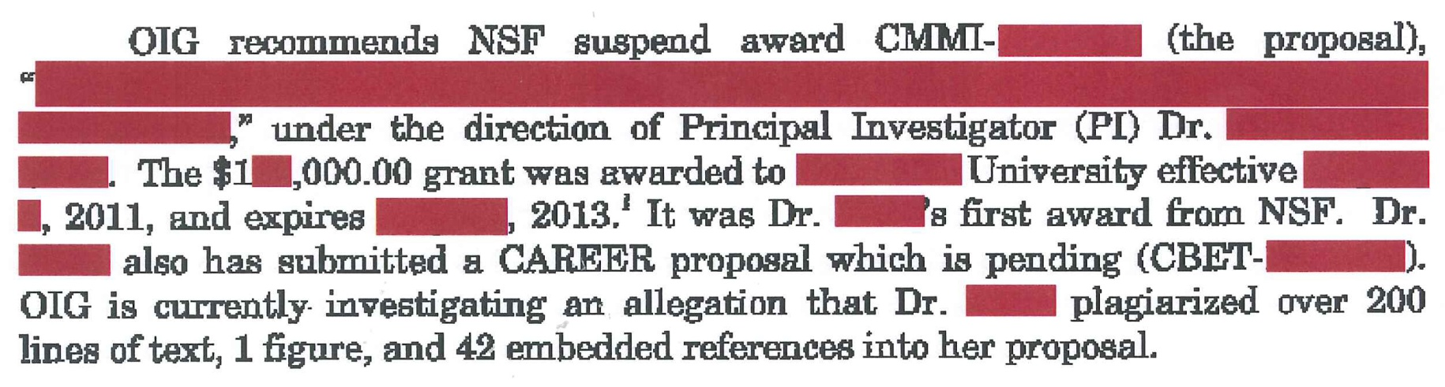
Plagiarism
THIS IS A POTENTIAL FELONY!!!

Slide 76
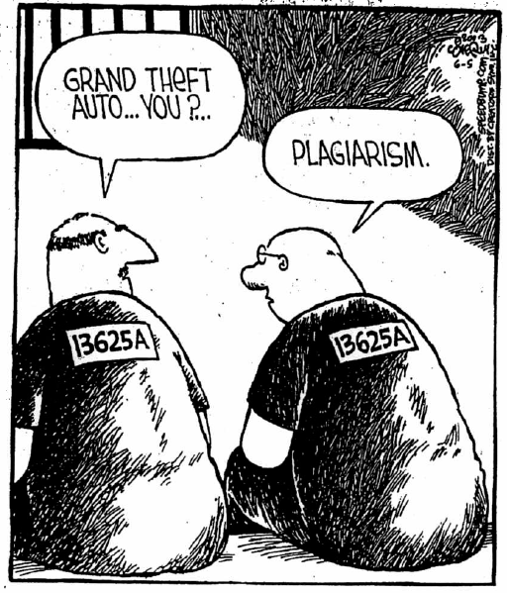
Actual PI Responses
“It’s only a proposal. It’s not like it’s a publication.”
“The reviewers are smart enough to know what is my work and what is someone else’s.”
“My English teacher told me it’s not plagiarism if I change every seventh word.”
“It’s not plagiarism; it’s just bad citation.”
“It got funded before.”
“I didn't have space for all the citations.”
“I didn’t do it. My grad student/ undergraduate/ postdoc/grant writer/faculty colleague/secretary/ Co-PI/SRO/AOR/VP of Research/Dean/spouse wrote that section.”
“It was ‘an act of lamentable carelessness’ and therefore not misconduct.”
“Severe acid reflux.”
SPEED BUMP, Dave Coverly

Slide 77
Examples
False charges
  Never pad travel
  Never commingle funds
    Don’t mix business and pleasure expenses
    Don’t mix grant funds and personal business expenses
  Never charge for time not spent on a grant
  Never bill items to your grant that shouldn’t be billed to the grant
  Never bill alcohol or entertainment to a grant
  Never charge give-aways to a grant

Slide 78
Misconduct
Chemical & Engineering News, Feb. 13, 2012—Federal prosecutors have charged a leading materials scientist with wire fraud, making false statements, and money laundering. The researcher, Craig A. Grimes, formerly an electrical engineering professor at Pennsylvania State University, defrauded federal agencies of some $3 million in research grants, the prosecutors say… Prosecutors also say Grimes applied for and accepted an ARPA-E grant for his solar work, while failing to disclose that the National Science Foundation had already funded the same research. Both agencies prohibit such grant duplication.
Sentenced to 41 months in federal prison

Slide 79
Examples, continued
Breech of confidentiality - never divulge confidential information
  Ideas conveyed in proposals
  Names of panelists
  Names of PIs
  Never use information that you received in confidence
Plagiarism is bad, plagiarism from a proposal you reviewed is a breach of confidence—much worse

Slide 80
Recommendation Letters
It is against the law for an employee of the Federal Government to represent a third party to the Government
That means it is illegal for a Government employee to write a letter of recommendation for you
Don’t ask – many Government employees don’t know this law, you can get them into a lot of trouble
PS: Recommendation letters are not permitted in a CAREER proposal

Slide 81
Ethics Training
It is highly recommended that you give your student researchers training in ethics - this protects you in an event of their indiscretion
Do it with all your students
Do it before they have a chance to do something bad
Ask them to sign a letter of recognition that you have provided ethics training, that it covers specific elements of ethics, and that they know that you expect appropriate behavior

Slide 82
Sticky Issues
You collaborate with a senior faculty person to write a proposal
You get an award
You later find that your collaborator plagiarized materials that are in the proposal
You should
  Consult with your institutional ethics person
  Report the matter to the NSF Inspector General
  Continue to work on the grant
You will not be held accountable for another faculty member’s bad behavior

Slide 83
Reference
OMB Circular A-110
CIRCULAR A-110
REVISED 11/19/93
As Further Amended 9/30/99
TO THE HEADS OF EXECUTIVE DEPARTMENTS AND ESTABLISHMENTS
SUBJECT:
Uniform Administrative Requirements for Grants and Agreements With Institutions of Higher Education, Hospitals, and Other Non-Profit Organizations
1. Purpose. This Circular sets forth standards for obtaining consistency and uniformity among Federal agencies in the administration of grants to and agreements with institutions of higher education, hospitals, and other non-profit organizations.
2. Authority. Circular A-110 is issued under the authority of 31 U.S.C. 503 (the Chief Financial Officers Act), 31 U.S.C. 1111, 41 U.S.C. 405 (the Office of Federal Procurement Policy Act), Reorganization Plan No. 2 of 1970, and E.O. 11541 ("Prescribing the Duties of the Office of Management and Budget and the Domestic Policy Council in the Executive Office of the President").
3. Policy. Except as provided herein, the standards set forth in this Circular are applicable to all Federal agencies. If any statute specifically prescribes policies or specific requirements that differ from the standards provided herein, the provisions of the statute shall govern.
The provisions of the sections of this Circular shall be applied by Federal agencies to recipients. Recipients shall apply the provisions of this Circular to subrecipients performing substantive work under grants and agreements that are passed through or awarded by the primary recipient, if such subrecipients are organizations described in paragraph 1.

Slide 84
Parting Thoughts
Remember, if your grad student writes your proposals, you are responsible for their content, and you are the person in trouble if there is a breach of ethics
You have worked hard to establish your career, don’t ruin it by a breach of ethics
Notes:
2

Slide 85
Supplements
Notes:
1

Slide 86
Beyond the Award
Beyond the award there are supplements
  REU (Research Experience for Undergraduates): nominally one student per award (two, provided one is from an under-represented group), does NOT include equipment
  RET (Research Experience for Teachers): $10,000 to involve a K-12 teacher in your research
  Initiating international collaborations (Office of International Science and Engineering)
  Informal education (EHR)

Slide 87
Supplemental Requests
Contact your program director first!
Must be submitted via FastLane
Must include a budget
Should be submitted early in the fiscal year (while we still have money) or to meet announcement deadlines
Don’t even think about asking for a supplement if you’re not up to date on your progress reports
Notes:
2

Slide 88
Progress/Final Reports
Notes:
1

Slide 89
Annual Reports
Annual reports are required for ALL grants (standard or continuing)
  This includes: unsolicited, CAREER, MRI, special initiatives, …
  This includes grants that are beyond their initial active period, i.e., grants that are in a no-cost extension period
Annual reports must be submitted via FastLane 90 days PRIOR to anniversary (or by May 1^{st,} whichever is sooner, for continuing grants)
Annual reports MUST be submitted in the order in which they are due as they build upon previous report(s)

Slide 90
Annual Reports
No annual report = no increments, no supplements, no no-cost extensions, no new awards (for PIs or Co-PIs)
Be sure to use FastLane format — pdf attachments are ok
REU supplement during reporting period - make sure to report activity under role of Research Experience for Undergraduates in PARTICIPANT section (this is different than role of undergraduate student)

Slide 91
Final Reports
All grants require a final report
All final reports must be filed using FastLane
Final reports are due not later than 90 days after the expiration date of the grant
You must use the FastLane format
PENALTY!!! You cannot get another grant or a supplement if you or a co-PI have an overdue final report
Warning – the grant is over when the final report is approved

Slide 92
Warning!!!
NSF money is good for six years. After that, it turns into a pumpkin – plan to spend all money within six years.
Notes:
2

Slide 93
Getting Involved
CAREER Proposal Writing Workshop
Notes:
1

Slide 94
Be A Reviewer
Proposal review is an important service to your community
There’s no better way to see how the system works
There’s no better way to understand what makes a winning proposal
If you think the system is unfair, try being part of it

Slide 95
How to Volunteer
Contact your program director
E-mail a brief (1-page) bio to your program director
Be sure to include your contact information
Indicate your areas of expertise
This will get you an expense-paid trip to visit your program director

Slide 96
12 Steps to a Better Proposal
Know yourself - strengths/weaknesses
Know the program from which you seek support
Read the program announcement and GPG
Formulate clear and appropriate research and education objectives
Develop a viable plan to accomplish your stated objectives
State your objectives up front in your proposal
Frame your project around the work of others

Slide 97
12 Steps to a Better Proposal
8. Grammar and spelling count
9. Format and brevity are important
10. Know the review process
11. Proof read the proposal before you submit it
12. Submit your proposal early and proof read it after you submit it
Writing a good proposal takes common sense and effort—it’s not magic

Slide 98
Questions
It’s always better to ask before you submit a proposal than after you get the reviews
Remember, we’re from the government, and we’re here to help
http://www.nsf.gov

