Slide 1
CAREER Workshop April 6, 2015
FLORIDA STATE UNIVERSITY
Selecting a Program
Michael Shatruk
Chemistry & Biochemistry
Ken Knappenberger
Chemistry & Biochemistry

Slide 2
Staff Offices
National Science Board
Office of the Inspector General
Director
Directorate for Computer and Information
Science and
Engineering
Directorate for Administration
Directorate for
Biological
Sciences
Directorate for
Education and
Human
Resources
Directorate for
Social,
Behavioral,
and Economic
Sciences
Directorate for
Engineering
Directorate for
Geosciences
Directorate for
Mathematical
and Physical
Sciences

Slide 3
NSF has a hierarchical organizational structure
Directorate
Division
Program
Mathematical & Physical Sciences (MPS)
Astronomical Sciences (AST)
Chemistry (CHE)
Chemical Catalysis (CAT)
Chemical Measurement & Imaging (CMI)
Chemical Structure, Dynamics and Mechanisms (CSDM-A)
Chemical Structure, Dynamics and Mechanisms (CSDM-B)
Chemical Synthesis (SYN)
Chemical Theory, Models, and Computational Methods (CTMC)
Chemistry of Life Processes (CLP)
Environmental Chemical Sciences (ECS)
Macromolecular, Supramolecular and Nanochemistry (MSN)
Materials Research (DMR)
Mathematical Sciences (DMS)
Physics (PHY)

Slide 4
ENG Organization
Office of the Assistant Director
Deputy Assistant Director
(OAD)
Emerging Frontiers
in Research and
Innovation (EFRI)
Senior Advisor
Nanotechnology
Engineering
Education and
Centers
(EEC)
Civil,
Mechanical, and
Manufacturing
Innovation
(CMMI)
Chemical,
Bioengineering,
Environmental,
And Transport
Systems
(CBET)
Electrical,
Communications
and Cyber
Systems
(ECCS)
Industrial
Innovation and
Partnerships
(IIP)

Slide 5
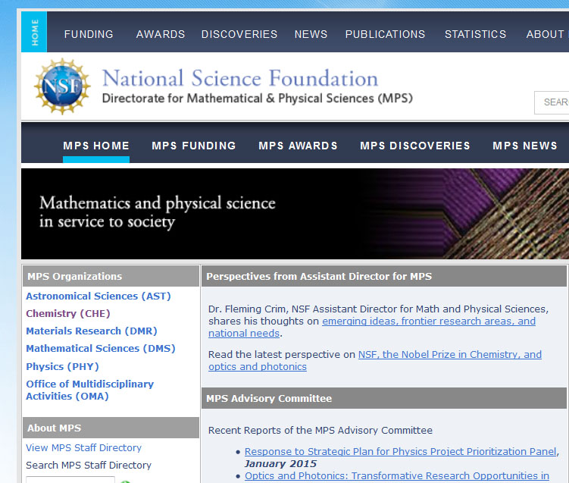

Slide 6
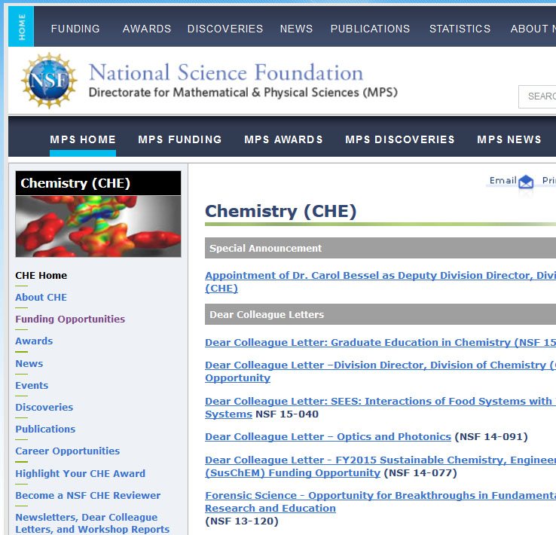

Slide 7
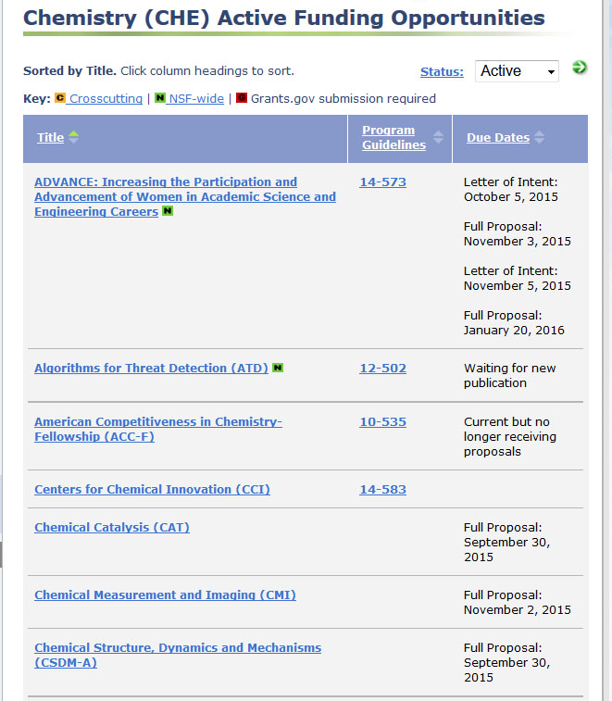
A regularly updated list of funding calls
Contains both recurring and one-time solicitations

Slide 8
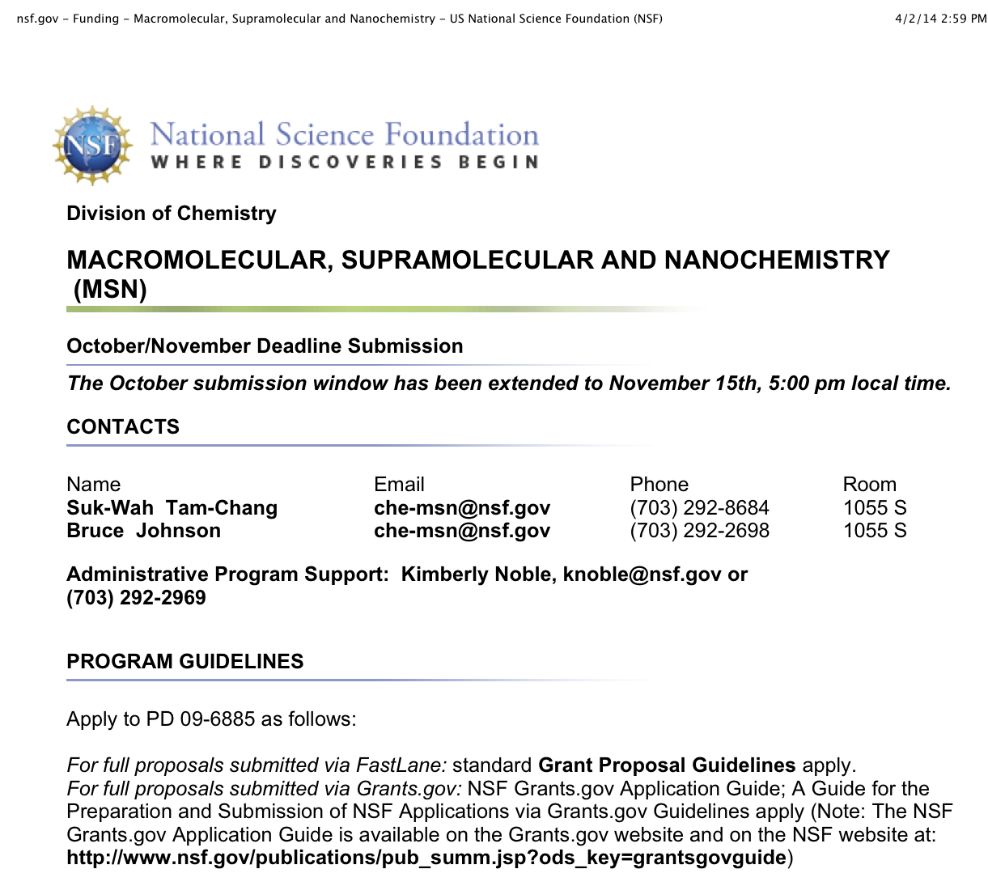

Slide 10
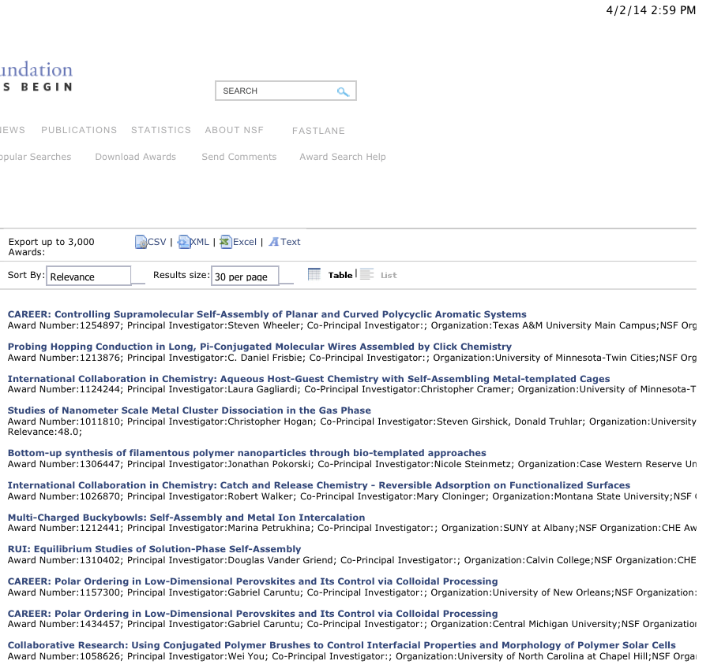

Slide 11
Identify funding sources of researchers in your area.
Search NSF’s web site: www.nsf.gov/awardsearch/
Check out research programs, read what research topics they support
Consider contacting an appropriate program officers
Be prepared to answer the question: “What is your research objective?” (25 words or less)

Slide 12
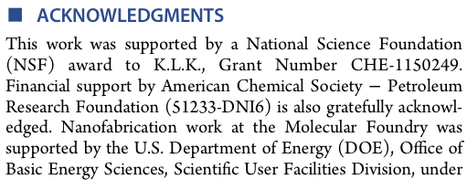

Slide 13
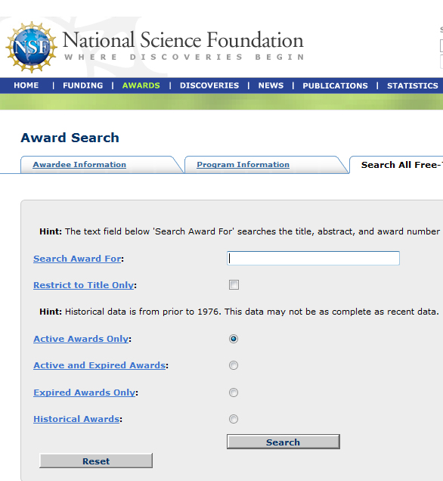
NSF award search engine http://www.nsf.gov/awardsearch/
String search by
CAREER
Disciplinary program
Key words/phrases
PI
Institution
Will provide details about award size and project summary

Slide 14
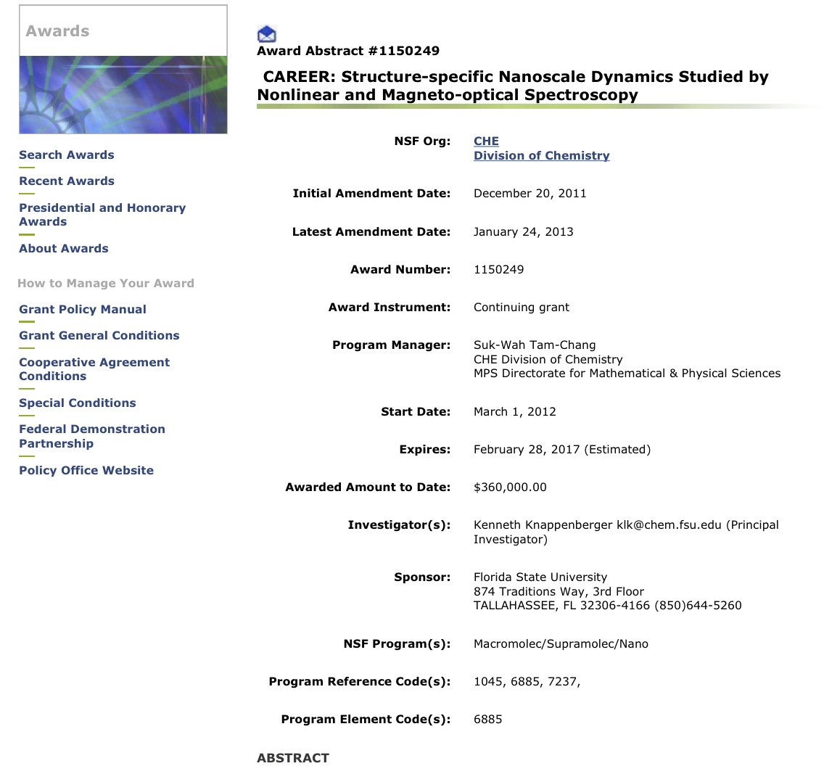

Slide 15
Should I Meet My Program Officer?
Why? What do you intend to gain?
Doesn’t hurt. Probably doesn’t help.
Or is your goal to schmooze? (It doesn’t help)
Don’t even think about taking your program officer to lunch
If you decide to meet:
Be prepared to listen (you don’t learn by talking)
Don’t ask questions answered in program guide
Remember, the program officer is not the panel
You can get a free trip to NSF (more later)

Slide 16
Advice from Ken and Mike:
Solicit anecdotal experiences from awardees.
Find the funding sources of people in your field by looking at acknowledgements in journal articles.
The list of funded projects will give you the best feel for the scope of the program (www.nsf.gov/awardsearch).
It is YOUR responsibility to determine which NSF program is best fit for your proposal.

