Slide 1


CAREER Workshop April 6, 2015
FLORIDA STATE UNIVERSITY
Putting a Face on the CAREER Peer Review Process
Ross Ellington
Associate Vice President for Research

Slide 2
When is the best time to apply?
Different Directorates and Offices at NSF have different takes on these proposals/awards based on norm career trajectories and paths for their PhD scientists.
Some programs encourage young investigators to apply for regular NSF grants first and CAREERs later. Others are agnostic on this point. Some encourage applying for both, especially when pre-proposals are required for the regular grant programs.
You colleagues can help you on deciding, especially those who have served on relevant NSF panels.
Direct contact with program officers is also a way of determining the directorate/division “culture” on CAREERs.
You have limited shots at a CAREER. Apply when you can put forward your best effort.

Slide 3
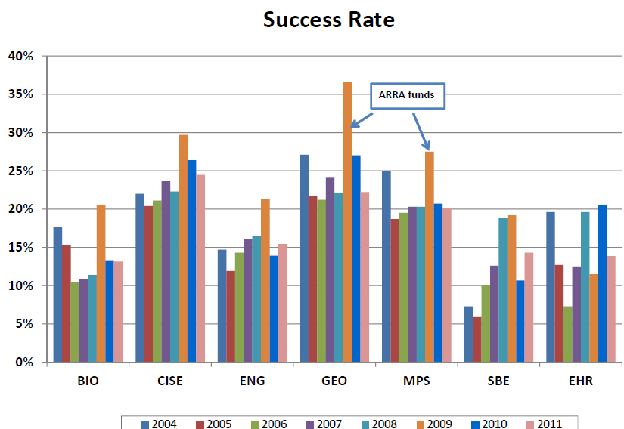
Success rate depends on division but is generally higher than regular proposals.

Slide 4
Peer Review
Treatment of proposals is highly dependent on the Directorate (BIO, CISE, ENG, GEO, MPS, SBE and HER) and even Division within a Directorate
Some review CAREERs in the regular full proposal panels—they need to stand on their own in that competition
Others like Biological Oceanography in GEO use a separate review panel for CAREERs
Regardless of the nature of the panel, the process and dynamics for peer review have very common elements

Slide 5
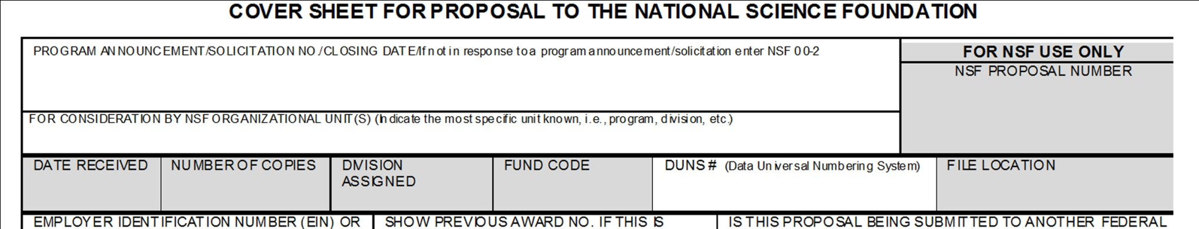
Depending on your discipline, there may be several NSF divisions that your proposal could be peer reviewed. Within a division there may be multiple programs. The program you choose on the cover sheet may not necessarily be the one that your proposal is assigned to.

Slide 6
After the deadline date, program officers within a division meet.
Typically, a proposal will be assigned to a single program for review.
Sometimes proposals will be co-reviewed by two programs within the same division.
Rarely, a proposal will be co-reviewed by two programs in different divisions.
Co-reviewed proposals are mixed blessings.
You have to please and convince two panels
Costs can be split between two programs

Slide 7
Merit Review Criteria
Intellectual Merit: The Intellectual Merit criterion encompasses the potential to advance knowledge;
And
Broader Impacts: The Broader Impacts criterion encompasses the potential to benefit society and contribute to the achievement of specific, desired societal outcomes.

Slide 8
The following elements should be considered in the review for both criteria:
1. What is the potential for the proposed activity to:
a. Advance knowledge and understanding within its own field or across different fields (Intellectual Merit); and
b. Benefit society or advance desired societal outcomes (Broader Impacts)?
2. To what extent do the proposed activities suggest and explore creative, original, or potentially transformative concepts.
3. Is the plan for carrying out the proposed activities well-reasoned, well-organized, and based on a sound rationale? Does the plan incorporate a mechanism to assess success?
4. How well qualified is the individual, team, or organization to conduct the proposed activities?
5. Are there adequate resources available to the PI (either at the home organization or through collaborations) to carry out the proposed activities?

Slide 9
See http://www.nsf.gov/bfa/dias/policy/merit_review/ for details of the overall process
The program officer identifies 5-8 ad hoc reviewers.
The program officer develops a panel of reviewers who will attend a panel meeting at NSF; each proposal is assigned a primary panelist, secondary panelist and “reader” panelist.
Reviews for ad hoc reviewers and panelists are electronic (on FASTLANE); typically each panelist will receive 10-15 proposals to review (half as primary) as well as another group of 5-8 to read only
Reviewers are asked to rate each proposal (Ex, VG, G, Fair, Poor) and then provide a justification based on both merit criteria (Intellectual Merit; Broader Impacts)

Slide 10
5) After panelists have uploaded their reviews, they will have access to the reviews of the ad hoc reviewers and those of the other panelist
6) The panel usually meets ~3 months after the target date; each proposal is treated as follows:
Primary gives his/her evaluation and rating
Secondary gives his/her evaluation rating and then summarizes the ad hoc reviews
There is general discussion about the proposal and a rating is arrived at
Ratings- High Priority, Medium Priority, Low Priority, Not Competitive (done on a PowerPoint slide; relative position within a rating category is important)

Slide 11
The “reader” takes notes and then drafts a “Panel Summary” which describes the strengths and weaknesses of the proposal; this is designed to be a very constructive document
The primary and secondary must approve the panel summary
All of this is done electronically; each panel member has a PC
At the end of the panel there is a general discussion about repositioning proposals in the rating categories as well as shifting of some to different categories
7) The program officer is not required to follow all the recommendations of the panel. He/she can take into account existing funding of the PI, geographic issues, stage of career of the PI, thematic imperatives of the Foundation etc
8) The program officer then will make recommendations up the chain of command for awarding or declining a proposal
9) Notification is electronic, usually within 2 months of the panel

Slide 12
No news is sometimes good news!
Program officers will often work on declination messages first and then awards next
If you do not hear in a couple of months after the panel, your proposal may on the borderline and the program officer is looking for resources to fund it.

Slide 13
Final considerations about the peer review process
Primary and secondary panelists are rarely experts in your specific area (depends on program)
This means that your narrative must provide sufficient background detail to set the stage for description of the project and the integration of the educational component
Ad hoc reviewers may be experts in your specific area
However, return of ad hoc reviews and the quality of such reviews is highly variable
Often, the most detailed and careful reviews are from the primary and secondary panelists

Slide 14
OK, so you are declined. What next?
Read the Panel Summary. It will tell you in broad terms the strengths and weaknesses of your proposal.
Read all the reviews and take notes. There may be as few as three full reviews.
Allow your program officer to process declinations and awards. Email him/her and arrange for a time to talk on the phone.
a) Program officers take detailed notes
b) He/she will be able to read between the lines of
panel summary and full reviews
c) Avoid asking questions that put him/her in an
awkward position
4. Move on to the rewrite.

