Slide 1



The Project Summary

Slide 2
Outline
Structure
Examples
Timeline

Slide 3
Project Summary
Three paragraphs, one page
  Summary of plans and anticipated results
  Intellectual merit
  Broader impact
Notes:
Unlike the rest of the proposal, the project summary is written in third person
use “I will ..”, “it is my plan to ..”

Slide 4
Frame Your Research for NSF
Fundamental research (not developmental)
State your research objective:
  “The research objective of this proposal is….”
  Your research statement should lead into your methodology
Notes:
You want to make it easy

Slide 5
Four ways to state a research objective
1. “The research objective of this proposal is to test the hypothesis H.”
2. “The research objective of this proposal is to measure parameter P with accuracy A.”
3. “The research objective of this proposal is to prove the conjecture C.”
4. “The research objective of this proposal is to apply method M from disciplinary area D to solve problem P in disciplinary area E.”
Notes:
You want to make it easy

Slide 6
Research Objective Ex. 1
Faculty, please see our Sharepoint site for examples of successful CAREER project summaries

Slide 7
Research Objective Ex. 2
Faculty, please see our Sharepoint site for examples of successful CAREER project summaries

Slide 8
Research Objective Ex. 3
Faculty, please see our Sharepoint site for examples of successful CAREER project summaries

Slide 9
Research Objective Ex. 4
Faculty, please see our Sharepoint site for examples
of successful CAREER project summaries

Slide 10
Avoid these words
Develop
Design
Optimize
Control
Manage

Slide 11
Rejected Research Objective
Complex microbial populations participate in and drive many biochemical and geochemical processes, ranging from greenhouse gas flux, to nitrogen fixation in soil, to processing of gut nutrients, and beyond [NRC, 2007]. Only recently has it become possible to deeply sample the
contents of these populations using next-generation sequence analysis [Mackelprang et al., 2011, Tyson et al., 2004]. Reference-free assembly of these metagenomes is a critical endeavor in modern biology, in part because we have yet to sample even a small fraction of the tree of life, and have no reference genomes for most environmental organisms.
De novo assembly techniques have not kept up with the advances in sequencing. A large class
of modern assemblers, de Bruijn graph assemblers, has been developed for the express purpose
of short-read assembly and can scale to assemble single human genomes on commodity hardware [Miller et al., 2010, Gnerre et al., 2011]. However, these assemblers are neither designed for nor scale to the volume of data being generated for metagenomes, which can contain many times the novel sequence in genomic samples. Scaling metagenome assembly is an important bioinformatics problem.
Research Objectives: I propose a research plan centered on combining a compressible graph representation with novel streaming online data reduction and graph analysis algorithms to provide a general scaling solution to the problem of metagenome assembly. We will combine these novel and existing approaches to develop a usable reference implementation that can be applied to existing and emerging sequencing data sets.

Slide 12
Summary of Plans: Paragraph 1
Why is this research needed ?
What difference will your research and education goals make?
Describe the major proposal tasks very briefly
Provide information on why you are uniquely qualified to perform this research.
Notes:
State up-front your research and education goals and integration of both - your Vision

Slide 13
Intellectual Merit: Paragraph 2
How important is the proposed activity to advancing knowledge and understanding within its own field or across different fields?
How well qualified is the proposer (individual or team) to conduct the project?
To what extent does the proposed activity suggest and explore creative, original, or potentially transformative concepts?
How well conceived and organized is the proposed activity? Is there sufficient access to resources?
What is the translational aspect of your proposal?

Slide 14
Broader Impact: Paragraph 3
How well does the project advance discovery and understanding?
How well does project broaden participation of underrepresented groups (gender, ethnicity, disability, geographic)?
Will results be disseminated broadly to enhance science and technology understanding? (summary of data management plan)
What may be the benefits of project to society?
Can outcomes be a model for other institutions?

Slide 15
Write your Project Summary Last
In third person (the PI will….)
Ask for feedback!

Slide 16
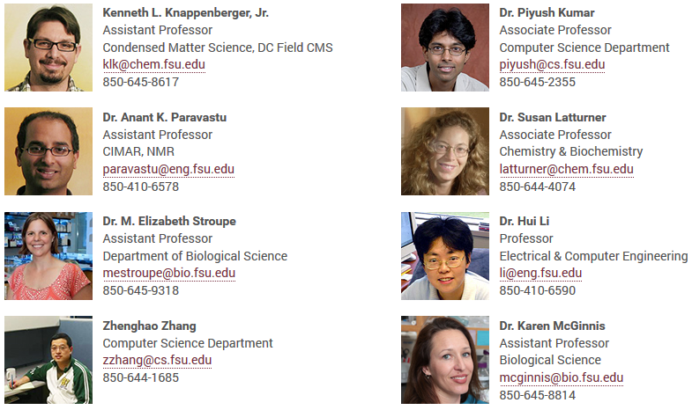
CAREER Award Winners

Slide 17
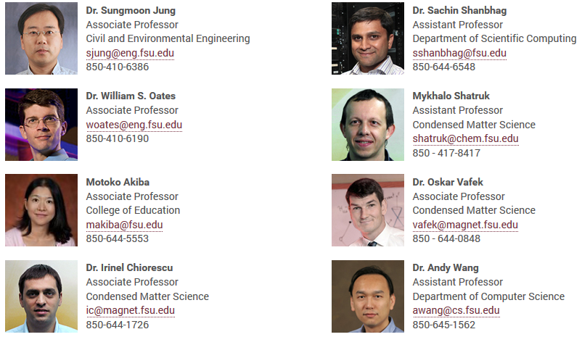
CAREER Award Winners

Slide 18
Thank you!
Beth Hodges bhodges@fsu.edu
Emily Hutcheson ehutcheson@fsu.edu
Tracy Ippolito tippolito@fsu.edu
Patrice Williams pcwilliams@fsu.edu
www.research.fsu.edu/research-offices/opd/

