Slide 1
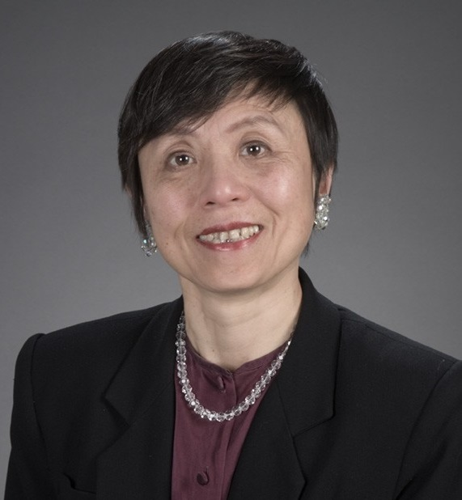
Amy L. Ai, PhD
College of Social Work
(Pepper Institute Associate; Psychology, Nursing, and Behavioral Science Adjuncts)
amyai8@gmail.com
Transitional Care for the Disadvantaged Populations: A Pilot Study, funded by the CRC
Behavioral Intervention for Hypertension Patients: A Pilot Multidisciplinary Clinical Trial, funded by the CRC
Health Disparities of Latino and Asian Americans: A Secondary Data Analysis Using a National Database
Find a biostatistician who can help develop a grant proposal for the next state of clinical trial as proposed in the model poster
As an interdisciplinary scholar and grant reviewers for Federal agencies and private foundations, I can help design grant proposals and work as a team member. I have a broad array of training backgrounds on health related projects and research methodology beyond my substantive knowledge base on health (e.g., cardiac health) and mental health. I am a team player.

