Slide 1
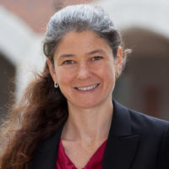
Angelina Sutin
Behavioral Sciences and Social Medicine
angelina.sutin@med.fsu.edu
I have a grant from NICHD to identify psychological, family, and environmental factors that increase risk for the development of obesity in Mexican-origin youth.
I am co-investigator on an NIA grant to identify personality changes in the prodromal phase of Alzheimer’s disease.
I also have a project that examines how intergenerational factors contribute to the development of trait psychological functioning.
My research focuses on how psychological factors contribute to health and well-being across the lifespan and across generations.
Expertise in psychological factors on health
Longitudinal methodology and analysis
Experience with interdisciplinary teams

