Slide 1
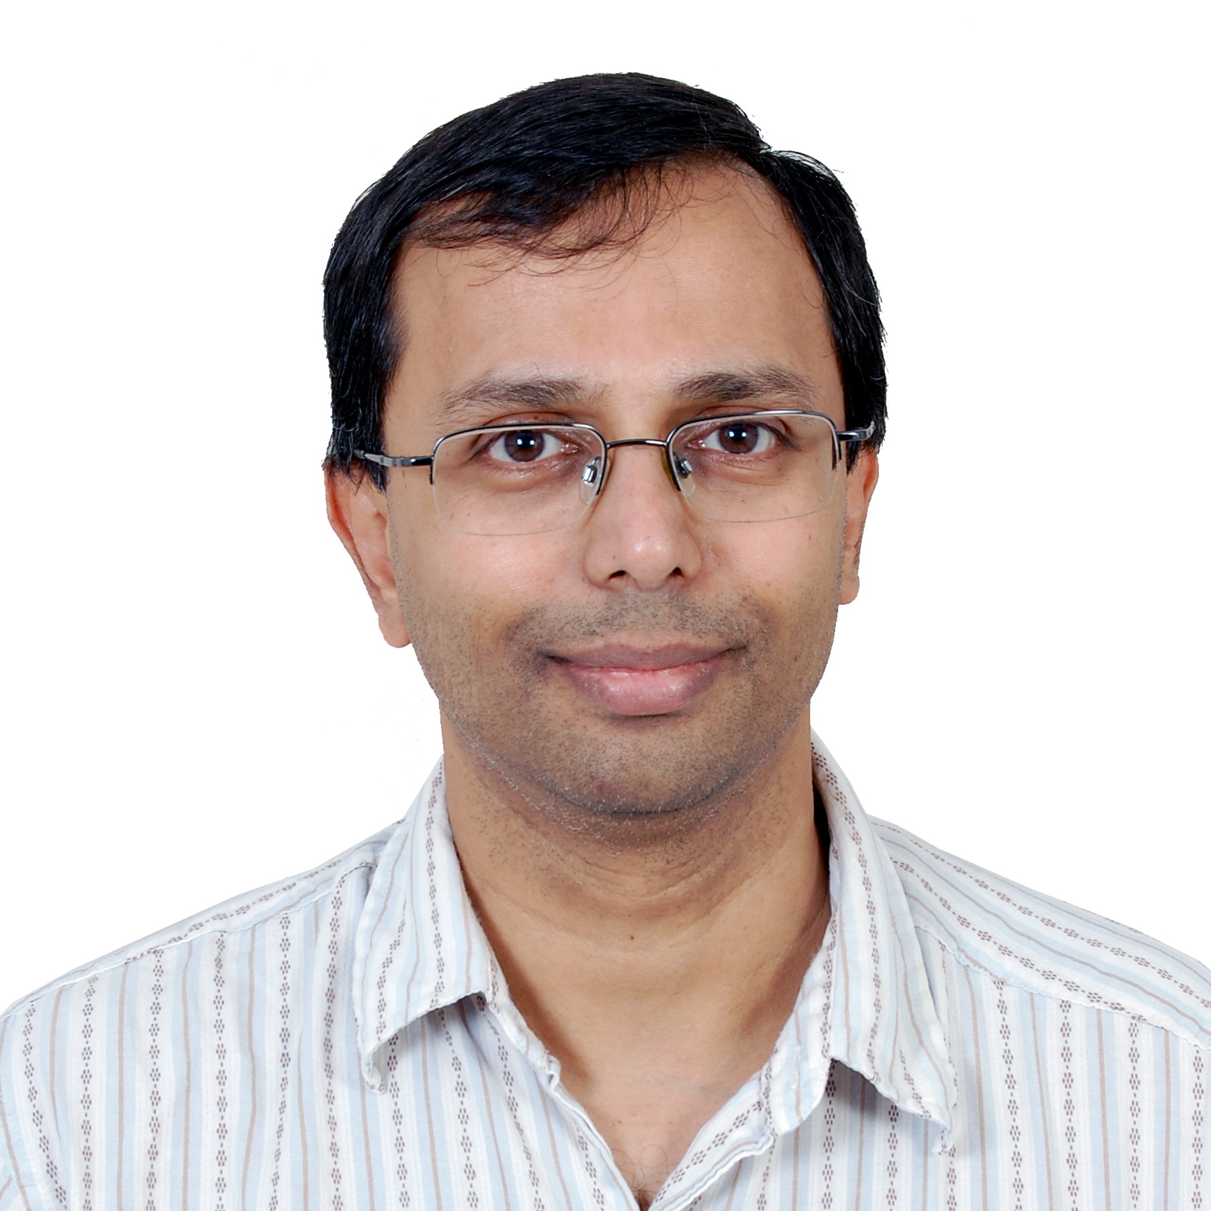
Ashok Srinivasan
Computer Science
asriniva@cs.fsu.edu
Simulation based analysis of strategies for reducing spread of viral infections through air travel. Project on Ebola funded by NSF
Public policy analysis requiring extensive computational power
My research expertise lies in high performance computing, especially in massively parallel simulations on supercomputers. I also have experience in putting together teams with diverse expertise to solve multi-disciplinary problems. The current research team for Project VIPRA (www.cs.fsu.edu/vipra) has expertise in human movement modeling, phylogeography, infection modeling, decision support software, and visualization.

