Slide 1
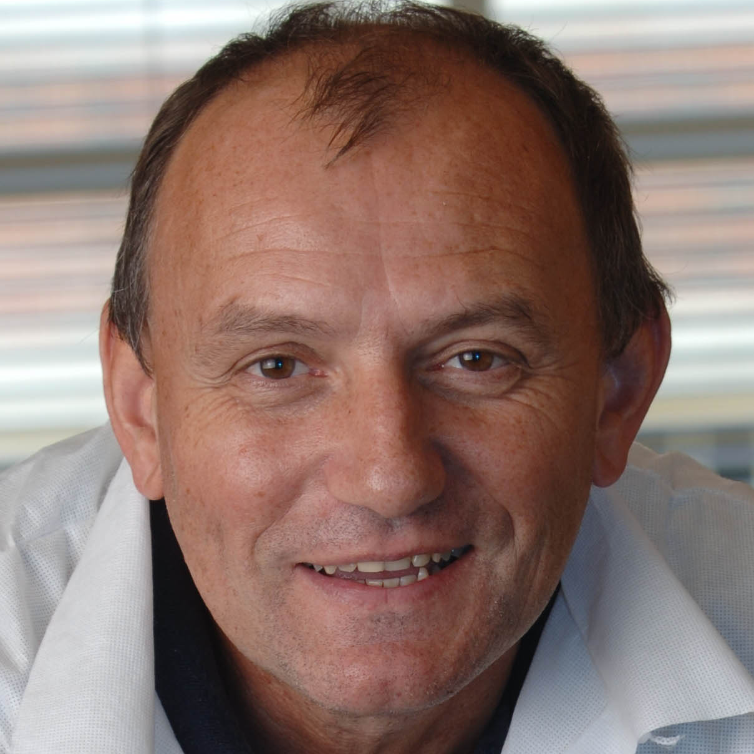
Branko Stefanovic
Biomedical Sciences
branko.stefanovic@med.fsu.edu
I work on molecular mechanism of hepatic fibrosis, discovery of novel drug targets and screening for antifibrotic or hepatoprotective drugs. A critical regulatory step for excessive type I collagen production in fibrosis has been validated as the specific target of antifibrotic therapy. Subsequently, I devised a high throughput assay to screen for the inhibitors and this assay is currently in use for discovery of novel chemical probes with potential to be developed into antifibrotic drugs.
My interests are understanding the molecular mechanism of hepatic fibrosis, discovery of novel drug targets and screening for novel antifibrotic drugs.
I have expertise in;
molecular biology of type I collagen biosynthesis in fibrosis
animal models of hepatic fibrosis
high throughput screening methods and technologies for discovery
of new drugs and biomarkers.

