Slide 1
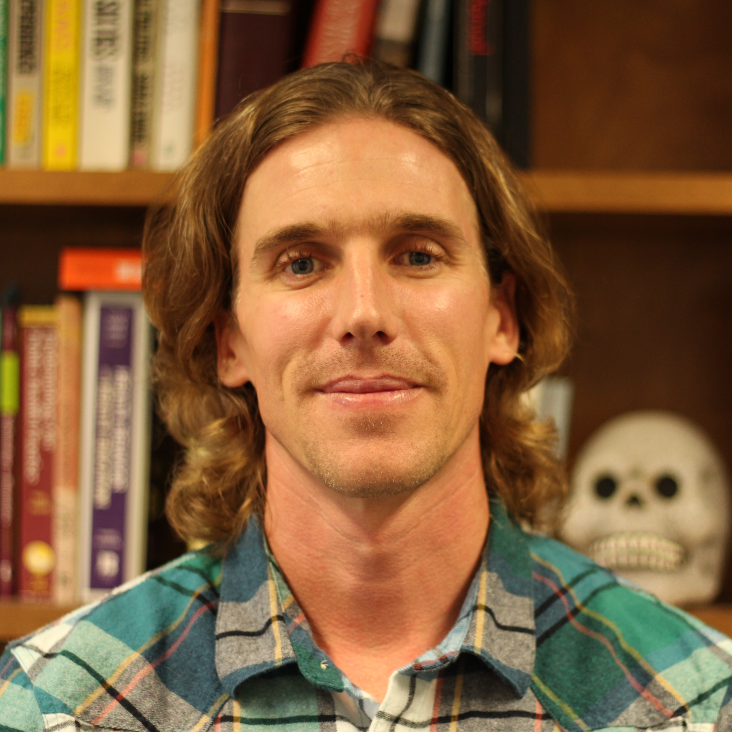
Chris Coutts
Urban and Regional Planning
ccoutts@fsu.edu
Green Infrastructure and Public Health (2016). Routledge Press.
Emerging Issues in Urban Ecology: Implications for Research, Social Justice, and Human Health and Well-being
Natural Burial as a Land Conservation Tool
Greenways as Active Travel to School Infrastructure: A Survey of Students and Parents in East Los Angeles
The influence of the built environment and ecologically-sensitive land use practices on community health and health behavior
Urban, regional, and environmental planning
Social system effects of environmental change
GIS
Not a jerk

