Slide 1
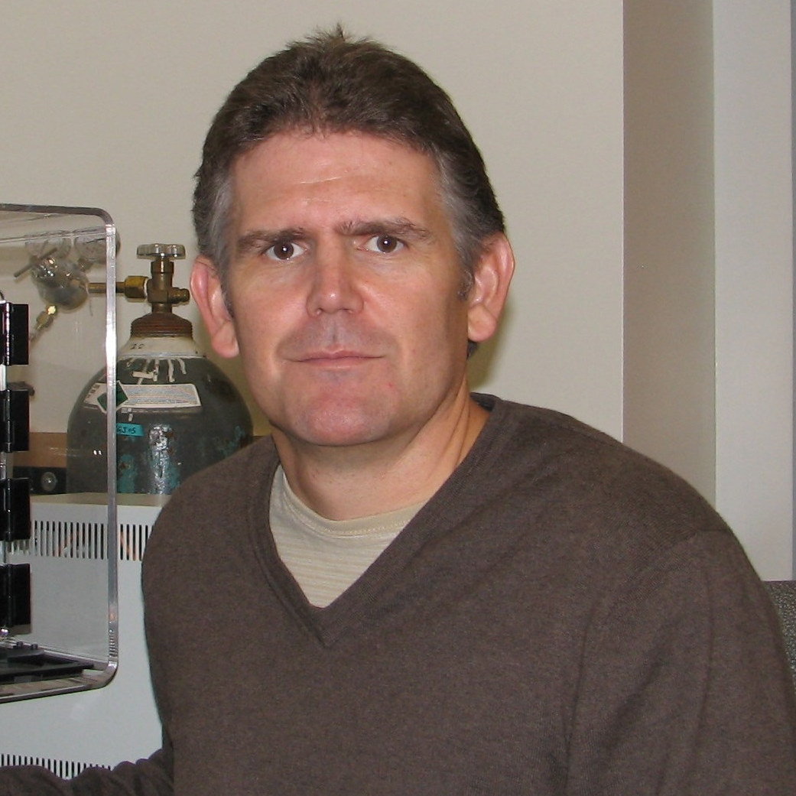
Eric Laywell
Biomedical Sciences
eric.laywell@med.fsu.edu
Using thymidine analogs to treat glioblastoma, particularly in combination with a novel adaptive dosing paradigm (currently supported by NIH).
Novel therapeutics and dosing strategies for brain tumors, as well as in vitro and in vivo models.
I have experience with methods of assessing neurogenesis in rodent brains, and in a variety of culture models. In addition, I am familiar with mouse models of human cancers, and with novel methods of therapeutic delivery that reduce overall drug burden for the patient.

