Slide 1
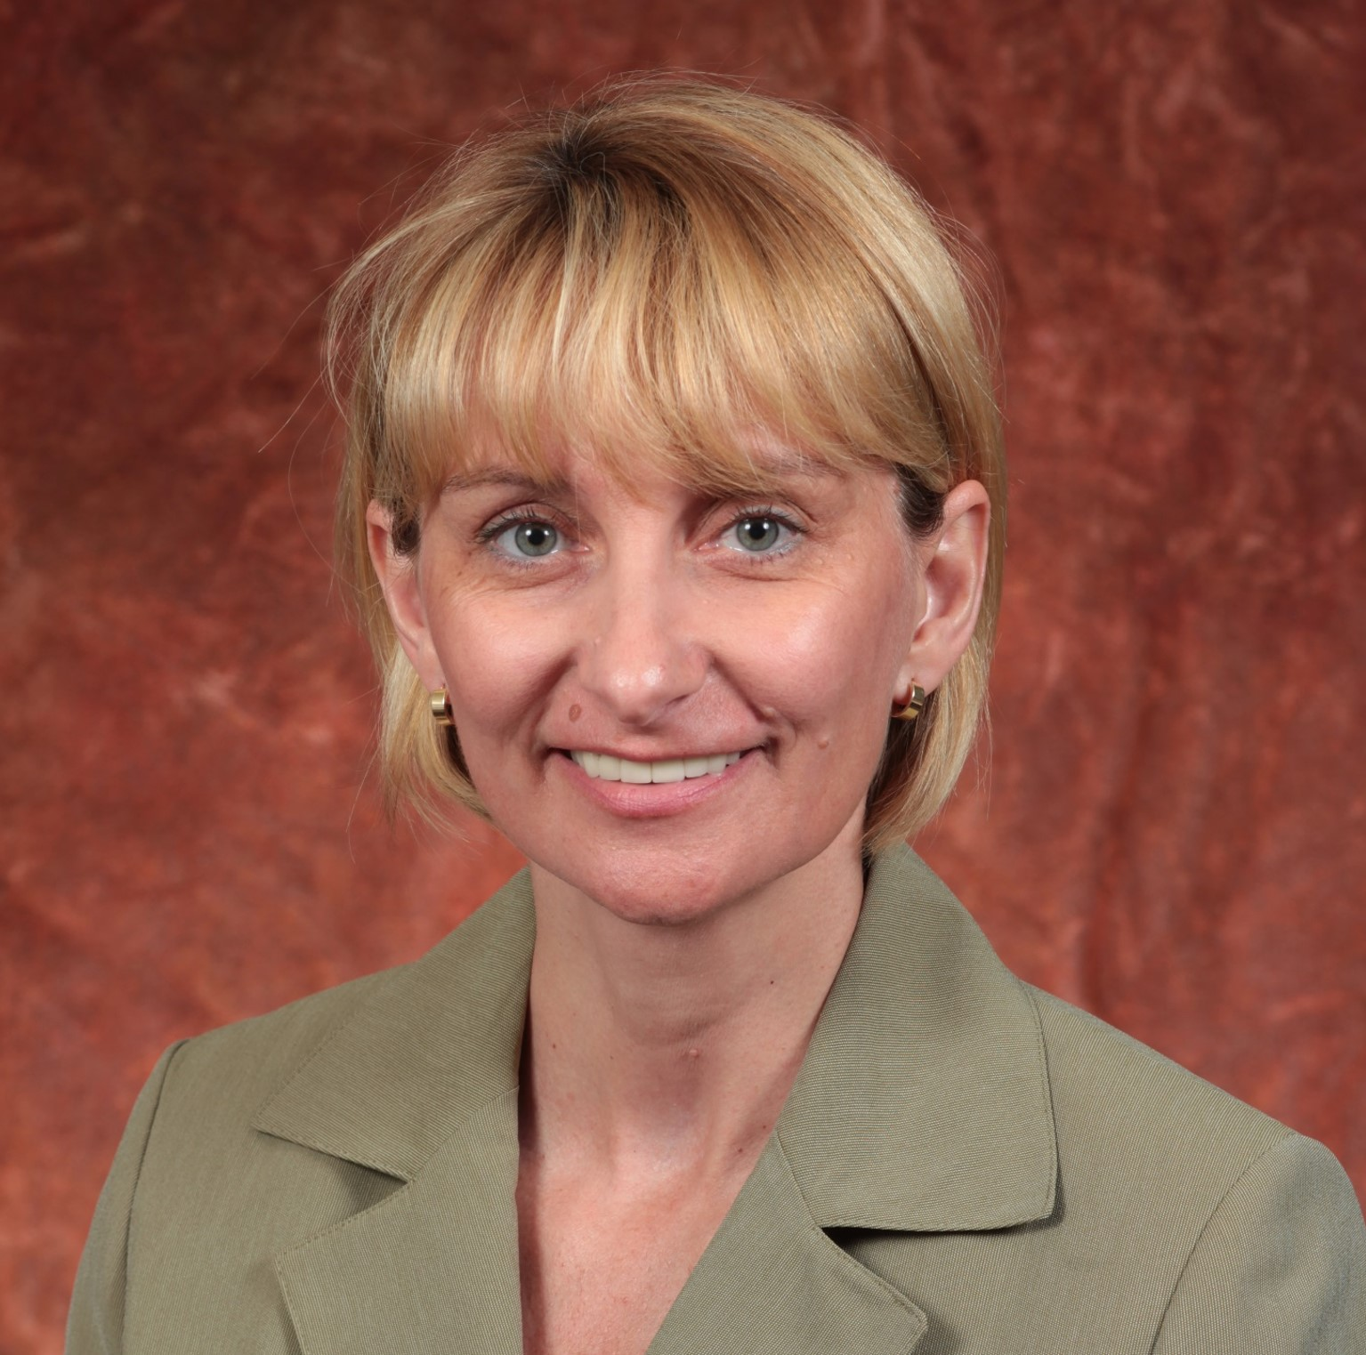
Ewa (Ava) Bienkiewicz
Biomedical Sciences
ewa.bienkiewicz@med.fsu.edu
Development of a novel therapeutic peptide for stroke.
Funded by NIH SBIR Phase I grant .
Jointly with Virtici, LLC.
Development of a combinatorial treatment for Alzheimer’s disease.
Funded by Alzyn, LLC and BMS.
Structure and function of intrinsically disordered proteins (IDPs) in the context of disease and development of novel therapeutic interventions.
Expertise in multidisciplinary research, encompassing fields of biophysics, biochemistry, and structural/molecular biology.
Experience in experimental design, data analysis and interpretation. Methodologies include circular dichroism spectroscopy, isothermal titration calorimetry, surface plasmon resonance, and fluorescence.
Translation of basic research into medically relevant applications.

