Slide 1
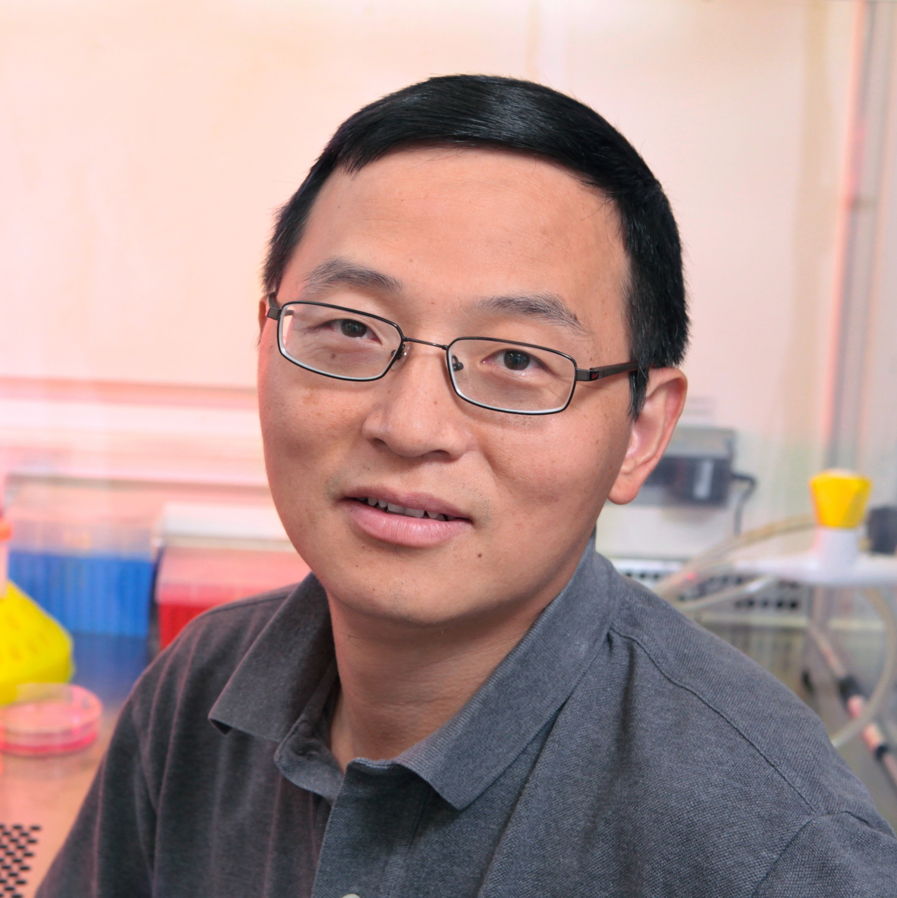
Fanxiu Zhu
Biological Science
fzhu@bio.fsu.edu
Roles of KSHV ORF45 in viral immune evasion and replication. Funded by NIDCR/NIH.
Subversion of cGAS DNA sensing by KSHV: Roles of ORF52/KicGAS. Funded by NIDCR/NIH.
Viruses and human cancers.
As a virologist with more than 25 years of experience with different viruses, I have learned many aspects of biology from the viruses. I have expertise in DNA tumor viruses, innate immunity, cellular kinase signaling, protein post-translation modifications, and etc. I’ll be happy to collaborate with anyone with complementary expertise.

