Slide 1
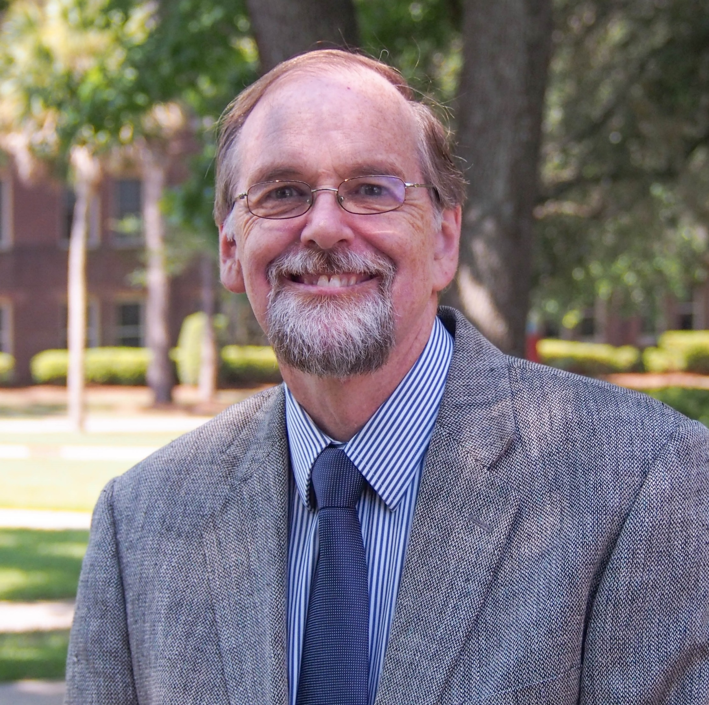
Frank Fincham
Family and Child Sciences
ffincham@fsu.edu
Intimate relationships in health and illness
  The impact of forgiveness and of prayer on relationship and physical health. Funded by Templeton Foundation.
  Infidelity and sexual risk taking in romantic relationships
  Impact of burnout on hemodynamic functioning.
The role of significant others in:
  etiology, treatment and recovery from illness.
  successful aging
My expertise in marital and family functioning lends itself to application in preventing and treating acute and chronic health conditions. I can help you add a relationship component to your grant on a specific health condition (CVD, obesity, diabetes etc.) and in doing so make it even more innovative. My background also allows me to help with research design and data analysis.

