Slide 1
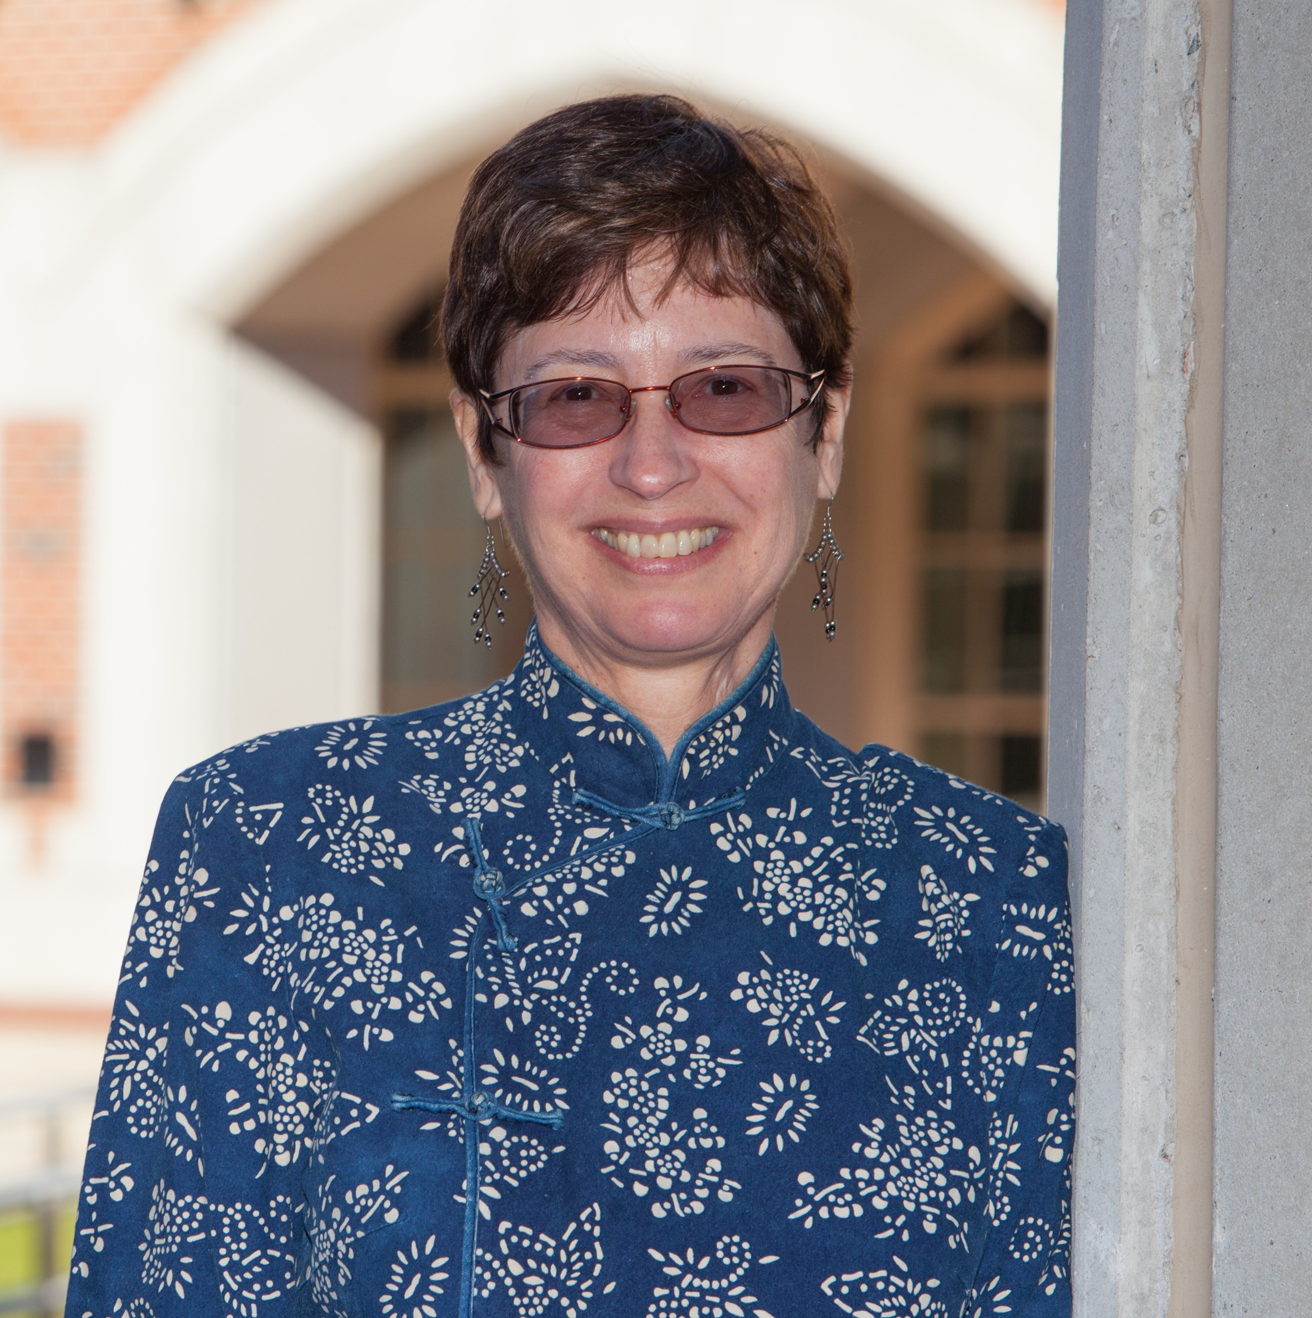
Gail Bellamy
Behavioral Sciences
and Social Medicine
gail.bellamy@med.fsu.edu
Studying knowledge, attitudes, behaviors of primary care medical residents and in practice physicians with respect to e-cigarettes. Looking for interested funders.
Developing a patient centered outcomes research community around early childhood obesity prevention. Seeking PCORI Tier 1 funding.
What are the regulatory and/or policy needs or impediments to health care access for disadvantaged populations, particularly those living in rural areas.
Experience working with disadvantaged communities, national network.
I can collaborate on developing research ideas and approaches that incorporate rural populations and the preparation of subsequent proposals.

