Slide 1
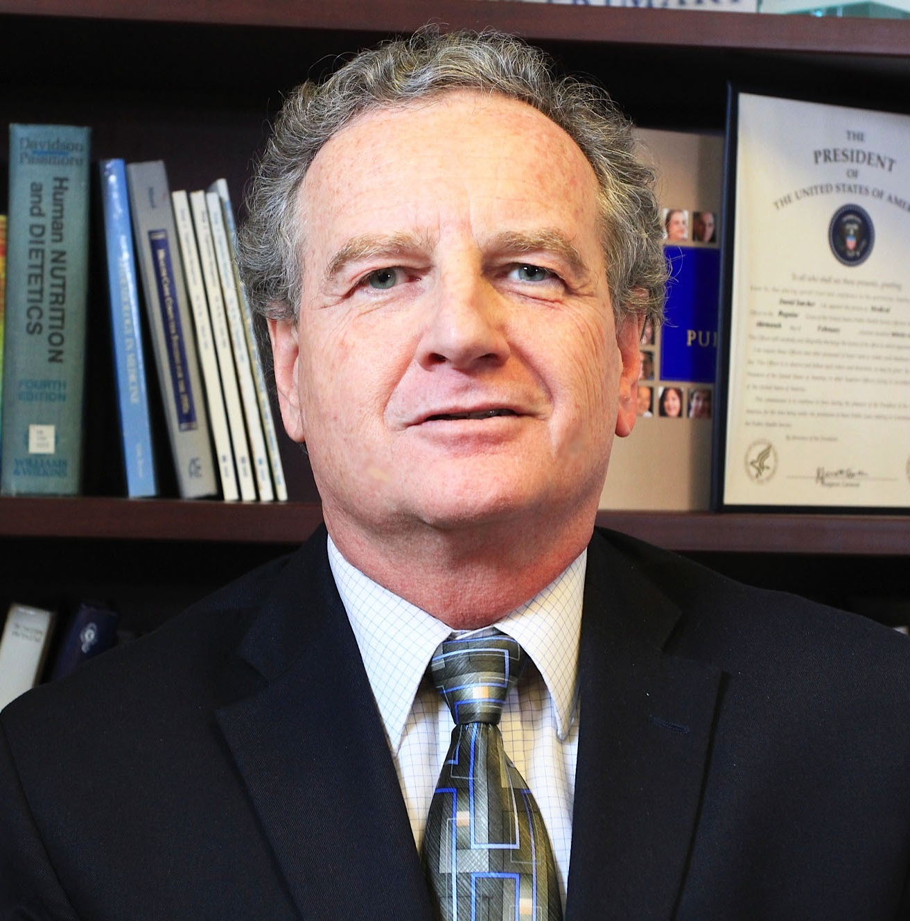
George Rust, MD, MPH
Behavioral Sciences and Social Medicine
george.rust@med.fsu.edu
Local area variation in racial disparities over time for conditions ranging from childhood asthma (emergency dept visit rates) to breast and colorectal cancer mortality to HIV to mental health conditions, especially in the Medicaid population (funding from AHRQ).
Building clinic-community-outcomes connections to promote optimal and equitable diabetes outcomes – see www.diabeteshealthequity.org
Intersection of primary care, community health, and health disparities/health equity.
As a family physician / preventive medicine specialist, I have content expertise in chronic disease and multimorbidity. . I have specific expertise in doing Medicaid claims data research. I also have experience and relevant collaborations in the racially/ethnically-nuanced focus area of health disparities / health equity research, as well as in cultivating minority investigators (previously through the Morehouse Faculty Development program.

