Slide 1
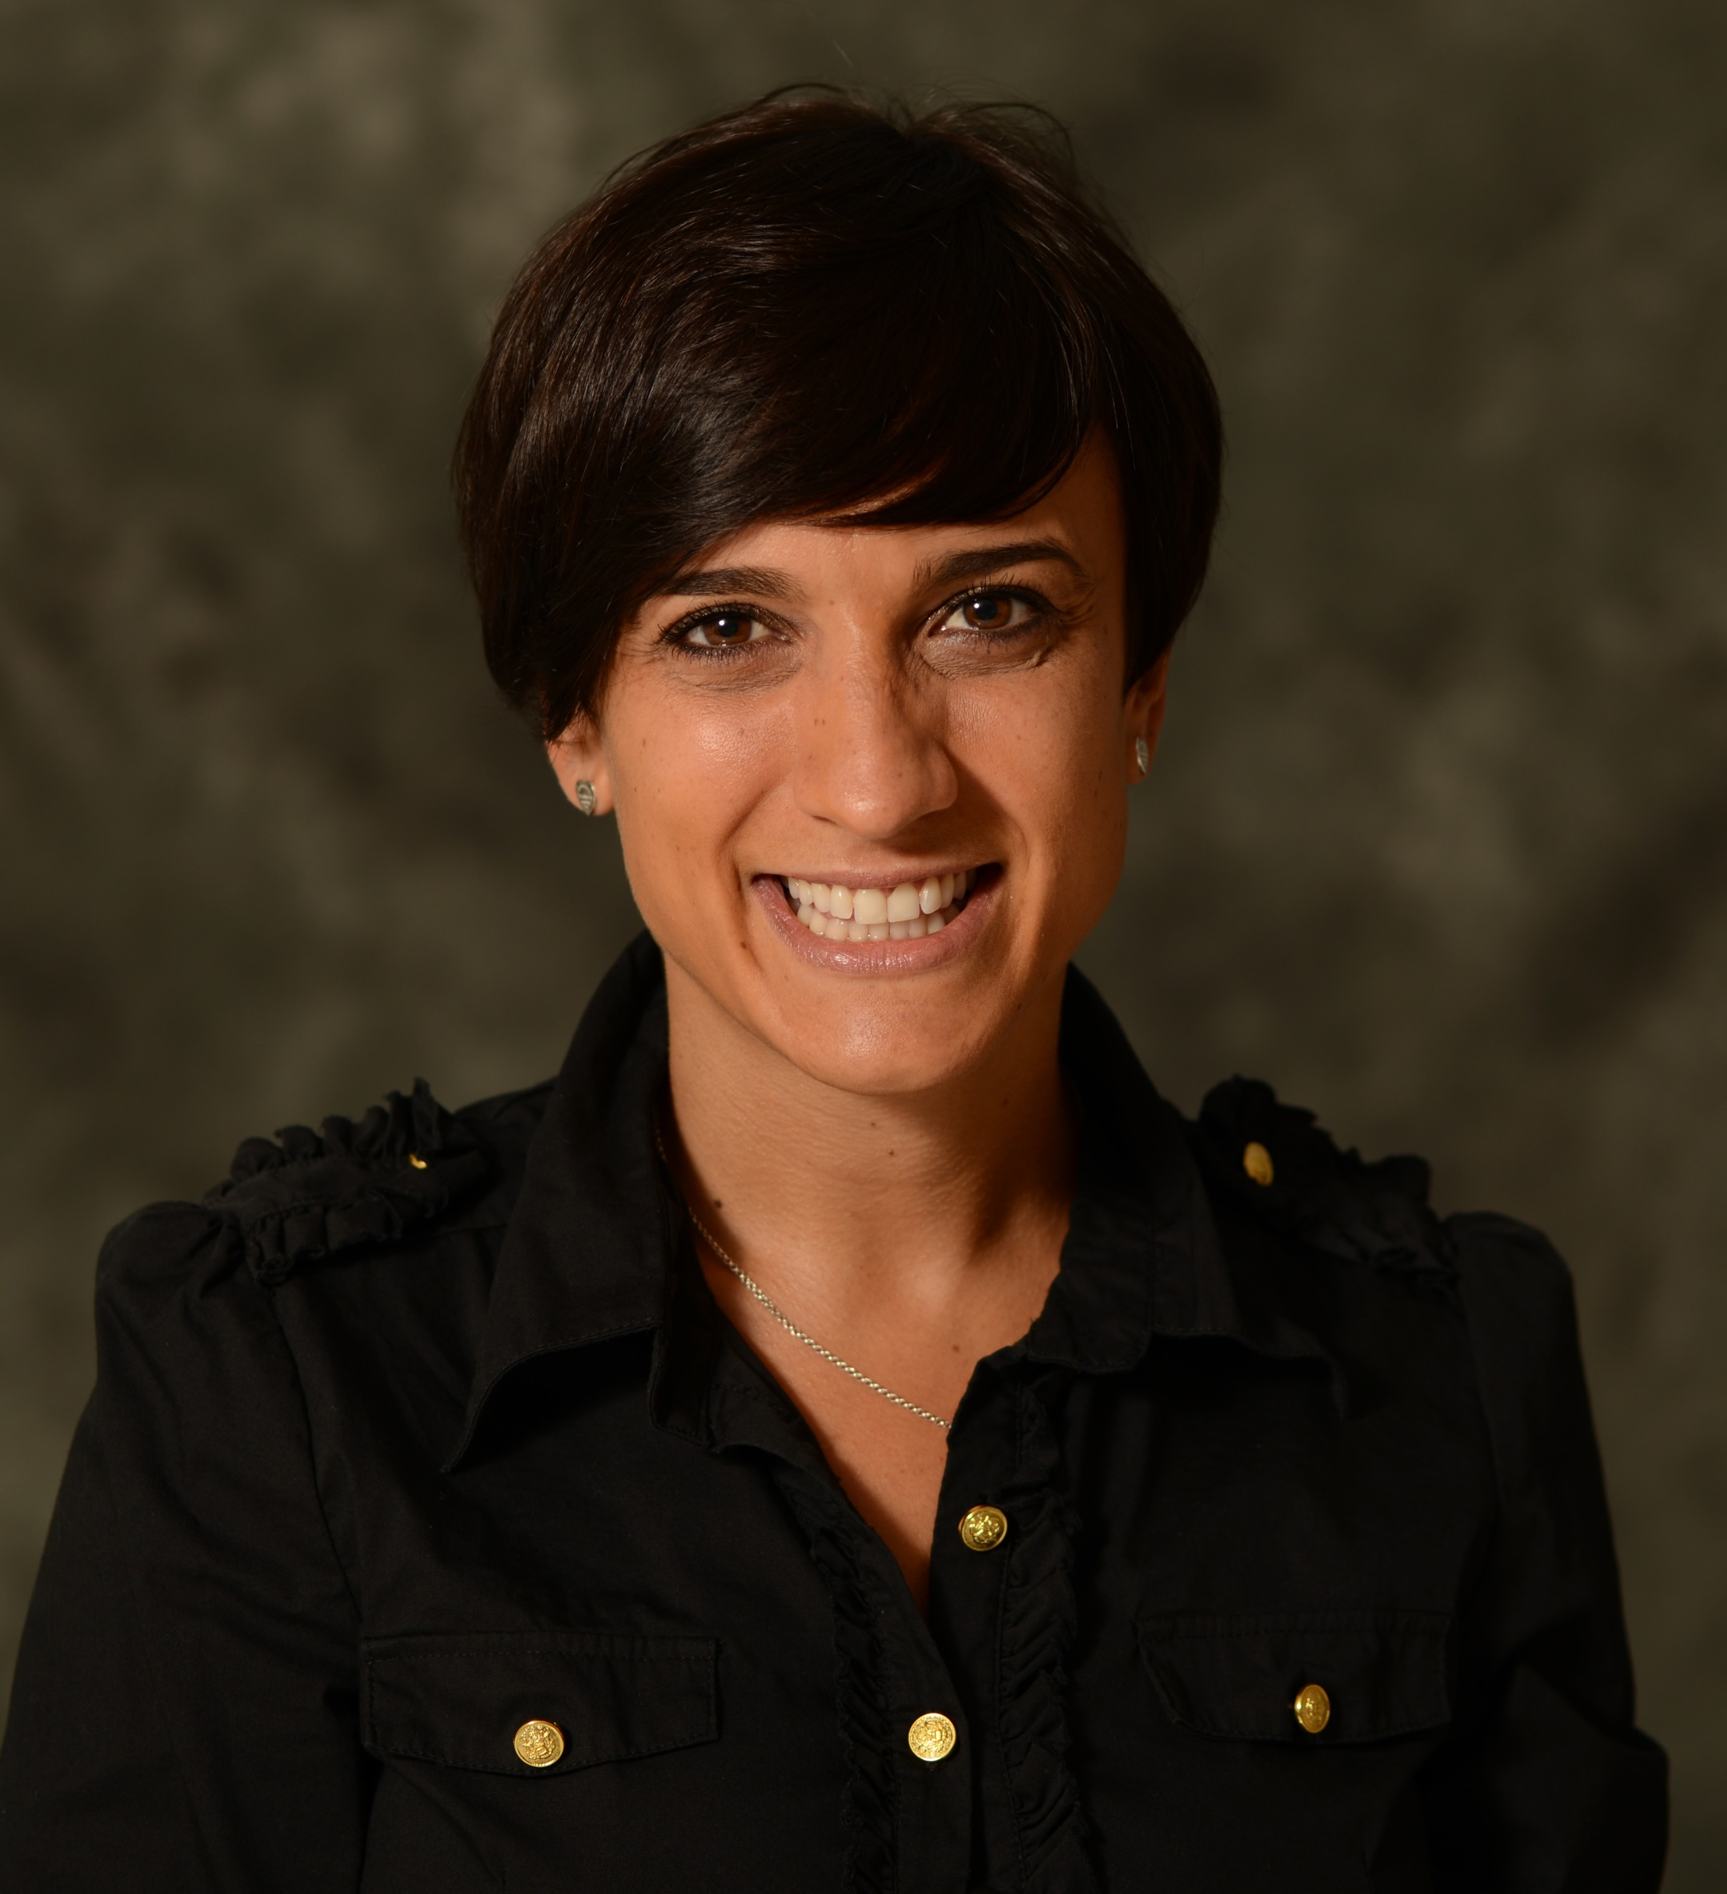
Geraldine Martorella
College of Nursing
gmartorella@fsu.edu
Tailored Web-based intervention for pain self-management funded by FRQ-S (Canada)
Chronic postoperative pain prevention funded by CIHR (Canada)
Complementary and alternative approaches to pain management
Beliefs and behaviors and their effect on pain self-management
As a nurse researcher, I can be involved in the study of chronic pain risk factors both physiological and psychosocial. My experience with patient-centered intervention research allows me to collaborate on proposals involving methodology for the development and evaluation of interventions (e.g. mixed method and experimental designs). I could also contribute to the conceptualization of Web-based educational platforms and persuasive messages for various populations.

