Slide 1
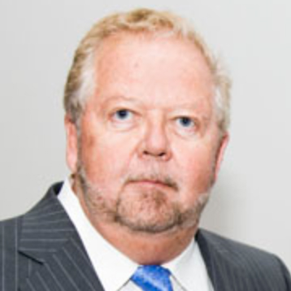
Gerry Maitland
Clinical Sciences
gerry.maitland@med.fsu.edu
My current research includes:
● Melatonin treatment for MCI in Parkinsonism
● Contrast sensitivity vision defects in REM behavior disorder
● TaiChi and vibration therapy for movement disorders
● Cognitive loading and its effect on walking performance
I am interested in Aging, Cognition, Disease, Injury, Patient Care, and Vision and Movement Disorders.
The neuroscience center will welcome collaboration and is open to all possibilities.

