Slide 1
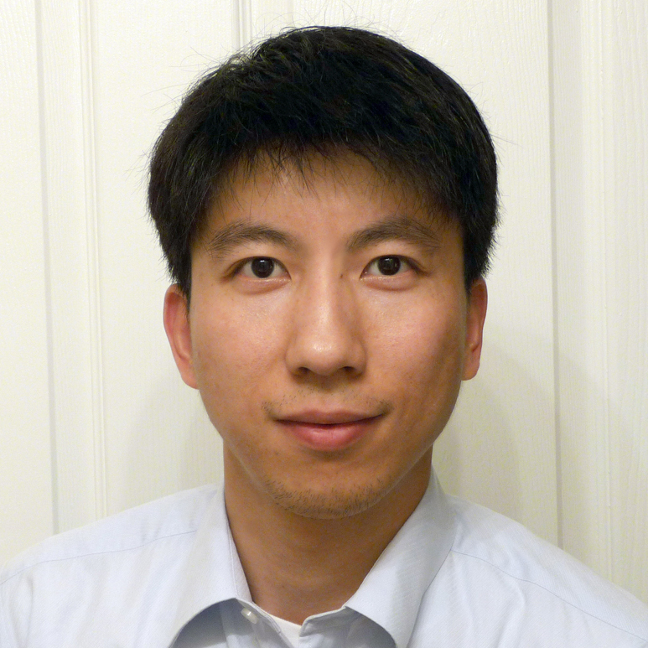
Hanwei Gao
Physics
h-gao@physics.fsu.edu
My current research includes Photonics, Optics, Electronics, Sensing, Nano- and microscale devices, Correlation between chemical, magnetic, electrical and optical signals.
Condensed matter physics
Applied physics
Our lab could invent functional (optical, magnetic, and electronic) devices in condensed matter physics research that could be useful in disease diagnostics and treatment.

