Slide 1
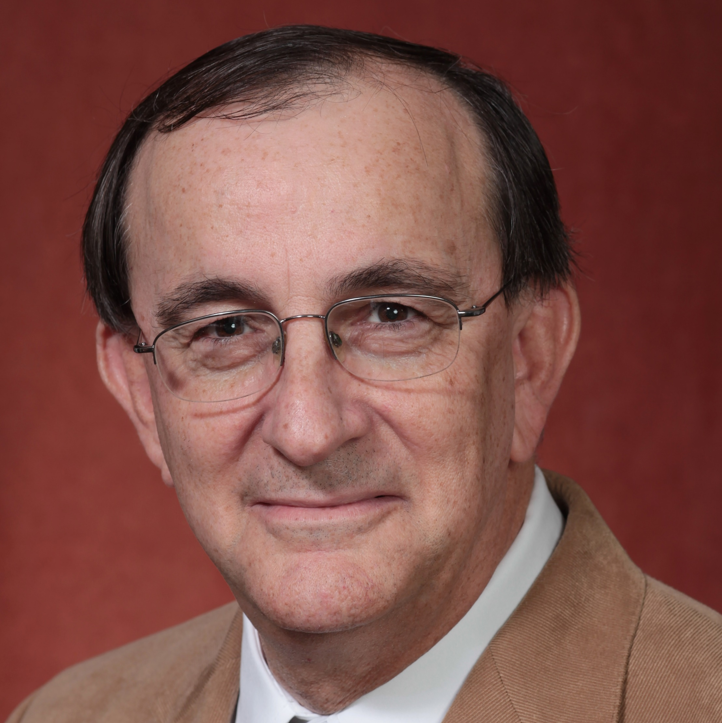
Henry Carretta
Behavioral Sciences and Social Medicine
henry.carretta@med.fsu.edu
Title: “Medical Care Utilization and Costs among Transition-age Young Adult Medicare Beneficiaries with Autism Spectrum Disorder”, Funding: Health Resources and Services Administration, Grant #R40MC28854.
Title: “Evaluation of the Florida Statewide Medicaid Managed Care Program. Funding: Florida Agency for Health Care Administration.
Program evaluation, health services research, chronic disease epidemiology, service utilization by adults with developmental disorders, and legal epidemiology
20+ years of progressive research experience in a medical school setting.
Extensive experience using medical claims and other administrative files for secondary data analysis.
Familiarity with large national health surveys.
Proficient in SAS, SPSS, Stata statistical software.
Enjoy working as part of a collaborative team.

