Slide 1
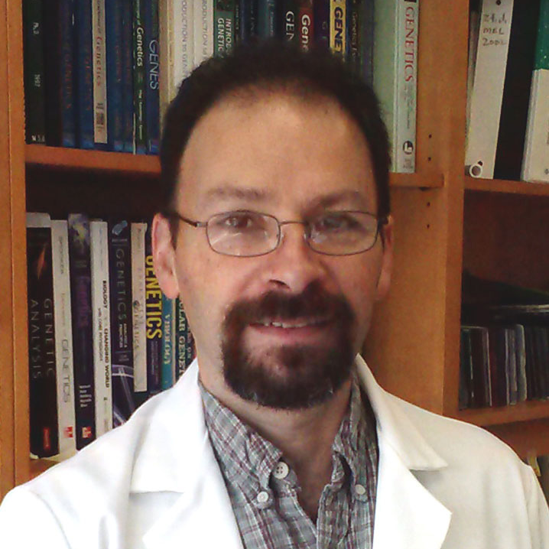
James M. Fadool
Biological Science
jfadool@bio.fsu.edu
Apply state-of-the-art genome editing tools to generate models for the study of eye development and inherited retinal degenerations.
Use our in vivo models of retinal disease in systematic genetic and small molecule screens to identify factors that slow the progression of cell death and secondary alterations.
Our work is funded by grants from the NIH/NEI and the Foundation Fighting Blindness.
Genetic and molecular regulation of the retinal development, neural degenerative diseases and regeneration.
With over 20 years of experience in zebrafish genetics, we can provide expertise to take advantage of the power of zebrafish genetics for understanding basic cell biology, vertebrate development and human disease; possible applications include gene knock-down strategies, incorporating existing genetic mutations and transgenic lines, and applying genome editing tools to generate precisely defined genetic lesions as models of inherited disorders.

