Slide 1
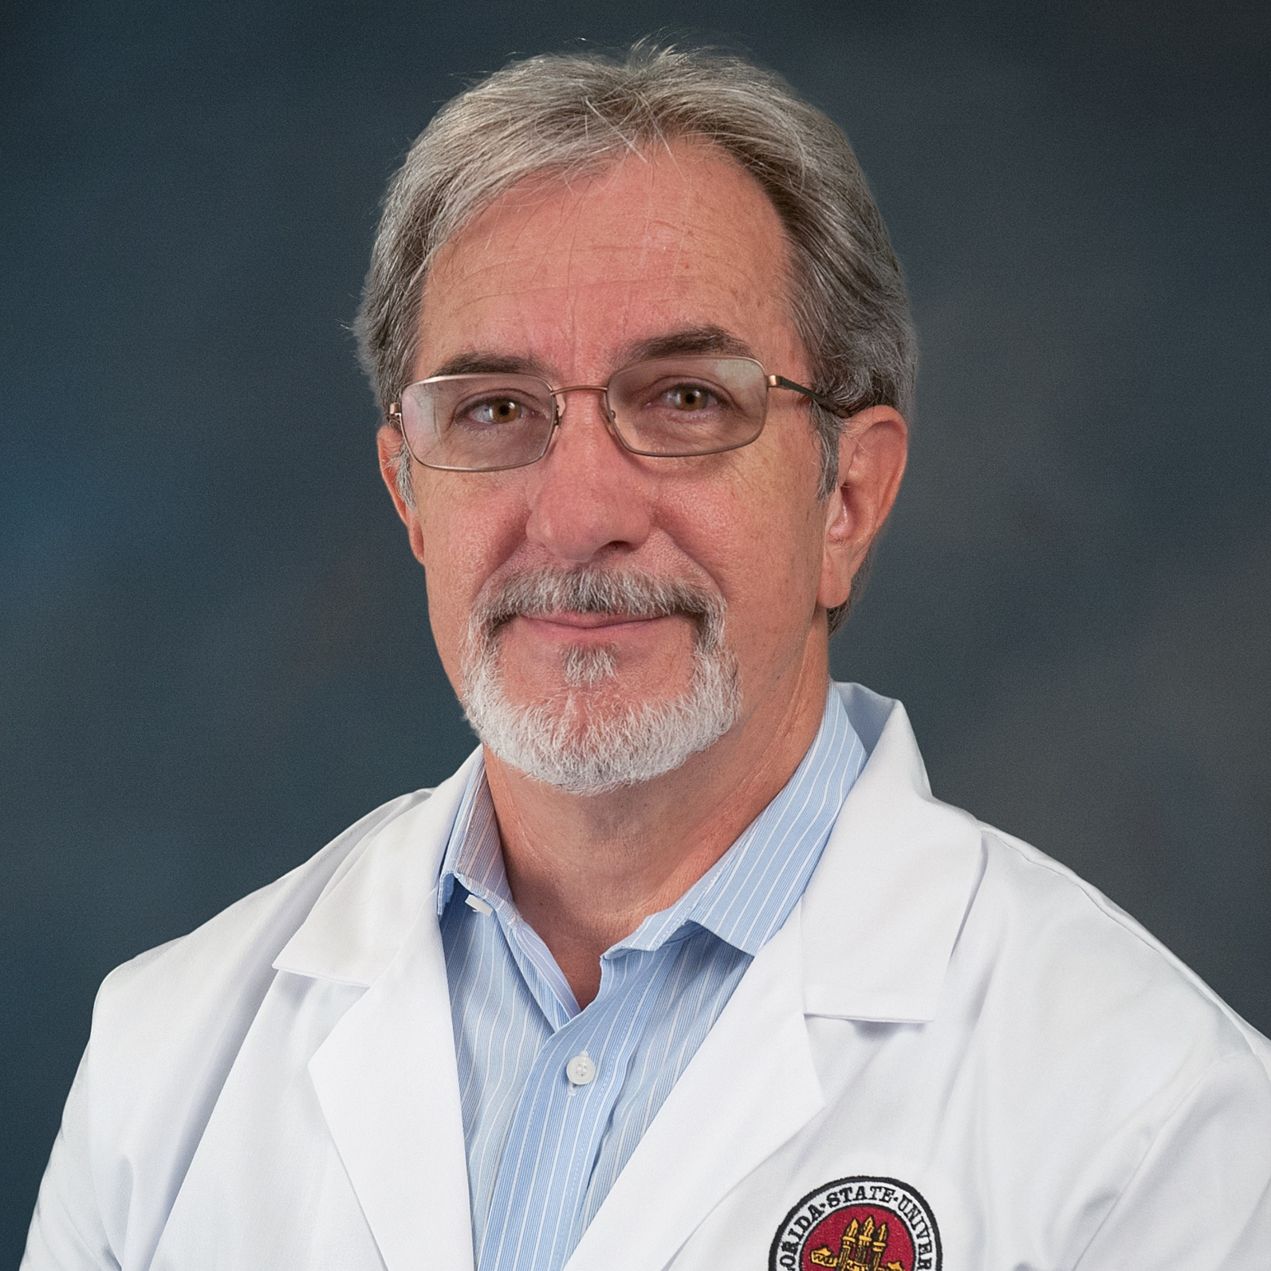
James Olcese
Biomedical Sciences
james.olcese@med.fsu.edu
With funding from the Florida Department of Health we are exploring the diagnostic potential of blood exosomes for the determination of risk of neurodegenerative disease (Alzheimer’s Disease).
Diagnosis and Therapeutics in Alzheimer’s Disease
Many years of experience in neuroscience, including molecular, cellular, and behavioral analyses of murine and human models of neurodegenerative disease.

