Slide 1
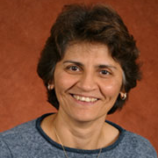
Jamila Horabin
Biomedical Sciences
jamila.horabin@med.fsu.edu
Understanding the role of the RNA silencing machinery on the status of chromatin. This encompasses the role of long non coding RNAs in the process of modifying histones.
How chromatin impacts gene expression over different biological states
As a molecular biologist and geneticist we have broad experience in multiple analytical processes including quantitative PCR, chromatin immunoprecipitations, Western and Northern blotting. We work on a model system, Drosophila melanogaster, so the potential of setting up a disease model or a specific condition is also an option, in addition to collaborating on analyzing various tissue and cell samples from other sources.

