Slide 1
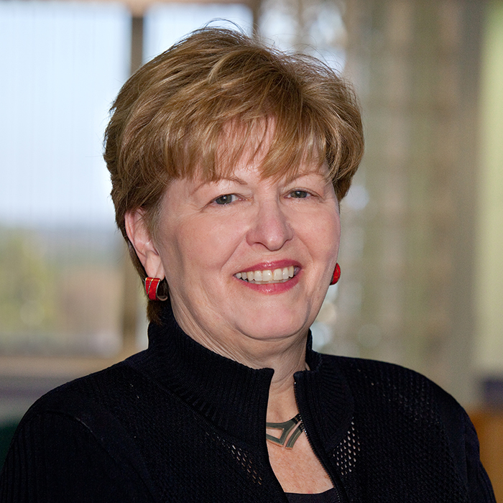
Jayne Standley
College of Music
jstandley@fsu.edu
Most recently, my research has specialized in research studies investigating music therapy to facilitate medical treatment and early intervention with premature infants in the Neonatal Intensive Care Unit.
Music therapy
An internationally acclaimed researcher and has published extensively in music in learning and music in medical settings with refereed publications appearing in nursing, early childhood, and music therapy journals.

