Slide 1
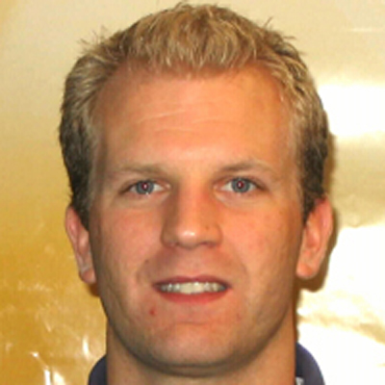
Jens Rosenberg
National High Magnetic Field Laboratory
rosenberg@magnet.fsu.edu
MRI based cell tracking in stroke animal models
High field MRI/S spectroscopy
MRI contrast agents for cell tracking and tumor detection
In vivo MRI of animals models
MRI sequence development
High field MRI and using MRI to investigate in stroke and other disease models.
I have extensive experience in imaging of neuronal diseases and injuries utilizing high magnetic field (21.1 T) MRI. My work involves optimizing MRI contrast agents for bio-compatibility and contrast, sodium MRI as a biomarker for stroke progression, MRI based cell tracking, neuronal imaging (DTI and diffusion) and MRI sequence optimization. I’m looking to collaborate with researchers wanting to perform MRI as part of their research.

