Slide 1
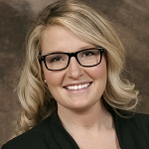
Jessica Ridgway
Retail, Merchandising and Product Development
jridgway@fsu.edu
Creating optical illusion garments in order to manipulate body shape perception in hopes of increasing overall body satisfaction.
How different body shapes influence consumers’ body image satisfaction, social comparisons, and purchase intentions.
Investigating body shape and size categorization through the use of body scanning.
Clothing’s impact on the perception of the body.
Collecting and interpreting precise body measurements using body scanning. Capable of producing avatars representative of the participant using body scanning data and Image Twin Software.

