Slide 1
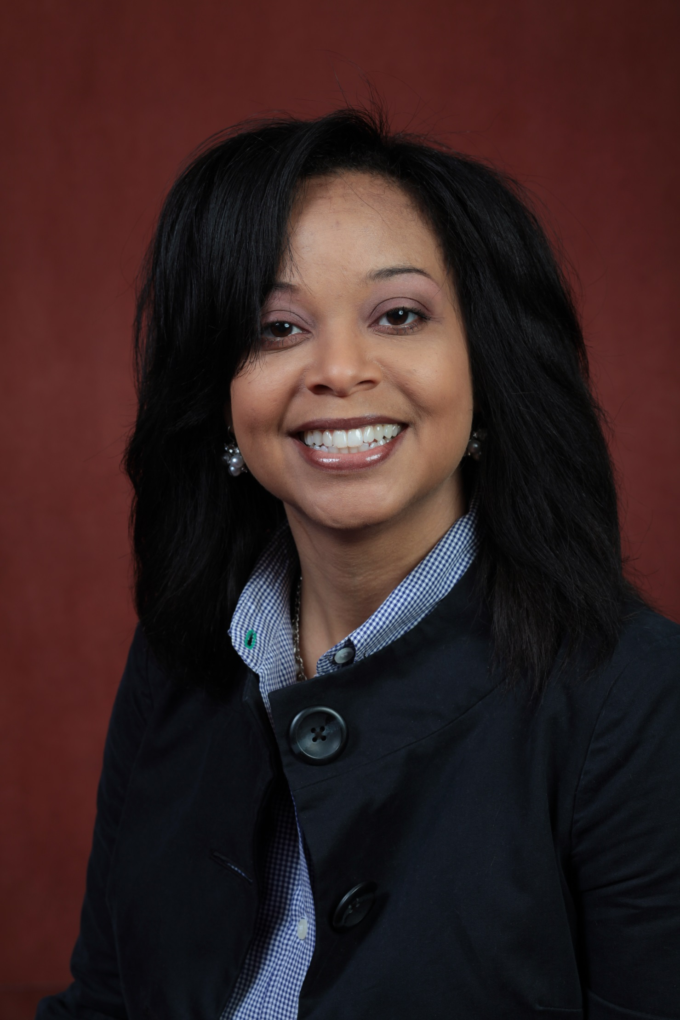
Joedrecka Brown Speights
Family Medicine
and Rural Health
joedrecka.brown@med.fsu.edu
Maternal and Child Health Equity Conference planning. R13 submitted. Partner sponsorship as well.
Adolescent Sexual Health Disparity elimination project. Departmental Funding.
Society of Teachers of Family Medicine (STFM) Quality Mentorship Project funded by STFM Foundation.
Maternal and Child Health Equity
As a Family Physician fellowship trained in Maternal and Child Health and collaboratively managing high risk conditions socioeconomically and medically, I bring a holistic life course perspective to the table. Additionally, working with women and underserved populations for years, I can collaborate on projects focused on health disparity elimination, promotion of health equity, community-engagement, and addressing social determinants of health and equity like racism.

