Slide 1
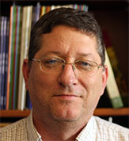
John Taylor
Sociology
jrtaylor@fsu.edu
My current research primarily focuses on racial/ethnic disparities in exposure to adversity as it relates to mental and physical health outcomes.
Conducting collaborative research in racial/ethnic disparities in health and successful aging.
I have experience in all aspects of quantitative research including study design, survey construction, and data collection and analysis. I currently have a letter of intent under review at the Robert Wood Johnson Foundation. I am proposing a study to investigate location in the built environment influences black/white contrasts in stress exposure, health behaviors, and health outcomes.

