Slide 1
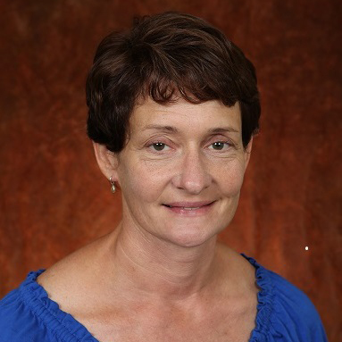
Judy Delp
Biomedical Sciences
judy.delp@md.fsu.edu
Protective vascular adaptations induced by regular muscular stretching. This work is funded by NIH.
Interactive effects of aging and exercise training on cardiovascular function
The role of cytokines in vascular health
Research opportunities that involve assessment of microvascular function
Collaborative opportunities in aging and exercise training
Extensive expertise in assessment of microvascular function and vascular remodeling
Track record of funding in cardiovascular adaptations to ageing and exercise training

