Slide 1
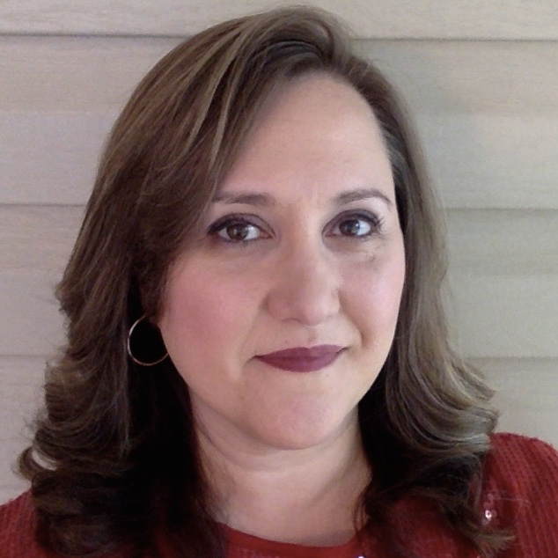
Juliann Cortese
School of Communication
jcortese@fsu.edu
Effects of online tailoring on influencing elaborative processing and behavioral intentions – CRC planning grant
Aging adults’ use of traffic signal educational material and how these messages may be enhanced by visual display and persuasive appeals – Florida Department of Transportation grant
Efficacy of online tailored videos on smoking cessation and STI awareness
Use of media for health promotion and education
I'm eager to work with others with interests in all health areas. My specific focus is eHealth, but my background is in mass media uses and effects. I have knowledge of Adobe software and teach a graduate level design course. My background is in experimental research, although I have experience with content analysis and other methods. I can bring to a team knowledge of statistical analysis, health and mass communication theory, and visual design skills.

