Slide 1
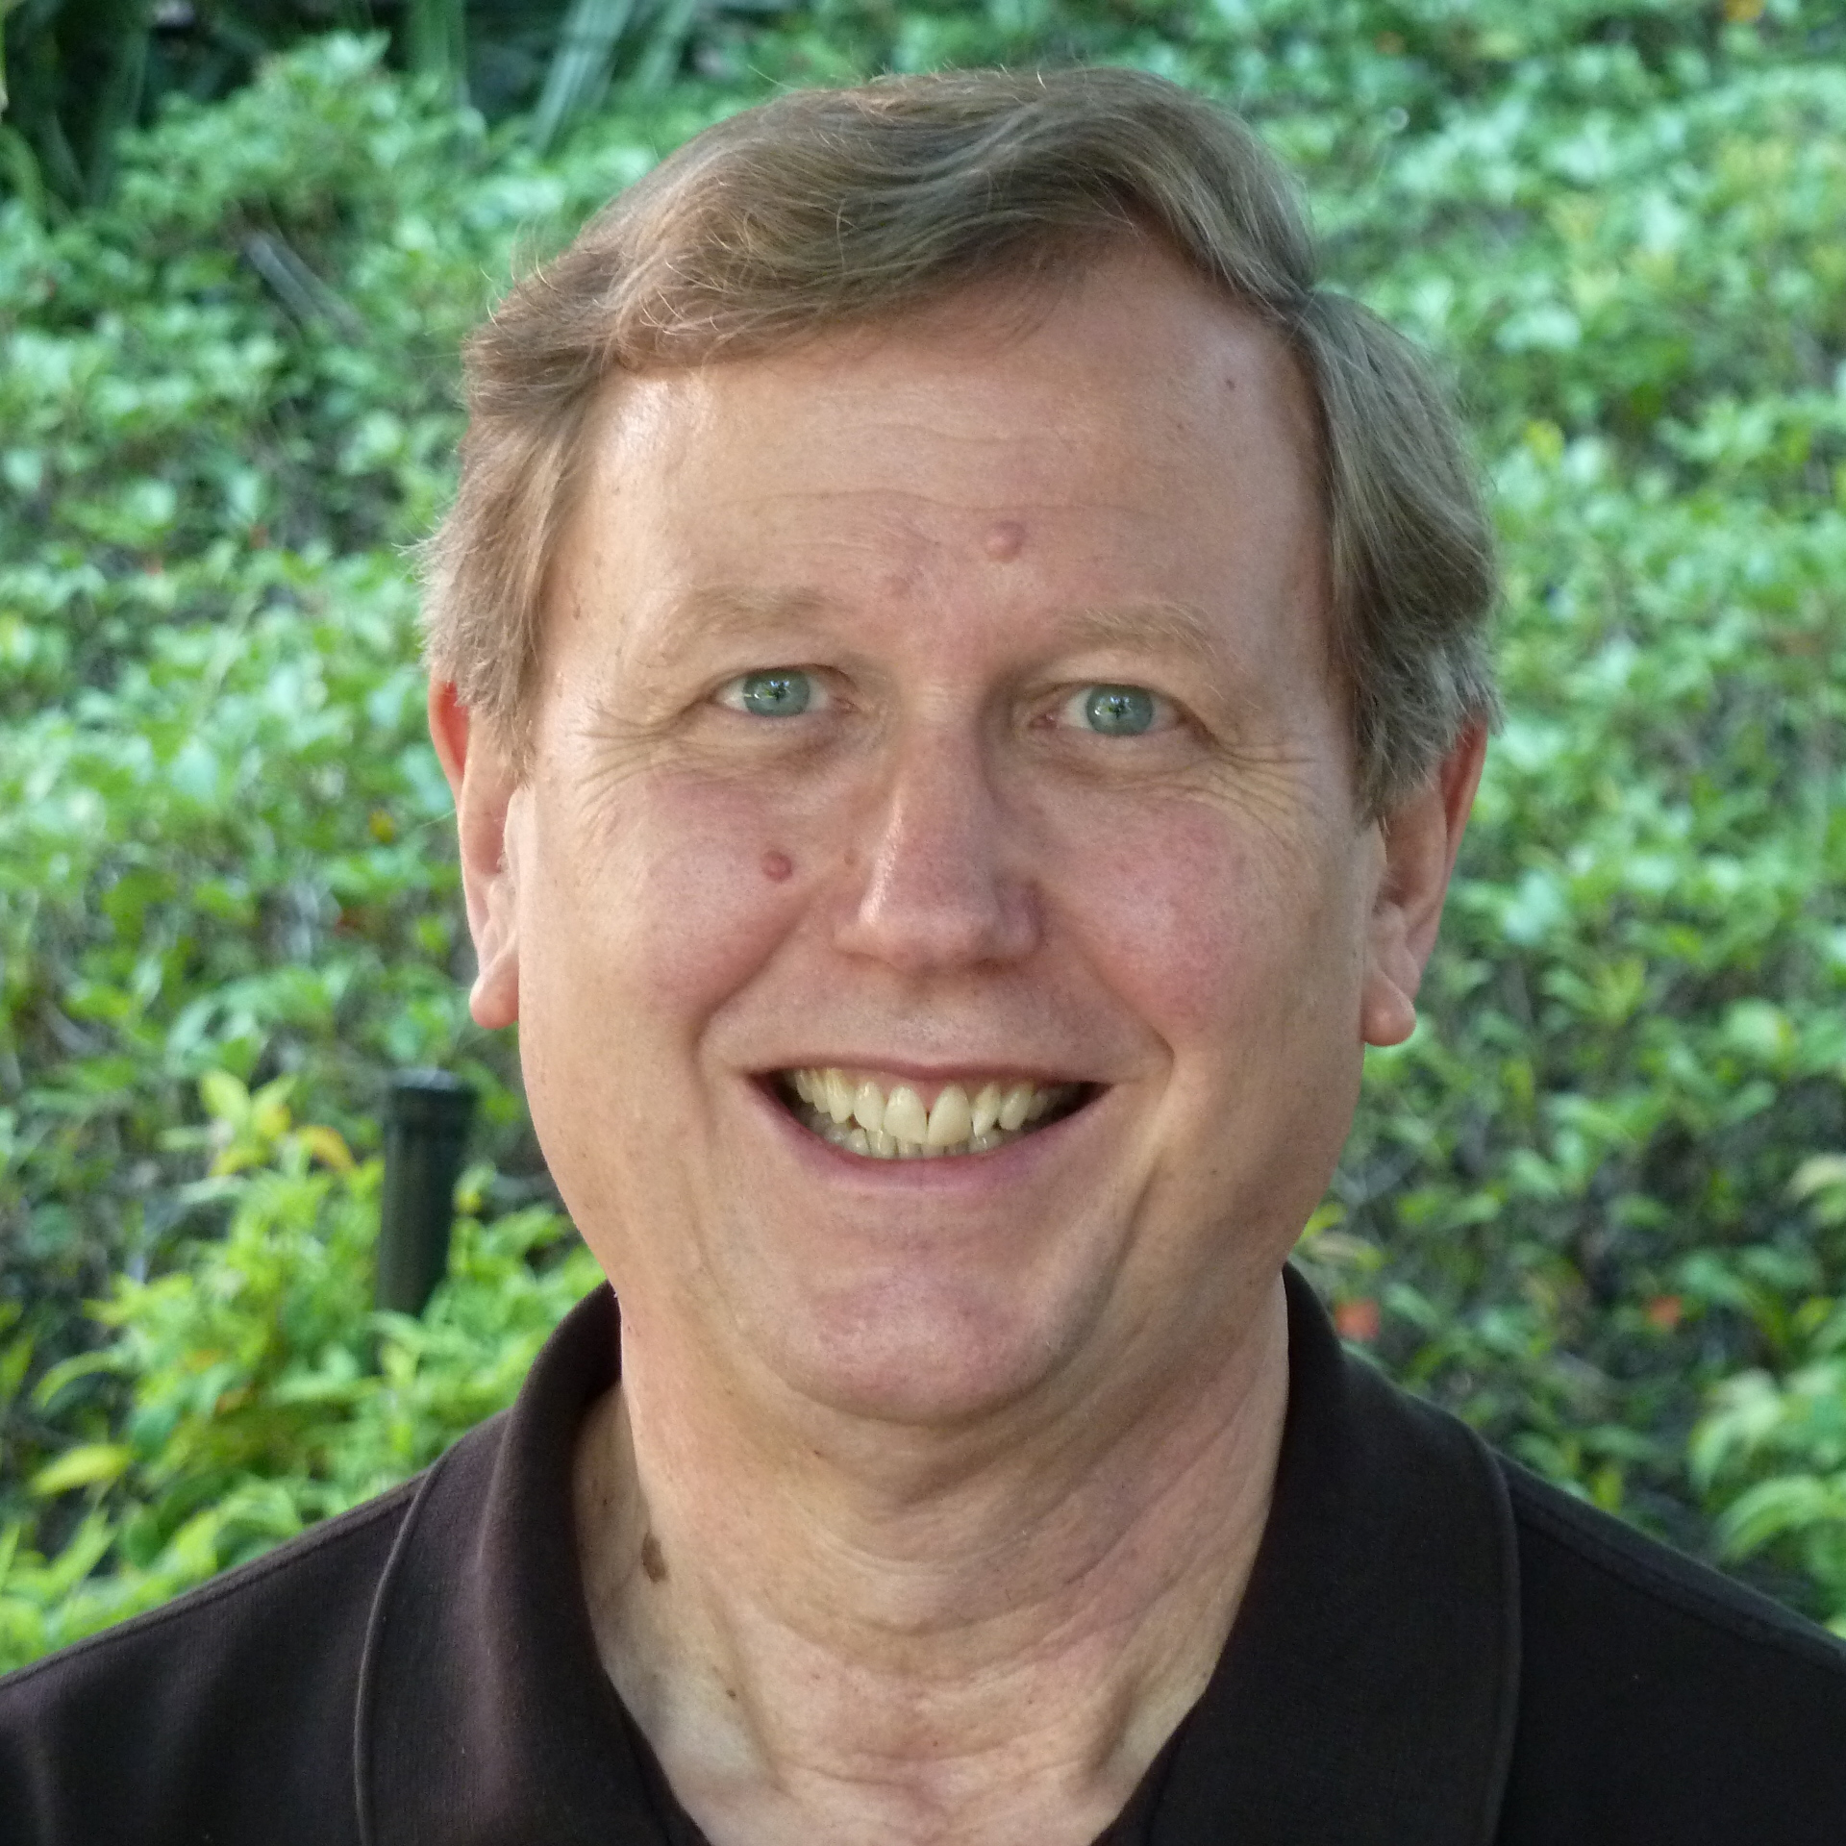
Kenneth Taylor
Institute of Molecular Biophysics
taylor@bio.fsu.edu
Near atomic resolution imaging of a striated muscle thick filament. The project was funded by NIH and was the basis of a grant proposal to the American Heart Association.
Structure of the Z-disk of striated muscle. Submitted ot the NIH
Methods for high throughput cryoEM with Prof. Scott Stagg. Submitted to the NIH
Our laboratory specializes in 3-D electron microscopy of proteins, macromolecular complexes and portions of cells. Mostly we work on muscle related projects, but have worked on viruses and various protein structures.
The structure determination of macromolecules and macromolecular assemblies is a very hot research area a the moment. We can in many cases obtain 3-D images at atomic resolution of these complexes and when imaging cells the imaging is generally lower but often is good enough to identify macromolecules within their native environment.

