Slide 1
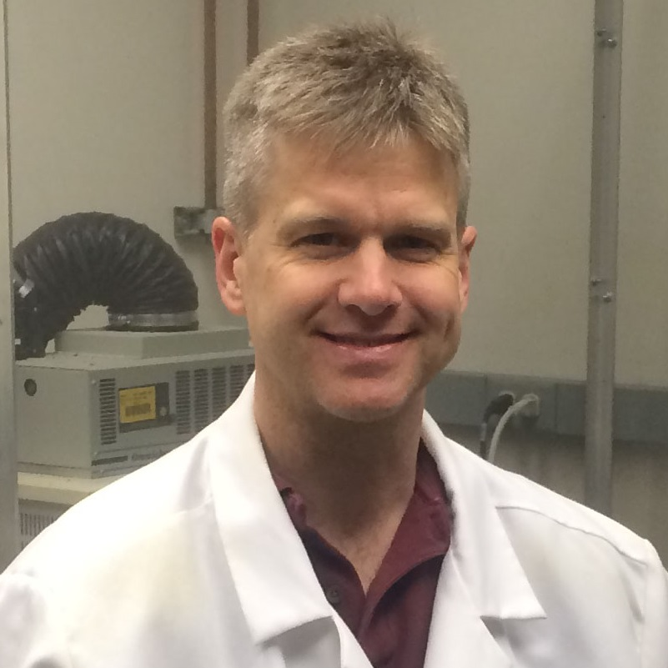
Kirk Evanson
Nutrition, Food
and Exercise Sciences
kevanson@fsu.edu
Effects of BK channel auxiliary subunits on BK channel function in arterial myocytes
Sex steroid regulation of ion channel function in arterial myocytes
Pathophysiological alterations in cerebral artery ion channel expression and function following traumatic brain injury
The effects of ion channel expression and function on arterial contractility, blood flow and pressure.
I have experience in the development, data collection, and writing of funded NIH grant proposals (R01, F32). I have a number of experimental methods such as PCR, Western blotting, RNA interference, recombinant expression systems, patch-clamp electrophysiology, calcium imaging, and myography. I believe that my collective experiences allow me to participate on several levels of grant proposal development. Ideal collaborations would be in the area of vascular physiology, however I would be happy to be involved in any project that I could assist with.

