Slide 1
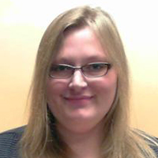
Lissa Anderson
National High Magnetic Field Laboratory- ICR Group
anderson@magnet.fsu.edu
Top-down proteomics method development at 21 Tesla
Analysis of human cancer cell lysate by qualitative top-down proteomics at 21 Tesla
Characterization of therapeutic monoclonal antibodies as well as antibodies derived from the serum of cancer patients at 21 Tesla.
Mapping contact surfaces of protein complexes by hydrogen-deuterium exchange.
Development and application of methods for the characterization of intact proteins.
I specialize in biological applications of mass spectrometry, specifically the analysis of intact proteins. The wealth of information that mass spectrometry is capable of generating, including amino acid sequence and post-translational modification identification, make it the method of choice for analysis of complex biological samples. The Maglab is home to several state-of-the-art mass spectrometers including the world-record 21T FT-ICR mass spectrometer. The facility provides sample analysis that requires the ultrahigh resolution and high mass accuracy of FT-ICR. Instruments are part of the NSF High-Field FT-ICR User Facility and are available free of charge to qualified users.

