Slide 1
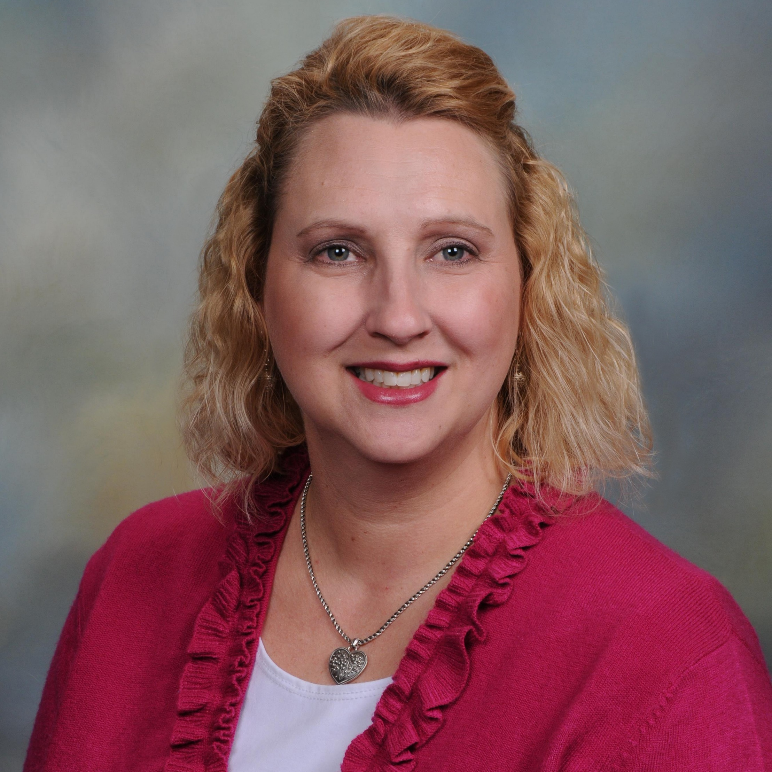
Lucinda J. Graven
College of Nursing
lgraven@fsu.edu
Effectiveness of a coping partnership intervention for patients with heart failure. Funded by the FSU First Year Assistant Professor (FYAP) grant and the American Nurse Practitioner Foundation (ANPF).
Psychosocial factors related to depression and self-care behaviors in caregivers of heart failure patients. Submitted for funding to the FSU College of Nursing Infrastructure Grant.
Adverse outcomes in patients with heart failure and their caregivers.
As a nurse researcher, with clinical and scholarly expertise in cardiovascular health, I can work on a variety of projects related to cardiovascular diseases. I also have expertise in social problem-solving and can collaborate on projects examining problem-solving in a variety of populations. I have experience in both quantitative and qualitative methodologies, as well as instrument development.

