Slide 1
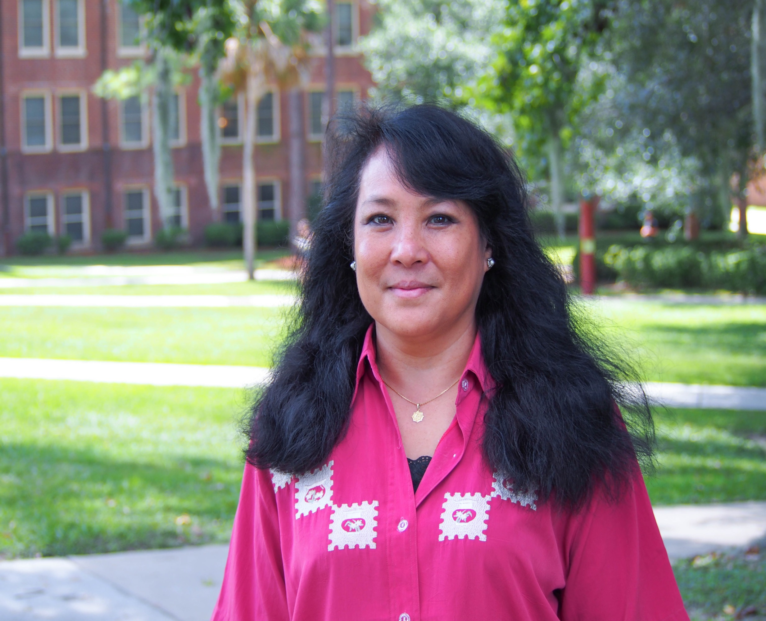
Maria Spicer
Nutrition, Food
and Exercise Sciences
mspicer@fsu.edu
Nutrition interventions to promote wound healing especially in people with diabetes mellitus
How improved nutrition affects inflammation and healing of diabetic foot ulcers
Insulin resistance, inflammatory response, clinical nutrition, chronic disease prevention, diabetes, health promotion and wellness in aging
Expertise in food and nutrition science, applied nutrition care, understanding of insulin resistance and inflammation.
I am a registered and licensed dietitian/nutritionist.

