Slide 1
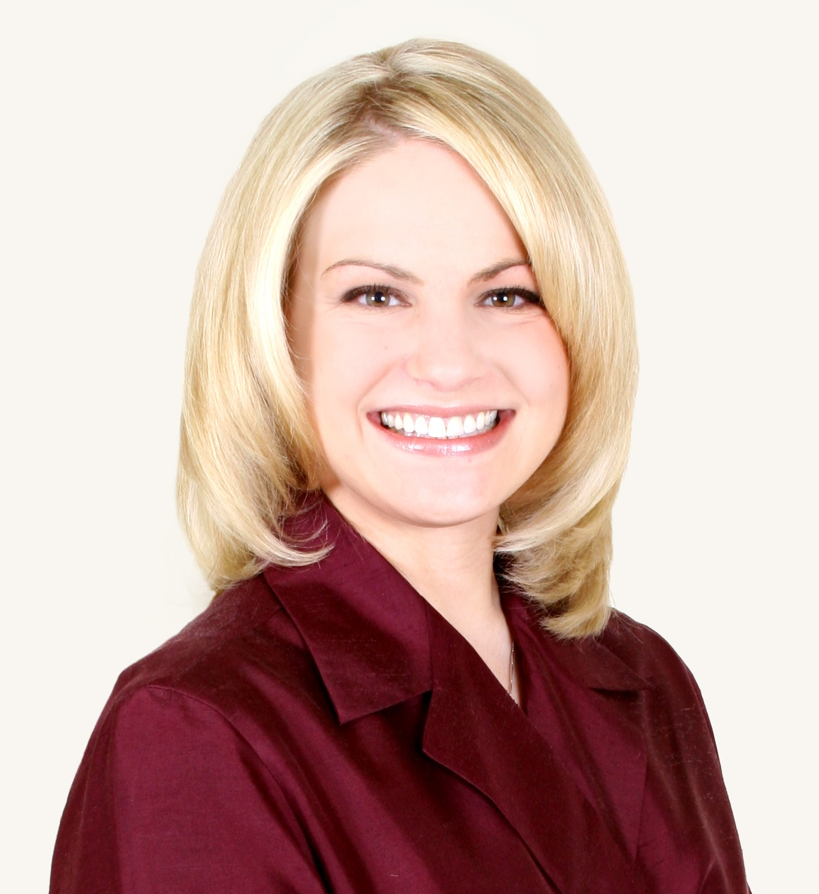
Megan MacPherson
School of Communication Science and Disorders
mmacpherson@fsu.edu
Healthy Aging and Speech Production: Interactions of Cognitive Demands, Autonomic Function, and Neuromotor Mechanisms
Parkinson’s Disease and Autonomic Nervous System Function for Speech and Language: Effects of Task Demands
Effects of Antidepressant Maintenance Medications on Speech-Related Autonomic Function in Asymptomatic Healthy Adults
Effects of healthy aging and Parkinson’s disease on interactions of speech motor, autonomic nervous system, emotional, and cognitive-linguistic functions.
As a speech physiologist and gerontologist, I use a variety of methods (e.g., electromyographic, articulatory kinematic, psychophysiologic), equipment (e.g., Biopac, Optotrak), and software (e.g., MATLAB) to quantify the effects of age and age-related disease. I can collaborate on projects and proposals that utilize similar methods and/or investigate the effects of healthy aging and neurological disease on a variety of functions (e.g., autonomic, motoric, cognitive, emotional).

