Slide 1
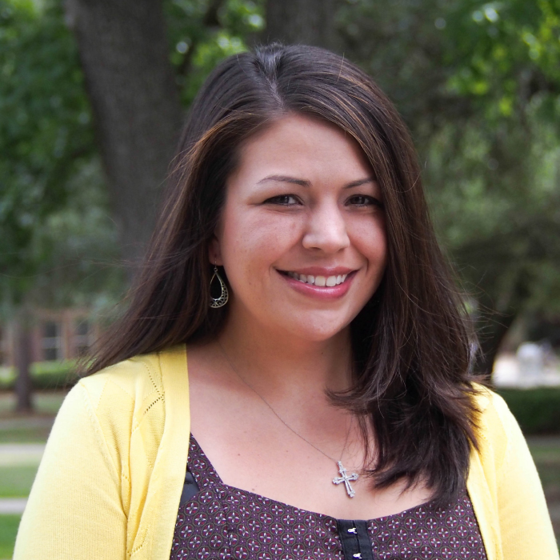
Melinda Gonzales-Backen
Family and Child Sciences
mgonzalesbacken@fsu.edu
Cultural influences on psychosocial and substance use among Latino adolescents.
Cultural processes and developmental trajectories among Mexican origin girls.
Longitudinal cultural and developmental influences on health among Latino immigrant families.
Identifying culturally and developmentally relevant avenues for promoting health and well-being among ethnic minority youth.
My focus on cultural and developmental processes allows me to contribute projects focused on ethnic-racial health disparities and youth adjustment. I have experience with survey methodology and recruiting hard to reach samples. I can also help with a variety of analytical methods including SEM, mixture modeling, longitudinal growth modeling, etc.

