Slide 1
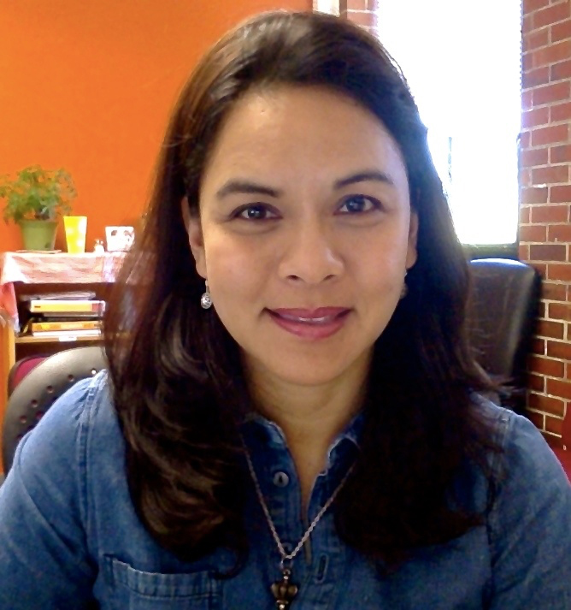
Mia Lustria
School of Information
mlustria@fsu.edu
ACTNow! (Advancing Care and Treatment to Enhance Outcomes for Women) – Mobile-Based Screening Intervention for Perinatal Depression. Funded by FSU College of Medicine.
RU@Risk: A Web-Based Tailored Intervention Promoting STD Screening Among At-Risk Young Adults. Funded by FSU-CRC, FSU School of Nursing and GenProbe Laboratories.
Health informatics, message tailoring, health literacy, and participatory design of eHealth approaches to support behavior-change and patient self-management primarily in the areas of adolescent and women’s health, cancer, diabetes, and STD prevention.
I explore different ways information and communication technologies can be designed and leveraged for persuasion and health promotion using multi-disciplinary, user-centered approaches. I have extensive experience conducting large-scale field and web-based experiments, surveys and focus group research. I am very open to collaborating on interdisciplinary projects aimed at improving access to healthcare and education among at-risk and medically underserved population groups.

