Slide 1
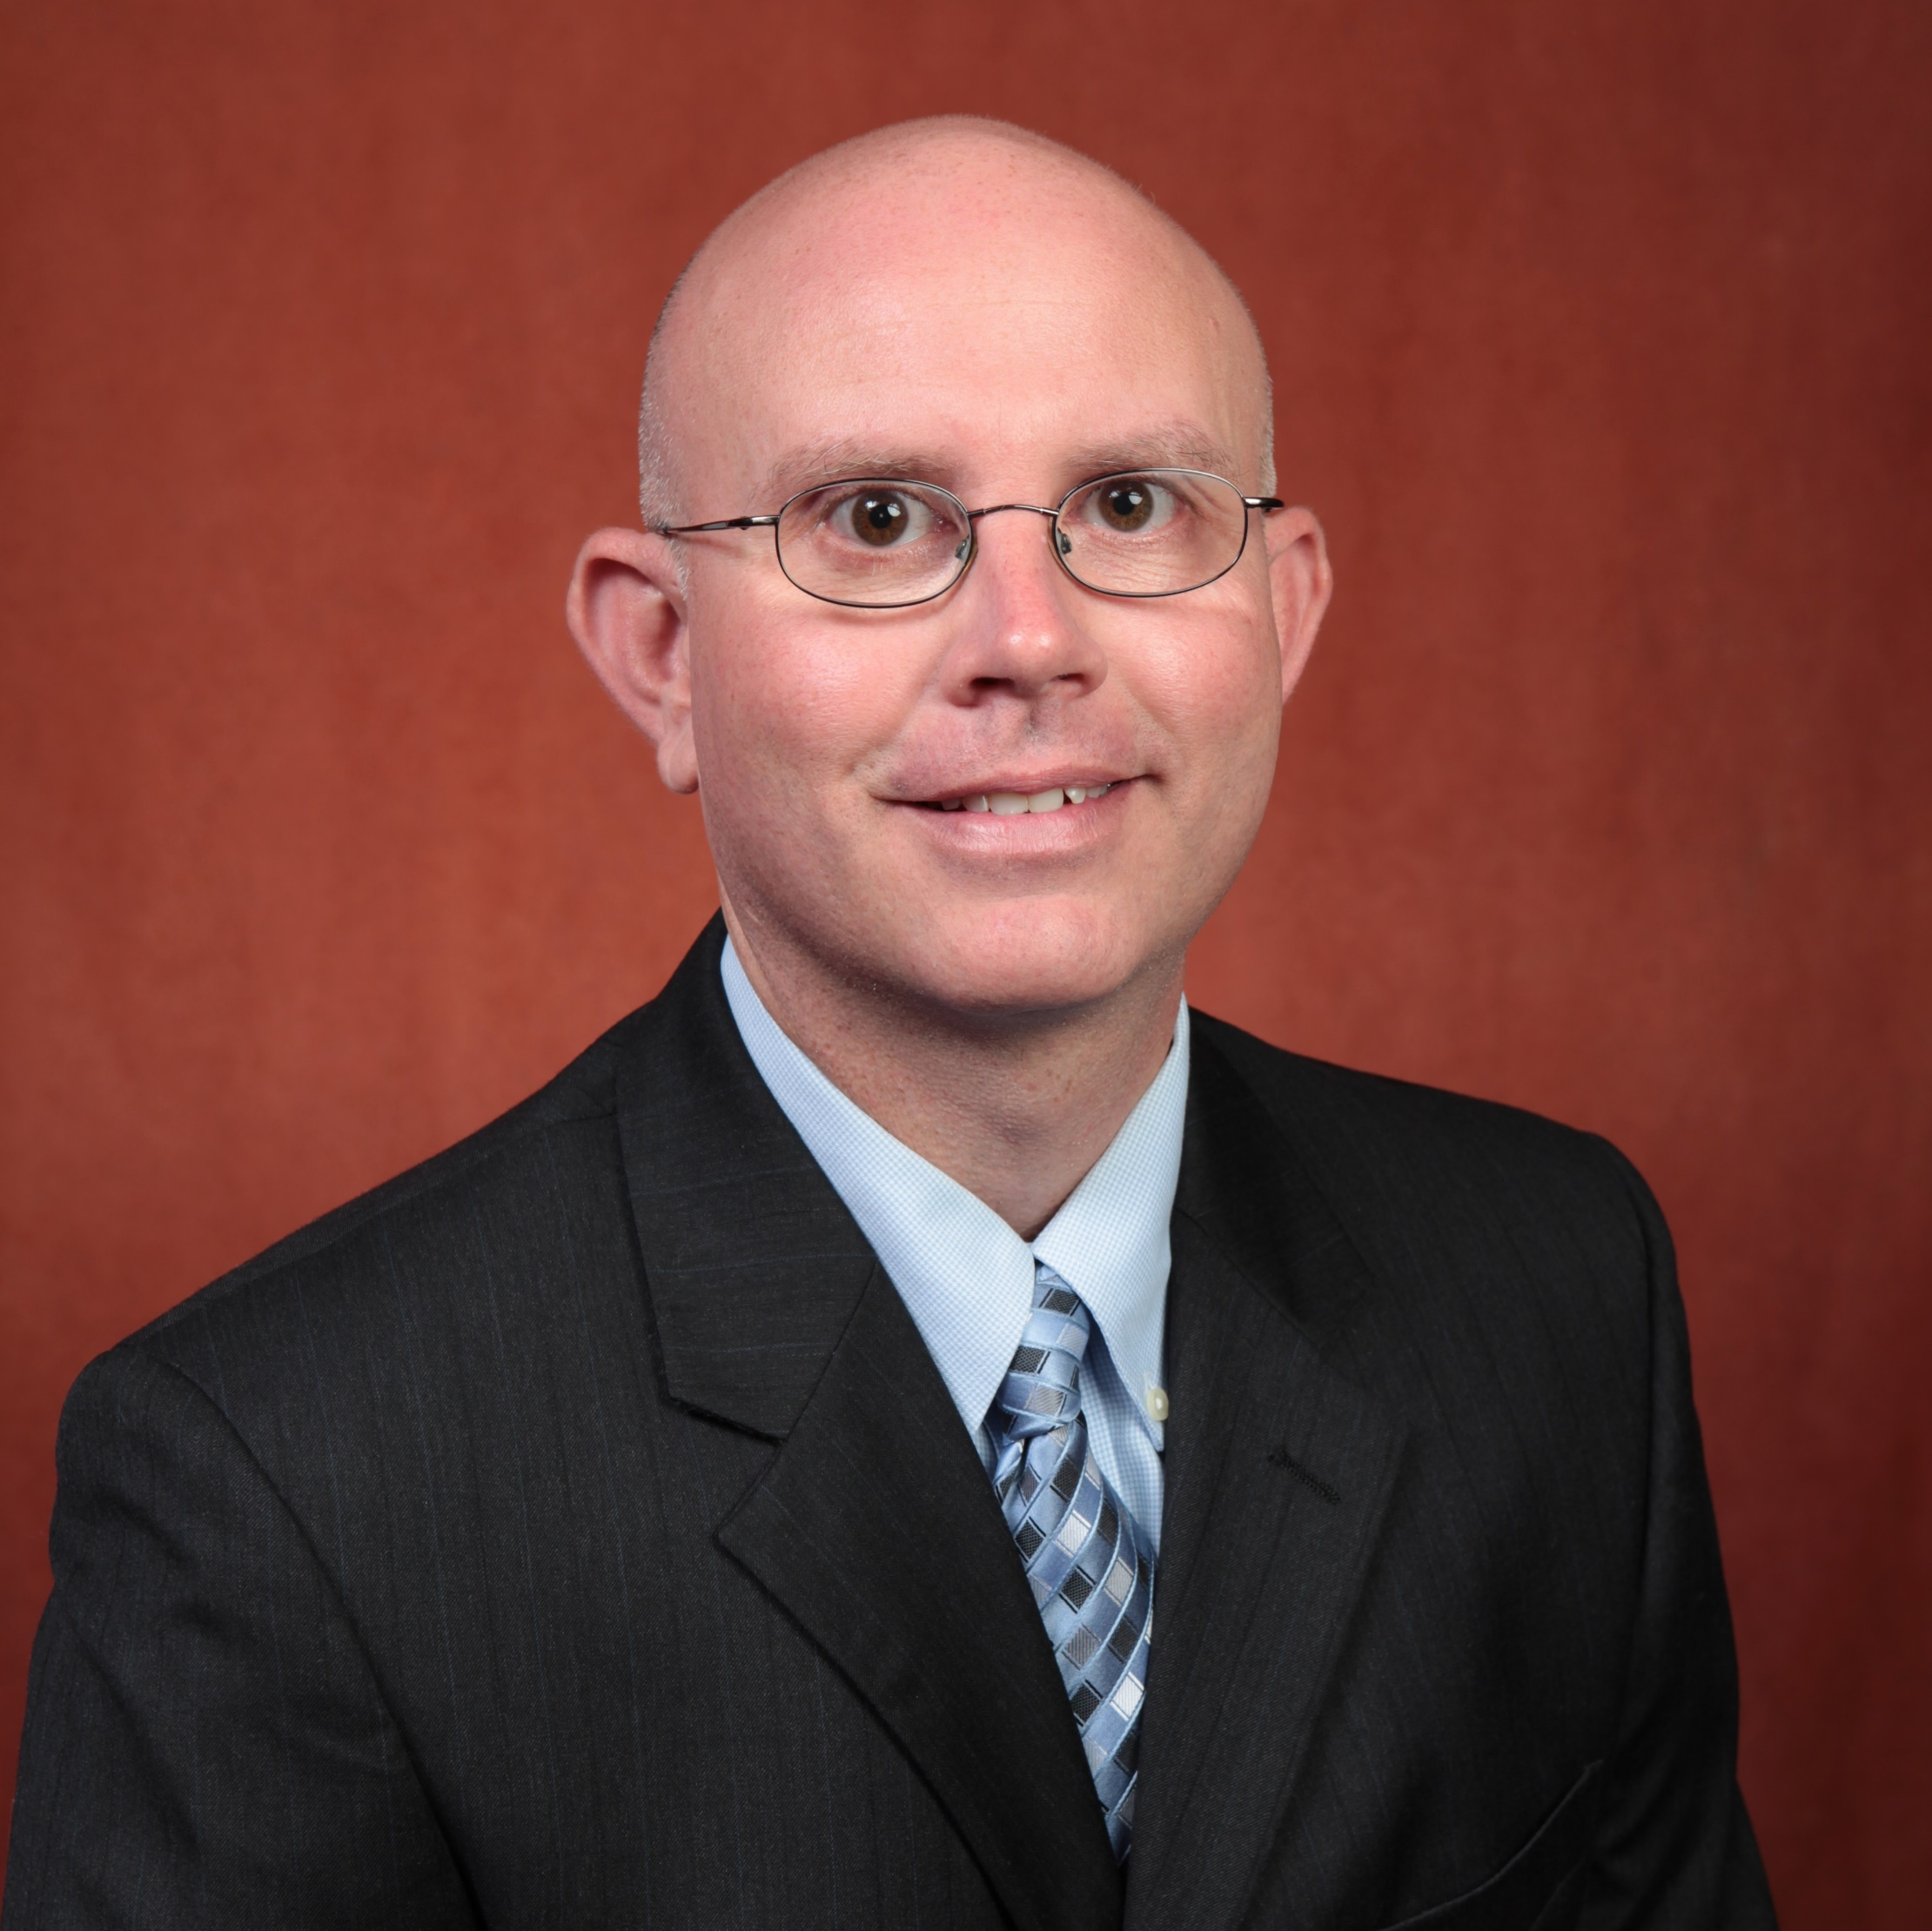
Michael Roper
Chemistry and Biochemistry
roper@chem.fsu.edu
Rapid measurement of cellular secretion (hormones) from living cells – NIH/NIDDK
Measurement of oscillatory dynamics in islet of Langerhans – NIH/NIDDK
Rapid measurement of small molecule (amino acids, GABA, dopamine, etc.) secretion – FSU
Automation of sample preparation using microfluidics - FSU
Biotechnology, sensors, separations applied to biological systems
As an analytical chemist, I can work on strategies to measure a number of biomolecules. We typically try to measure with high time resolution to monitor cellular dynamics. Can be applied to a number of biological systems (in vivo microdialysis, in vitro cell culture systems). Also have an interest in automating sample preparation strategies using microfluidics.

