Slide 1
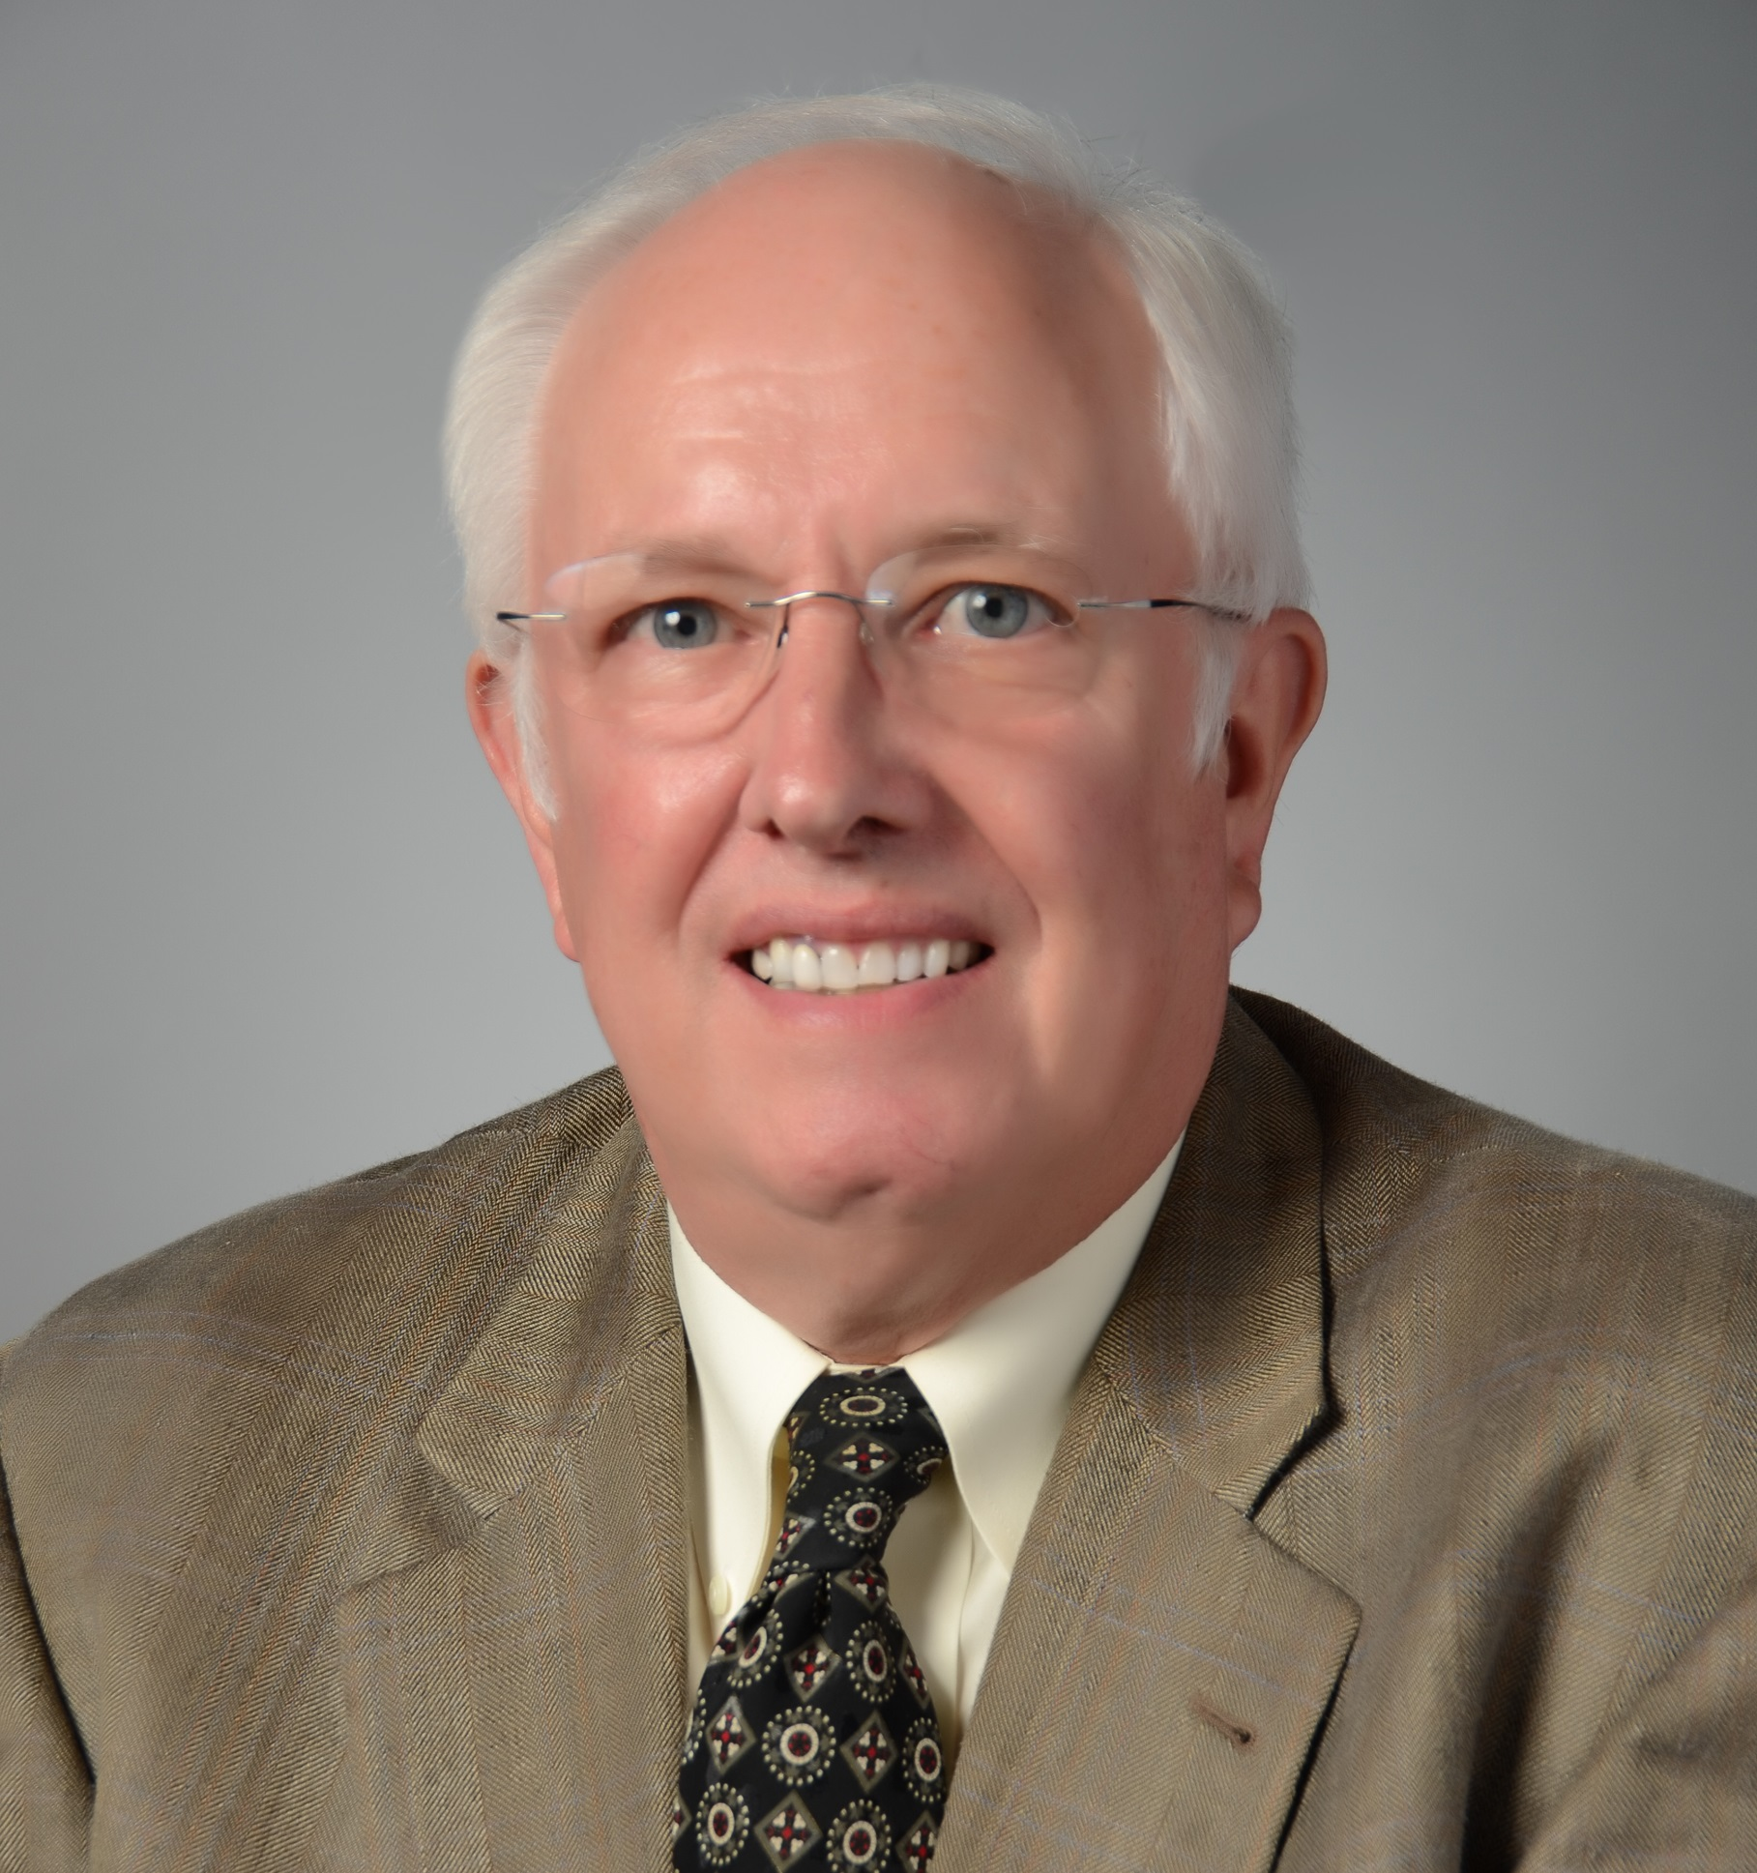
Michael Smith
Behavioral Sciences
and Social Medicine
mike.smith@med.fsu.edu
Program evaluation of Florida’s statewide Medicaid Managed Long-term Care Program
  Includes evaluation of access to care, quality of care, and cost-effectiveness of the program
Program evaluation of Florida’s Medication Therapy Management program for certain aged and disabled populations
Implementation of telemedicine and telehealth technologies to bring quality health care and services to rural and underserved communities.
Extensive background in state agency related programs and program evaluation. Previous experience as a U.S. Department of Defense program manager.

