Slide 1

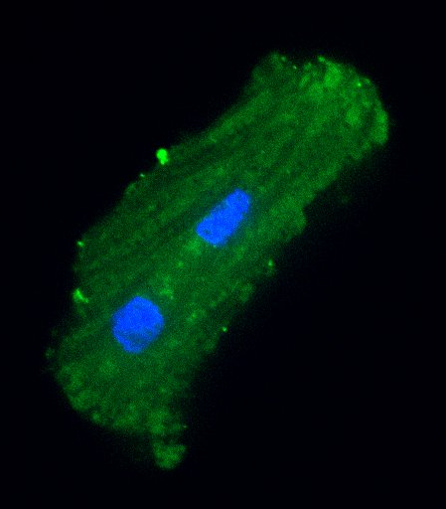
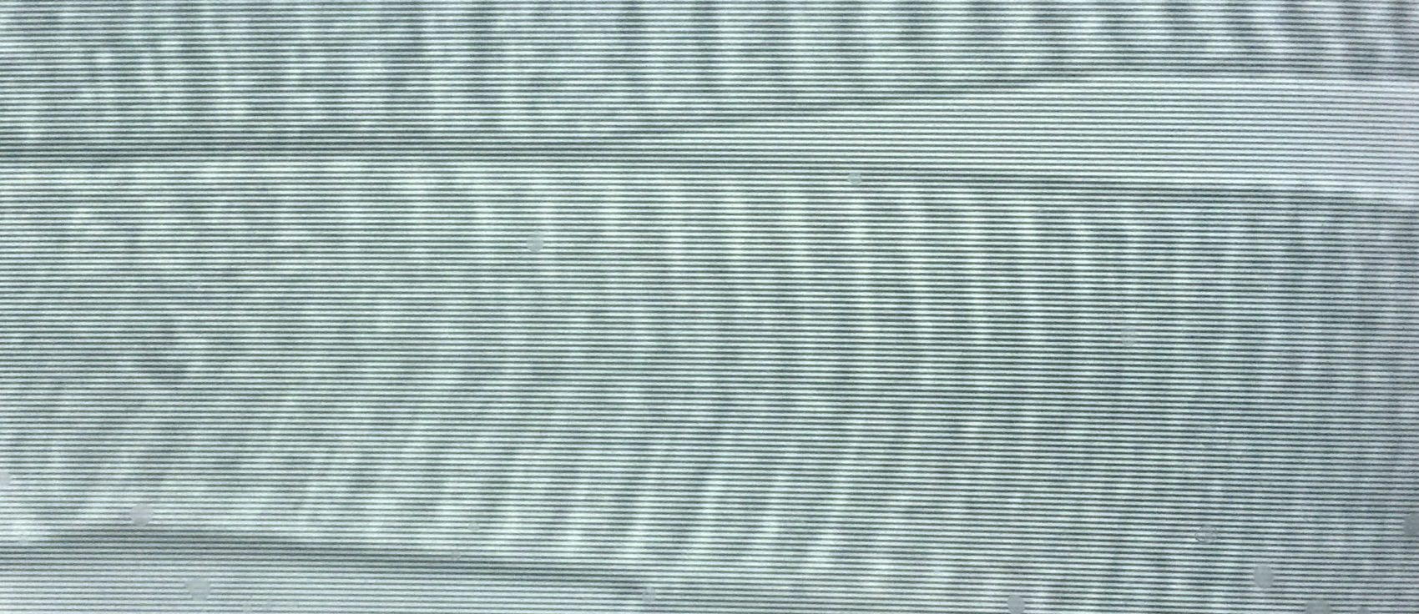
P. Bryant Chase
Biological Science
chase@bio.fsu.edu
How does troponin enable Ca²⁺ regulation of striated muscles of vertebrates—skeletal muscles and the heart—and how is troponin function affected by mutations associated with myopathies?
What other functions does troponin have in striated muscle myocytes—particularly in the nucleus—and how are those functions affected by myopathy-causing mutations?
How is muscle biomechanical function altered in some examples of extreme, evolutionary adaptations found in invertebrates at the protein level?
Physiology, biophysics and biomechanics of muscle at the cellular (myocyte) and molecular levels; Ca²⁺ regulation of striated muscle contraction; myopathies, with an emphasis on cardiomyopathies; bionanotechnology
Biophysical, quantitative approaches to physiological and pathological problems
Over 70 peer-reviewed publications in a wide range of journals
History of funding/peer-review with a variety of agencies: NIH, NSF, American Heart Assn, DARPA, NASA
40 μm

