Slide 1
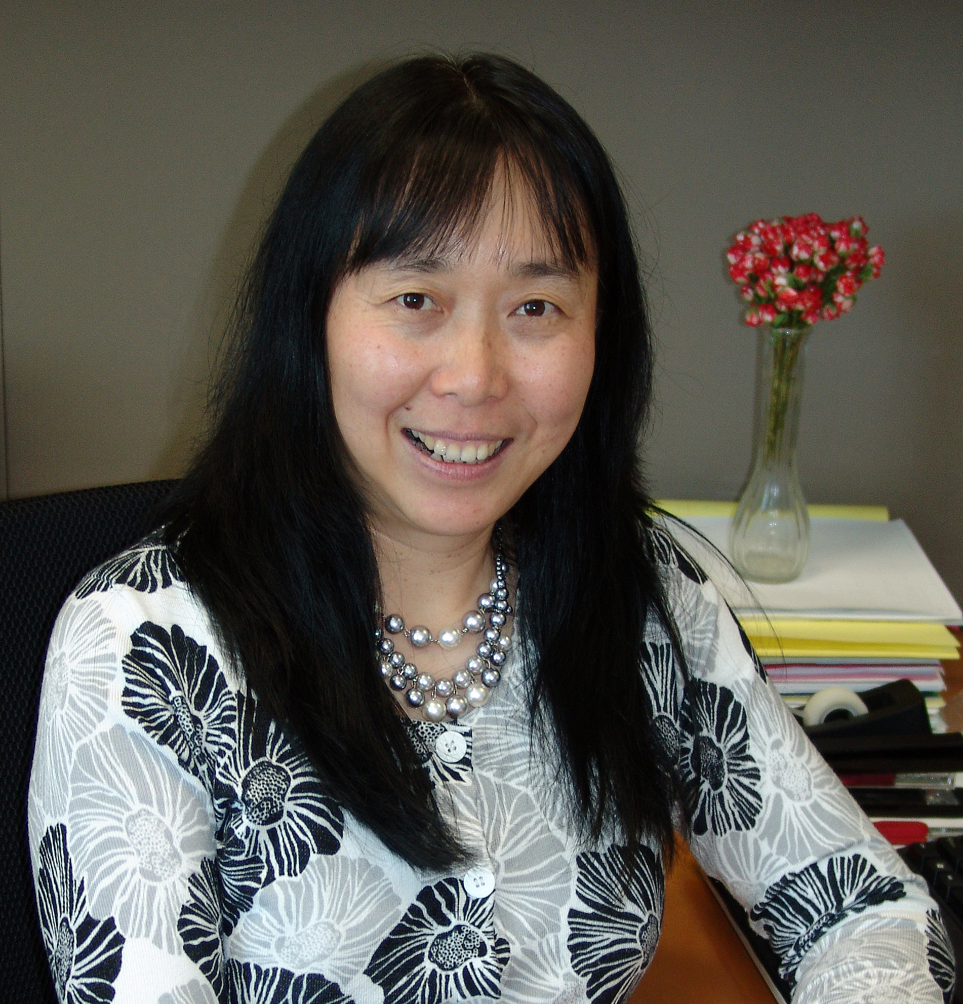
Qing-Xiang (Amy) Sang
Chemistry and Biochemistry
qxsang@chem.fsu.edu
Biochemical, Molecular, and Pathological Mechanisms of Cancer, Stroke, Obesity, and Stem Cell Differentiation, and Cancer Biomarker and Drug Discovery for Precision Medicine. Funded by NIH, DOD, Susan G. Komen Foundation, Florida DOH previously.
Research on human breast cancer, prostate cancer, skin cancer, cancer health disparity, novel strategies for cancer chemotherapy, targeted therapy, and immunotherapy for precision medicine.
We identify biomarkers for human cancer diagnosis, prognosis, treatment, and drug response for precision medicine, and biochemical mechanisms of inflammation, cancer, obesity, and stem cell formation.
Dr. Sang’s lab is identifying novel human cancer biomarkers and mutational signatures for early cancer detection, chemotherapy, targeted therapy, and immunotherapy stratification, drug response, and prognosis for precision medicine to help patients with cancer, obesity, stroke, and inflammatory and cardiovascular diseases. We can offer biochemistry, molecular cell biology, and bioinformatics expertise for collaborative work on cancer, regenerative medicine, and precision medicine for multiple human disease models.

