Slide 1
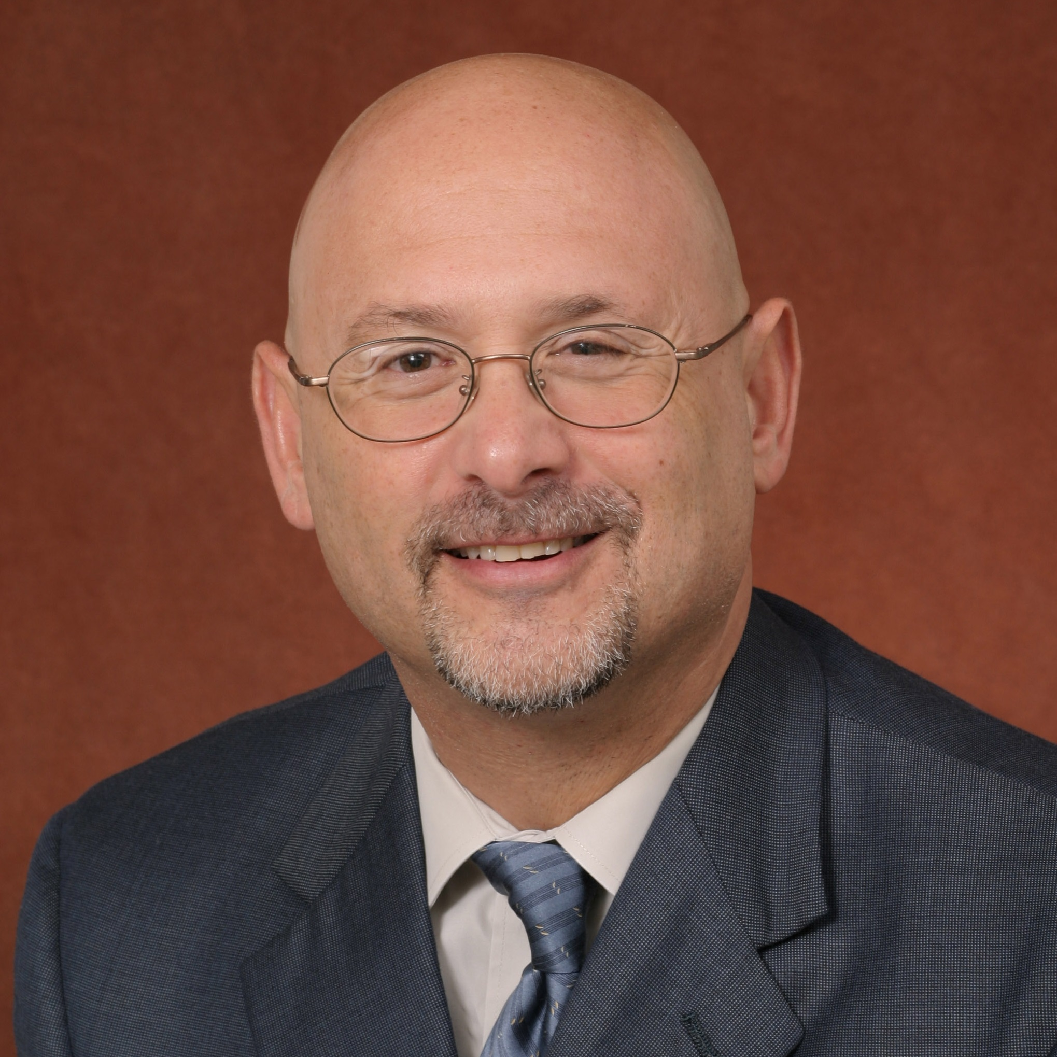
Robert Glueckauf
Behavioral Sciences and Social Medicine
robert.glueckauf@med.fsu.edu
African-American Alzheimer’s Caregiver Training and Support Project 2 (ACTS 2) funded by VALIC, Inc., Dave Groves, and the Sandy Halperin Alzheimer’s Research Fund
Optimization of Powerful Tool for Dementia Caregivers funded by the FL Dept. of Health
Project TECH: Technology Experiences and Care for HIV funded by NIMH
Development and evaluation of telehealth-based psychosocial interventions for persons with chronic health conditions and their family caregivers; spirituality and health.
Creative thinking about best methods for integrating telehealth modalities into the framework of interventions for persons with chronic health conditions and their family caregivers.
Developing strategies for developing and evaluating culturally-concordant interventions for persons with chronic illnesses and their family members.

