Slide 1
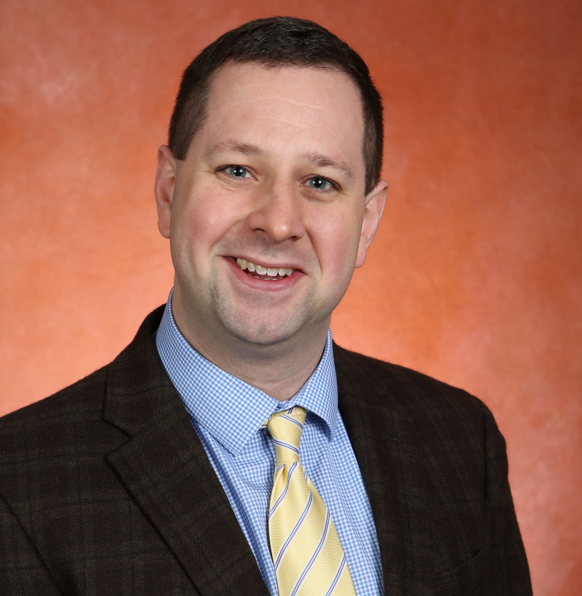
Robert J. Tomko Jr.
Biomedical Sciences
robert.tomko@med.fsu.edu
Proteasome assembly and catalysis, protein degradation
High-throughput screening for novel modulators of proteasome assembly or function
Quality control of multisubunit complexes in health and disease
Macromolecular complexes, protein quality control, structure-guided analyses, high-throughput drug screening, germline and disease-associated polymorphisms in the protein degradation machinery
We have expertise in cellular and molecular mechanisms of protein degradation, particularly the ubiquitin-proteasome system. We are skilled at reconstituting complex biological processes in vitro from purified components, as well as at structure-guided protein engineering for functional analyses of proteins or protein machines in vitro and in vivo.

