Slide 1
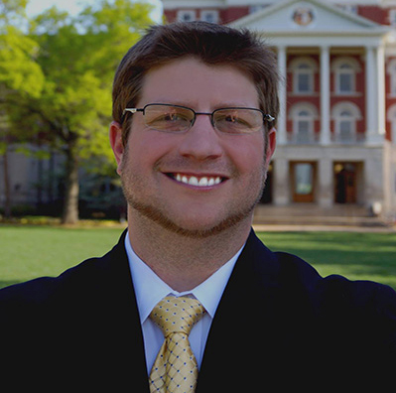
Russell Clayton
School of Communication
rclayton@fsu.edu
Cognitive and emotional processing of anti-tobacco advertisements. Funded by American Academy of Advertising (AAA).
Development of educational tip cards for aging road users. Funded by Florida Department of Transportation (FDOT).
Role of addiction in processing drug-related cues in health promotional messages.
Reactance theory and motivated message processing.
Cognitive and emotional processing of health messages.
Psychological, social, and health implications of media use.
I can collaborate on projects geared toward examining how people cognitively and emotionally process media messages. Specifically, collection, interpretation, and analysis of psychophysiological responses including heart rate, skin conductance, and facial electromyography. I can also aid with experimental design and appropriate methodology.

